Slide 1
More Than a Smile: Dental Affordability Problems and Potential Solutions
Alexandra Allen, Health Policy Analyst
Altarum Healthcare Value Hub October, 2023
@HealthValueHub
www.HealthcareValueHub.org

Slide 2
Housekeeping
Thank you for joining us today!
Please submit your questions in the Q&A chat
Webinar is being recorded and will be shared afterwards
Technical problems?
Contact Britt Sanderson at Britt.Sanderson@Altarum.org
@HealthValueHub www.HealthcareValueHub.org

Slide 3
Agenda
Welcome & Introduction
Overview of Dental Coverage Gaps and Solutions - Kasey Wilson, Community Catalyst
Engaging Policymakers - Emily Brice, Northwest Health Law Advocates
Impact on Affected Communities – Marcy Bowers, Statewide Poverty Action Network
Q&A
@HealthValueHub www.HealthcareValueHub.org

Slide 4
Respondents Forego Care Due to Cost Across Insurance Types
*Note: In Washington State, employer-sponsored insurance and individually-purchased insurance were grouped together due to sample size.

Slide 5
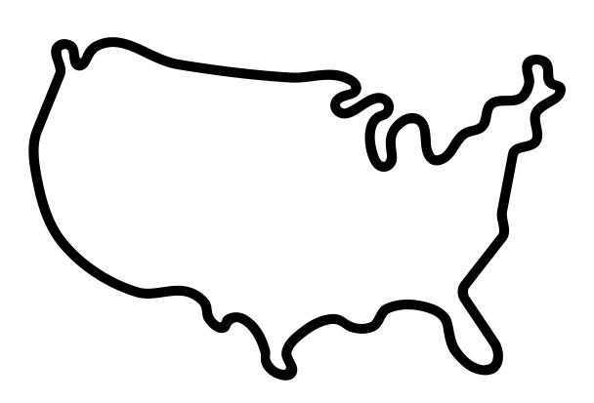
“I am battling a[n] addiction to opiates. I really wanted to get the Vivitrol shot. However, the price tag on the shot alone is really expensive. That isn’t even including continuing care, visits, etc. so I just…continued to use.”
Washington State Respondent
“I have needed a new walker fir a few months, and a motorized scooter and wheelchair. Medicaid doesnt pay for any of it unless your bedridden.”
Indiana Respondent
“I need teeth implants so I can eat. Dentures don't fit right so I can chew…I can't open my mouth wide enough with dentures to put food in my mouth. But I can't afford the ridiculously high cost of implants and dental insurance doesn't cover implants.”
Utah Respondent
“I had gallbladder issues with stones that wouldn’t pass and stomach ulcers but could not afford an ultrasound.”
Louisiana Respondent

Slide 6
Respondents Most Frequently Went Without Dental Care Due to Cost Across States

Slide 7
Foregoing Dental Care Due to Cost Affects People with Medicaid and Private Insurance
Medicaid | Private Employer-Sponsored or Individually Purchased Insurance
“Currently I have a very bad dental issue which requires a dentist to accept my insurance coverage which is slim, also an appointment would be around 3 months from now. I'm hoping the bad tooth just falls out.” (WA) “Dental is not covered by my insurance. Living with pain because of lack of coverage. And had tooth pulled instead of a cavity filled because of the expense.” (UT) “I am in need of having several teeth pulled in order to get dentures, but my Medicaid dental coverage only covers $200/yr for extractions. I can't afford the costs above that, so I just walk around with rotting teeth...” (LA) “Unable to get the dental impression for dentures but was approved for all the teeth to be pulled by insurance so couldn't afford impression, couldn’t [continue] with procedure.” (IN) | “I have teeth literally breaking and needing pulled and they even get infected because I cannot afford to go to the dentist.” (WA) ”Both my husband and me have holes in our teeth- can't afford root canals.” (UT) “I need a lot of dental work but did not receive any of it because I couldn’t afford it even with insurance.” (LA) “I'm still pushing back a root canal and 3 fillings due to not being able to afford the copay.” (IN)

Slide 8
Medicaid Coverage Gaps & Affordability of Dental Care
Kasey Wilson
Community Catalyst
OCTOBER 2023 | PRESENTED BY KASEY WILSON

Slide 9
For more than two decades, Community Catalyst has been a leading nonprofit national health advocacy organization dedicated to advancing a movement for health equity and justice. We partner with local, state, tribal, and national advocates to leverage and build power so all people can influence decisions that affect their health. Our work spans a range of health access issues. Among other areas of work, we focus on ensuring everyone can get the dental care they need.
300+
45+
9
Partner organizations at the local and state level
states where we do
our work
where we’ve incubated
health advocacy organizations

Slide 10
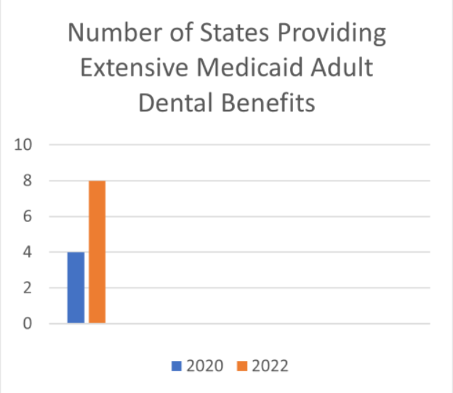
MORE THAN A SMILE
Medicaid Dental Coverage
About 2/3 of adults have dental insurance
7.4% of adults* have Medicaid with dental coverage
Adult dental benefits are optional in Medicaid
Wide geographic variability in coverage
No standard definition of “comprehensive” benefits
Dental coverage ≠ access
Source: CareQuest Institute. (2023). https://www.carequest.org/about/blog-post/five-key-takeaways-about-medicaid-adult-dental-benefits-2023
*2015 data

Slide 11
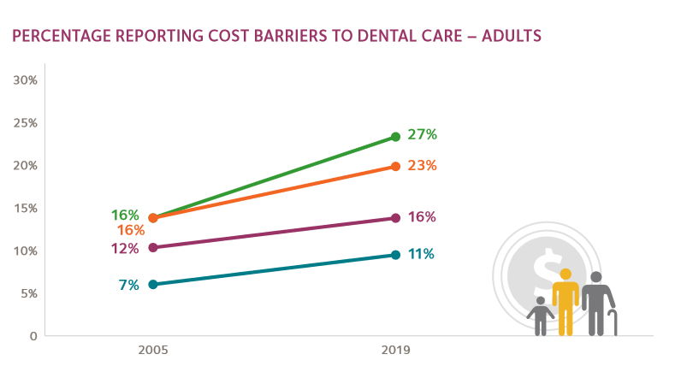
MORE THAN A SMILE
Dental Coverage ≠ Access
Workforce and geographic barriers
~72 million people live in dental provider shortage areas
67% of dentists see zero patients with Medicaid
Economic barriers
Dental care presents the highest financial barriers of any health care service
Lack of integration of oral health with the broader health care system
End of Medicaid “continuous coverage”
~14 million people could lose dental coverage
Source: ADA Health Policy Institute. https://www.ada.org/-/media/project/ada-organization/ada/ada-org/files/resources/research/hpi/hpigraphic_0421_3.pdf?rev=413e25b4271940139d303e02b6bdbf78&hash=A314EDFAD1AD7B409D471C6C5E33BC5E
©COMMUNITY CATALYST

Slide 12
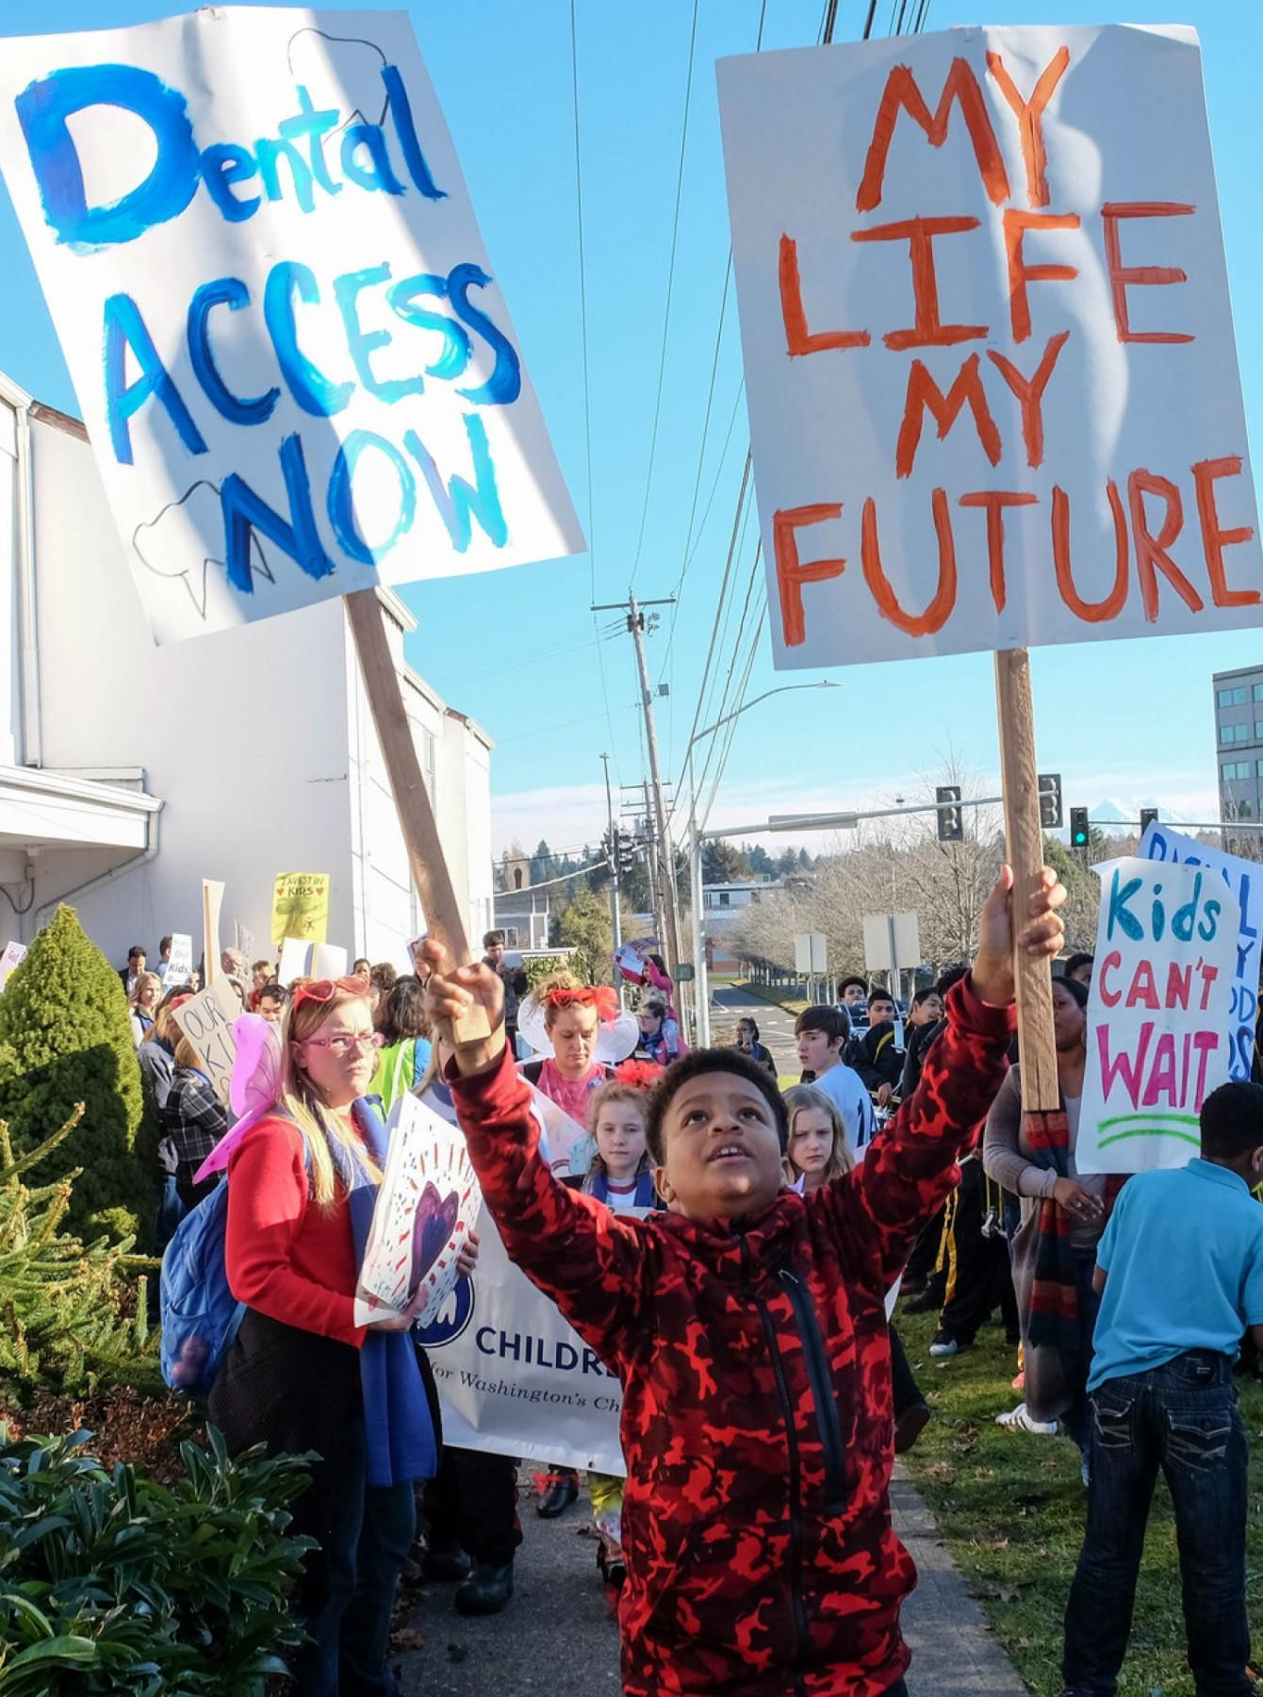
MORE THAN A SMILE
Impact of Lack of Access to Dental Care
Poorer oral health outcomes
Impact on overall health
Costlier care (to patient and system)
Dental-related ER use costs ~$1.6 billion/year
1/3 of these costs are paid by Medicaid
©COMMUNITY CATALYST

Slide 13
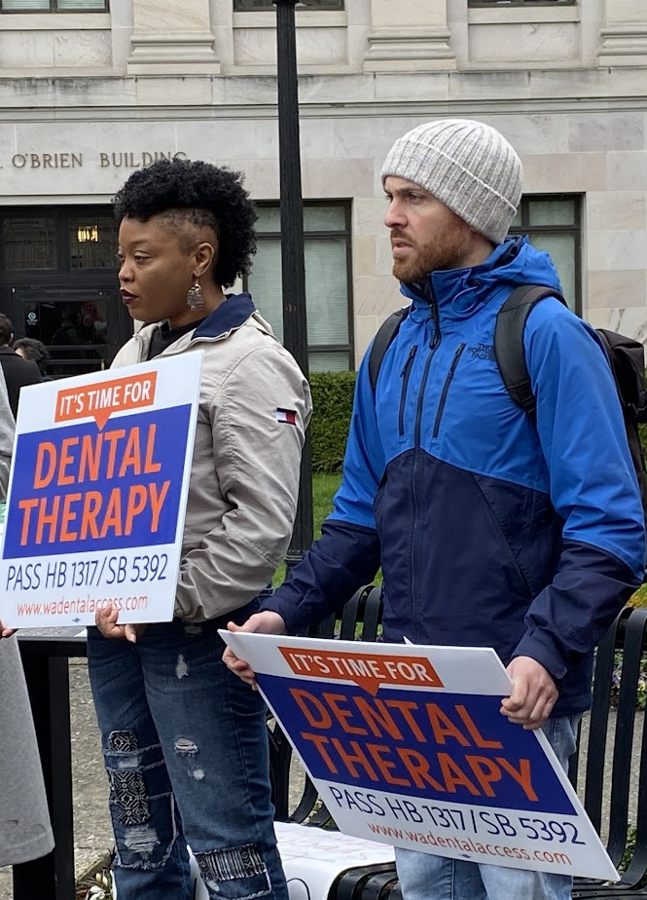
MORE THAN A SMILE
Policy Solutions
Mandatory Medicaid adult dental benefits
Inclusion of adult dental care in Essential Health Benefits (EHBs)
Expanding the oral health workforce
Expanding the scope of dental hygienists
Training and reimbursement for Community Health Workers (CHWs)
Authorizing dental therapists
Solutions should be grounded in community perspectives
©COMMUNITY CATALYST

Slide 14
Thank you!
Kasey Wilson, Senior Policy Analyst
kwilson@communitycatalyst.org

Slide 15
Emily Brice
Northwest Health Law Advocates

Slide 16
Oral health is part of our two-decades fight for health justice:
Advanced Cover All Kids & Medicaid expansions that included dental care
Fought cuts to adult dental Medicaid during the Great Recession & after
Advocacy when Medicaid restricts scope of dental care
Discussions about different delivery systems for Medicaid dental care

Slide 17
Identifying the Crisis: WA Consumer Healthcare Experience State Survey (CHESS)
Went without care due to cost | Did not fill a prescription, cut pills in half, or skipped a dose due cost
.
Altarum Healthcare Value Hub, Consumer Healthcare Experience State Survey, 2022.

Slide 18
Apple Health Enrollees’ Responses to CHESS
I haven’t gotten any dental work done in over a decade because the cost is too high.
I’ve severely neglected my dental health because there isn’t a dentist locally who will accept my state insurance.
I would like a crown, but insurance only covers extraction.
Currently I have a very bad dental issue which requires a dentist to accept my insurance coverage which is slim, also an appointment would be around 3 months from now. I'm hoping the bad tooth just falls out.
My insurance only covers 1 dental x-ray a year, and for the procedure I need, I need 4 x-rays.
I have very bad teeth that are affecting my health severely. Apple Health covers very little dental and only a couple dentists accept it. The one I went to was very disrespectful. I was judged based on a past struggle with addiction, even though it wasn’t the cause of my dental issues and I am now clean and sober.
I know I need extensive dental work, some of which is not included in the insurance I get through Medicaid.

Slide 19
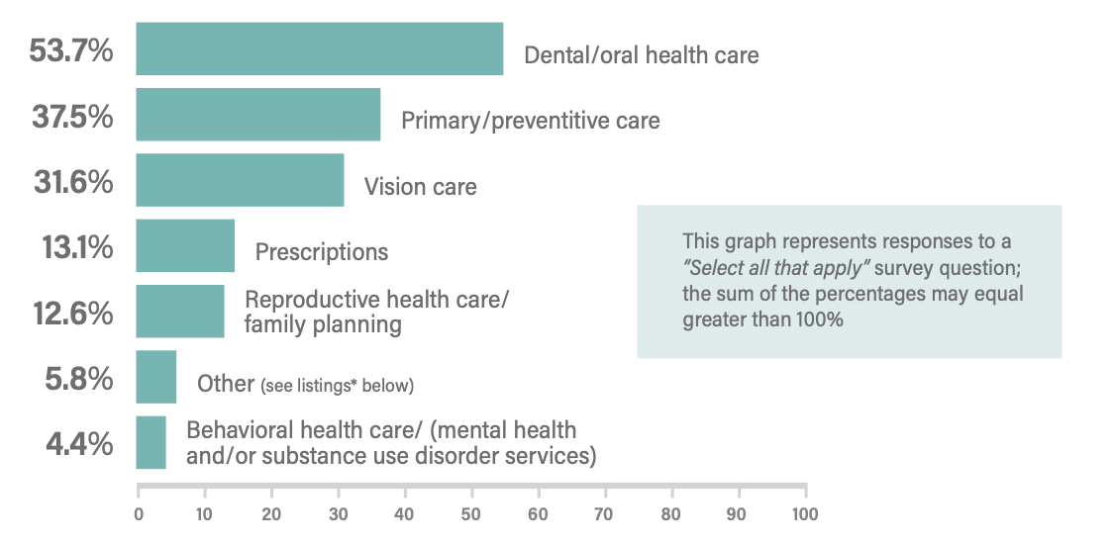
Identifying the Crisis: Immigrant Health Survey
Health services respondents wanted or needed to use,
but were unable to access in the past 2 years
.
WA State Health Equity for Immigrants Report, 2020, n = 4,702

Slide 20
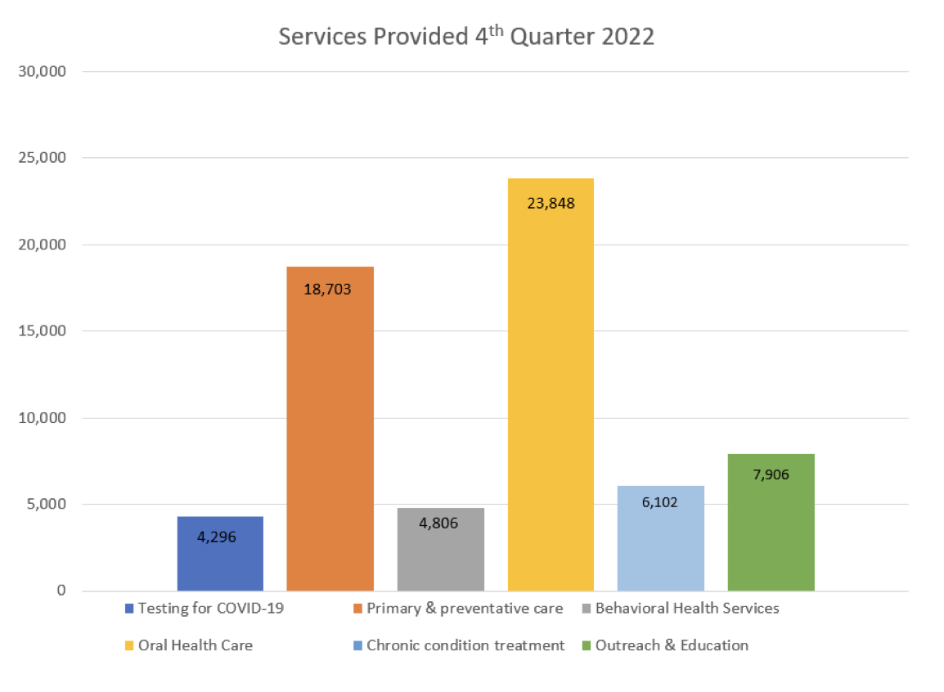
Identifying the Crisis: Immigrant COVID Relief Care
Services provided, 4th Quarter 2022
.
Uninsured Care Expansion Grant Report, WA Health Care Authority, 2023.

Slide 21
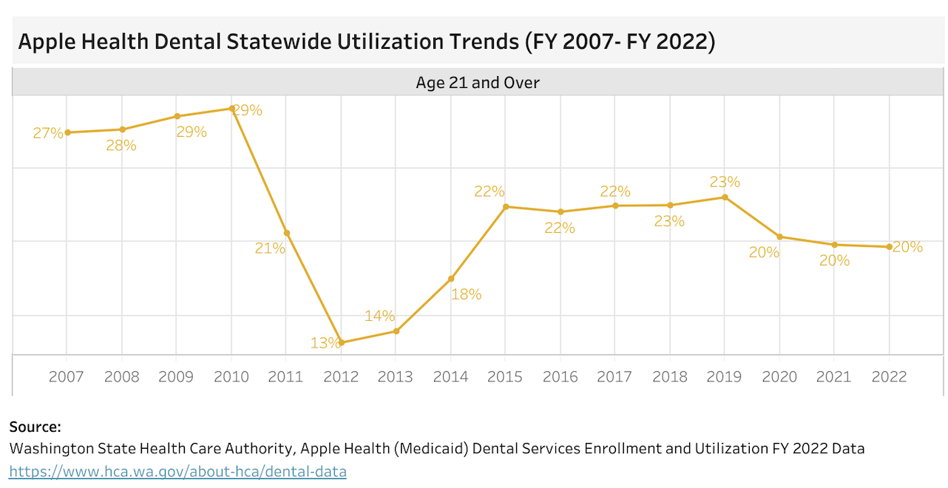
Digging Deeper: Data Shows Limited Access
.
Access to Dental Care Dashboard, Arcora Foundation, 2023.

Slide 22
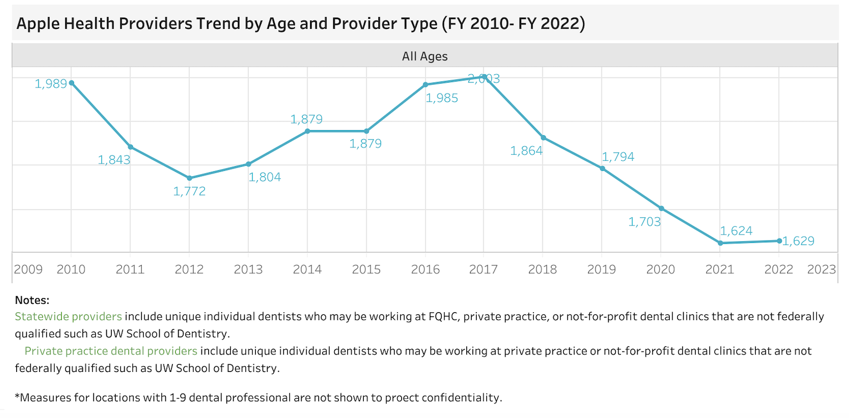
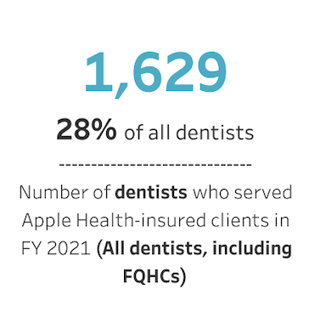
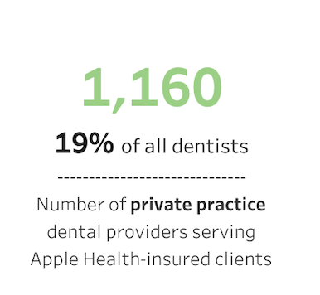
Digging Deeper: Data Shows Limited Provider Network
.
Access to Dental Care Dashboard, Arcora Foundation, 2023.

Slide 23
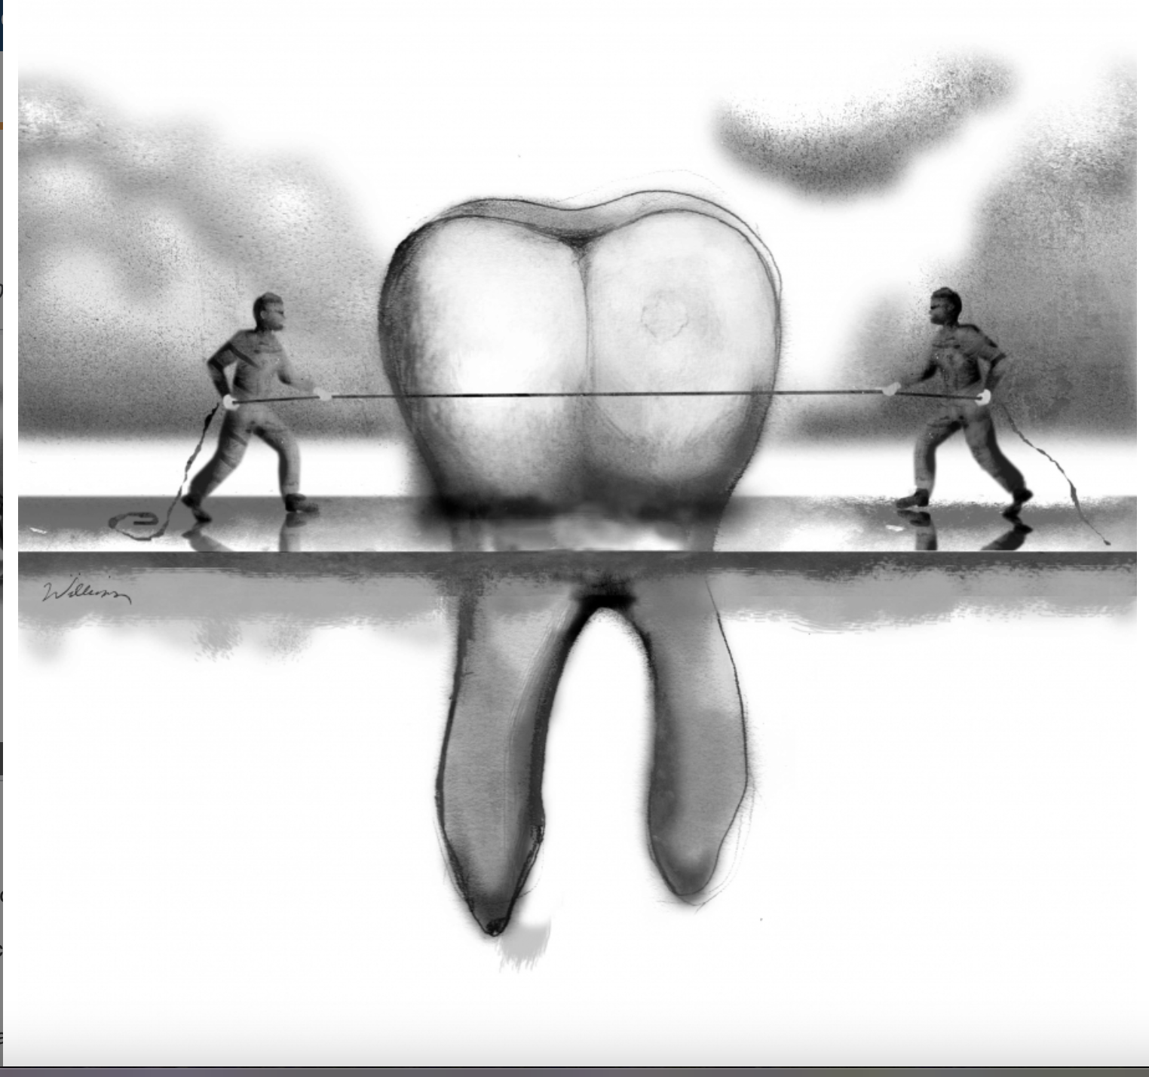
Finding Solutions: Root Cause Analysis
History of cuts
Coverage limitations
Provider network adequacy
Reimbursement
Provider culture
Broader delivery system
.
Illustration by Jon Williams, Real Change News, 2020.

Slide 24
Finding Solutions: The Road Ahead
We’re just getting started…
Considering dental benefits and access in coverage expansions
Engaging with the Medicaid agency and policymakers
Listening to community feedback!
.

Slide 25
Questions? emily@nohla.org

Slide 26
Marcy Bowers Statewide Poverty Action Network

Slide 27
Who is Poverty Action?
Poverty Action builds grassroots power to end causes of poverty and create opportunities for everyone to prosper. Through in-person community organizing and online advocacy, we advance equitable policy solutions for low-income people in Washington state.
Core work: Advancing policy solutions, building community leadership
Travel around WA every year to host listening sessions that inform policy agenda.

Slide 28
Access to Dental Care Affects Wellbeing & Quality of Life
Poverty Action did not set out to do oral health policy work! Our work in this area is a direct result of community stories.
Impacts on job/employability
Difficulty finding patience with children when in constant pain
Feelings of judgement/assumptions of behaviors
Recognition of importance, but also lack of choices

Slide 29
No Care Now = More Expensive Care Later
This is a logical response to lack of affordability and access:
Inability to get routine or preventive care (in 2022, 9% of adults on Medicaid had a preventive dental visit) means more invasive care for emergencies.
People report feeling judged for not taking care of their teeth or issue before it became an extraction.
No one does well with this system: higher costs for patients and health care systems.
FQHCs have some options for meeting these needs, but can’t cover the full community need.

Slide 30
Affect on Health Conditions
People absolutely know that they should see a dentist for their health and overall wellbeing
Most common story: hard to eat healthy without teeth (ex: crunch broccoli, leafy greens)
Forces short-term-only thinking about health: Paying for prescriptions will always beat paying for dental care until it is an emergency

Slide 31
Our Journey to Dental Therapy Advocacy
We had long advocated in support of Adult Dental in Washington, but were disappointed by the number of people accessing that care.
WA Dental Access Campaign successfully passed a bill in 2023 to:
Allow dental therapists (DTs) to practice statewide in FQHCs
Allow DTs to practice under “general supervision” to be able to work in mobile clinics, etc.
Enter the profession without first becoming a hygienist

Slide 32
Some Key Campaign Takeaways
Legislators are humans. They do not know everything about every issue area. Focusing on procedures is confusing and intimidating to lawmakers too – just like many people.
There is a business and a community case to be made for DT. In Washington, the community access and equity case was stronger, but that won’t be true in all states.
People’s stories make a difference!
Find a strong legislative champion.

Slide 33
Thank you! Feel free to reach out with any questions.
Marcy Bowers
marcy@povertyaction.org
Povertyaction.org

Slide 34
Questions for our speakers?
Submit your questions in the Q&A chat
@HealthValueHub www.HealthcareValueHub.org

Slide 35
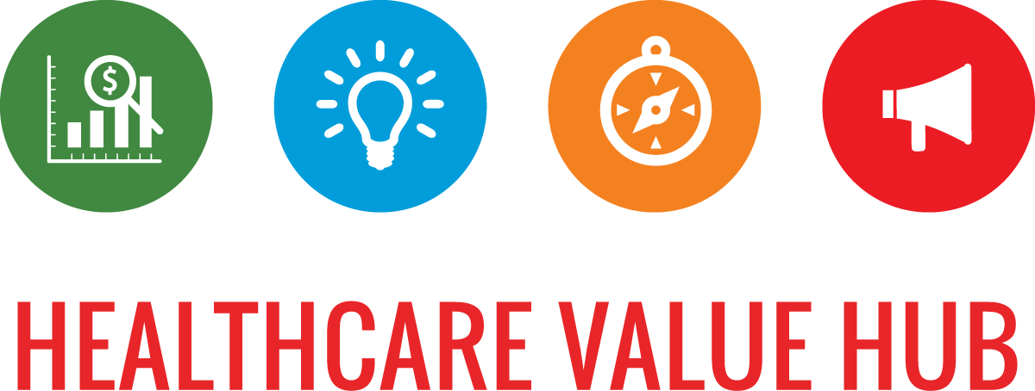
Thank you!
To our Speakers: Kasey Wilson and Emily Brice
To our funder, the Robert Wood Johnson Foundation
Register for future webinars at: HealthcareValueHub.org/events

