Slide 1
Building on the Affordable Care Act: Working with States and Marketplace Enrollees to Address Cost Challenges
Healthcare Value Hub
Notes:
Good afternoon, everyone, and welcome. Thank you for joining us today to discuss strategies to address cost challenges in the Marketplace. ​
​
My name is Britt Sanderson, and I am a health policy analyst with the Altarum Healthcare Value Hub. ​I will be moderating and monitoring the webinar this afternoon.
​
Before we begin, I’d like to take a moment to cover a few housekeeping items:​
​
We would like to ask that everyone remain muted during the presentations to minimize background noise.​
​
If you have any technical issues or questions, feel free to use the chat box, and we’ll do our best to assist you. ​
​
You may also use the Q&A feature to submit questions for the panelists during the presentation or throughout our discussion. We will do our best to address all questions at the end.

Slide 2
Claire Heyison
Senior Health Policy Analyst, Health Insurance and Marketplace Policy
Center on Budget and Policy Priorities
Erin Miller, MPH
Deputy Director of Policy, Community Catalyst
Notes:
Wonderful. We have a couple excellent presenters with us today, and It is my pleasure to introduce:​
​
Claire Heyison, senior health policy analyst with the Center on Budget and Policy Priorities, and Erin Miller, the Deputy Director of Policy at Community Catalyst.
​
Claire will kick us off today with an overview of their Marketplace Affordability Project, which examines the causes of high out-of-pocket health care costs for low-income marketplace enrollees. This was an incredibly impressive undertaking, and I’m grateful to have Claire here to dive into the process and purpose. Claire, over to you!

Slide 3
Findings from the Marketplace Affordability Project
Claire Heyison
Center on Budget and Policy Priorities
October 21, 2024

Slide 4
The Marketplace Affordability Project
18-month project
Aimed at building on the successes of the Affordable Care Act (ACA)
Led by the Center on Budget and Policy Priorities (CBPP)
Focus areas:
Features of plan design that result in high out-of-pocket costs experienced by marketplace enrollees (deductibles, co-payments, co-insurance, covered benefits)
Federal policy
Long- and short-term solutions

Slide 5
Our Goals
Bring together health policy experts, marketplace enrollees, assisters, and health care advocates in a series of conversations to identify the most pressing affordability challenges for low-income marketplace enrollees
Meaningfully include and amplify the voices of people most familiar with and most impacted by unaffordable Marketplace cost-sharing
Develop and publish equitable and sustainable federal policy solutions

Slide 6
Who participated?
14 marketplace enrollees
7 health policy experts
6 organizations representing specific racial, ethnic, disability, and age constituencies
5 ACA marketplace navigators
3 patient advocacy groups
CBPP staff and consultants

Slide 7
People with lived experience (PLE)
“People with lived experience are those directly affected by social, health, public health, or other issues and by the strategies that aim to address those issues.
This gives them insights that can inform and improve systems, research, policies, practices, and programs.”
Definition from ASPE, “What is Lived Experience?”

Slide 8
Benefits of engaging PLE
Can build equity, inclusion, and justice for people who are marginalized because of their race/ethnicity, sexual orientation, gender identity, disability status, immigration status, and more
Focuses advocacy on the priorities of those most affected by a policy or issue
Uncovers hidden issues or unintended consequences
Builds momentum for change
Can be part of building community power

Slide 9
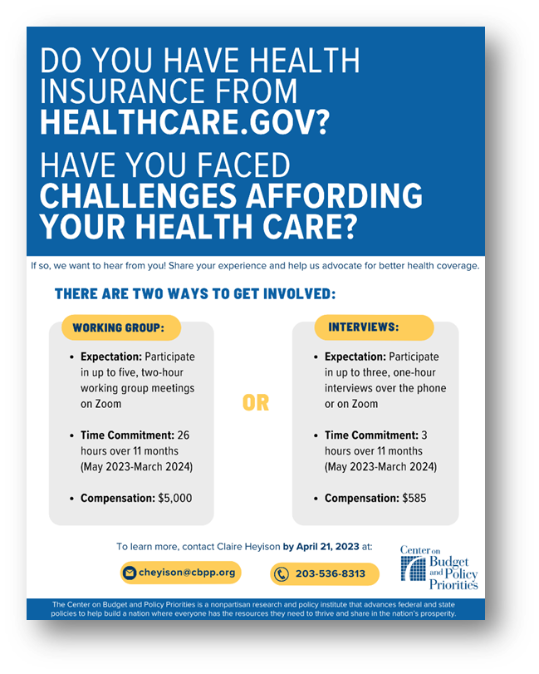
What we learned: recruiting
Significant pre-work is required before beginning outreach
Compensation
Time commitment
Privacy
Ensuring diverse voices
Recruitment takes time and effort
Flexibility is key
Leverage existing relationships
Use visual aids

Slide 10
What we learned: engagement
Avoid jargon and take the time to explain difficult concepts
Ideally, identify a single point of contact
Encourage questions and create multiple opportunities to share feedback
Leave ample time for discussion and connection
Offer resources
Building trust takes time
Emphasize that their expertise is valued

Slide 11
Our Process
Three ways to engage
Working groups
Focus groups
1:1 interviews
In-person convening

Slide 12
Affordability Pain Points
Premium and cost-sharing affordability must be addressed together
People can easily find themselves underinsured after a change in health status
Individuals with chronic and complex conditions often face no-win choices
Deductibles are a major barrier to affordability and a driver of exorbitant health care costs
Marketplace plans, like many private insurance options, are not designed in ways that recognize the needs of low-income enrollees

Slide 13
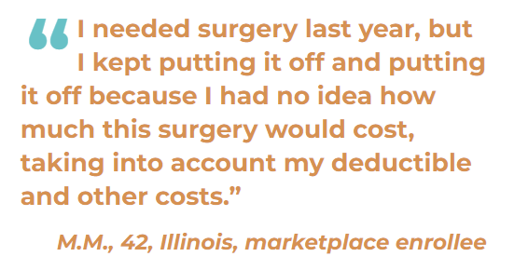
In Their Own Words…

Slide 14
Policy Solutions
Ensure Affordable Premiums
Reduce Cost-Sharing
Strengthen Coverage Requirements
Create Federal Backstops for Coverage
Simplify Plan Options and Enrollment Pathways

Slide 15
Ensuring Affordable Premiums
Require coverage of additional high-value services with no or low cost-sharing
Update the ACA’s essential health benefits to close coverage gaps
Better enforce ACA protections regarding coverage of preventive services and cost-sharing

Slide 16
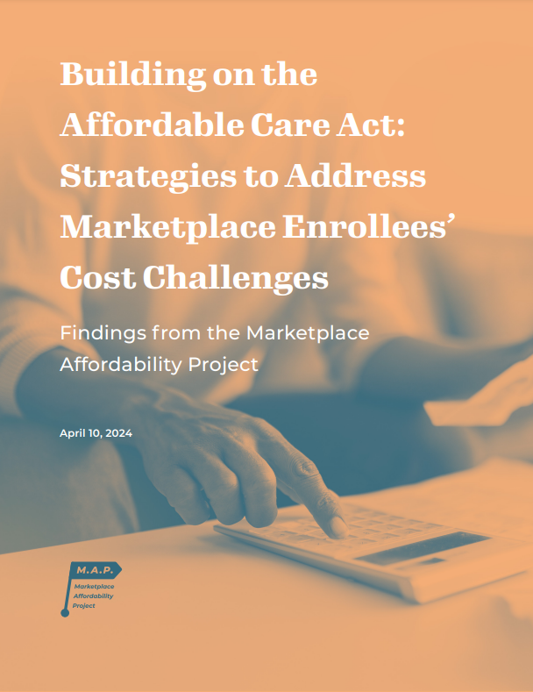
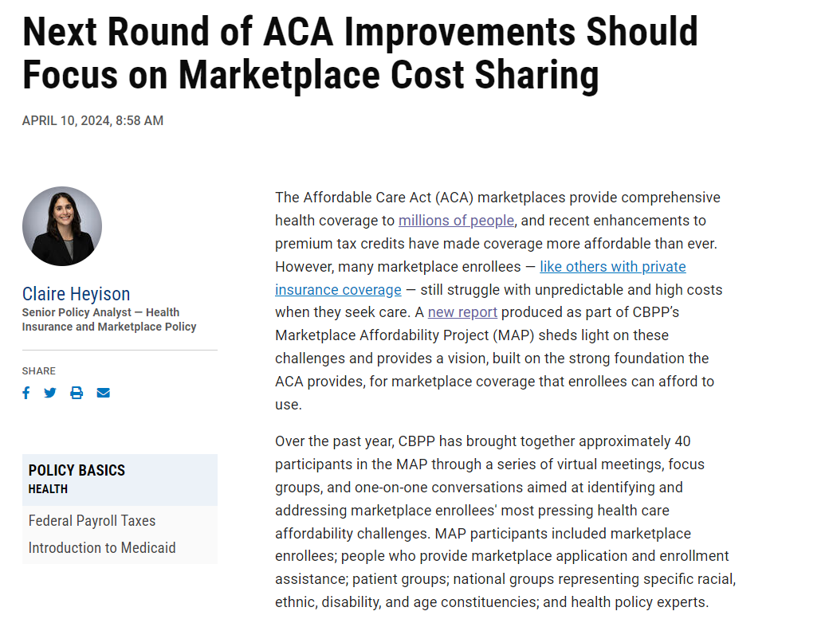
More about MAP
Read the full report
Read a summary

Slide 17
Resources for engaging PLE
Chicago Beyond, “Why Am I Always Being Researched?”
Jessica Greene et al., “A Guide To Monitoring Medicaid Using Lived Experience”
Urban Institute’s Community Engagement Resource Center
I have especially appreciated their “Equitable Compensation for Community Engagement Guidebook”

Slide 18
Thank you
Contact: cheyison@cbpp.org
Notes:
Thank you, Claire, for that excellent presentation. Up next, we will hear from Erin Miller on Community Catalyst’s work on Marketplace Affordability.​ We’re very lucky to have her with us this afternoon, and I’m excited to share this platform to highlight their work. It’s all yours, Erin!

Slide 19
Marketplace Affordability in the States
October 2024
Erin Miller, Deputy Director of Policy

Slide 20
We’re a national organization dedicated to building the power of people to create a health system rooted in race equity and health justice and a society where health is a right for all. Together with partners, we’re building a powerful, united movement with a shared vision of and strategy for a health system accountable to all people.
300+
45+
9
Partner organizations at the local and state level
states where we do
our work
where we’ve incubated
health advocacy organizations
Notes:
-- 322 as of beginning of Oct.

Slide 21
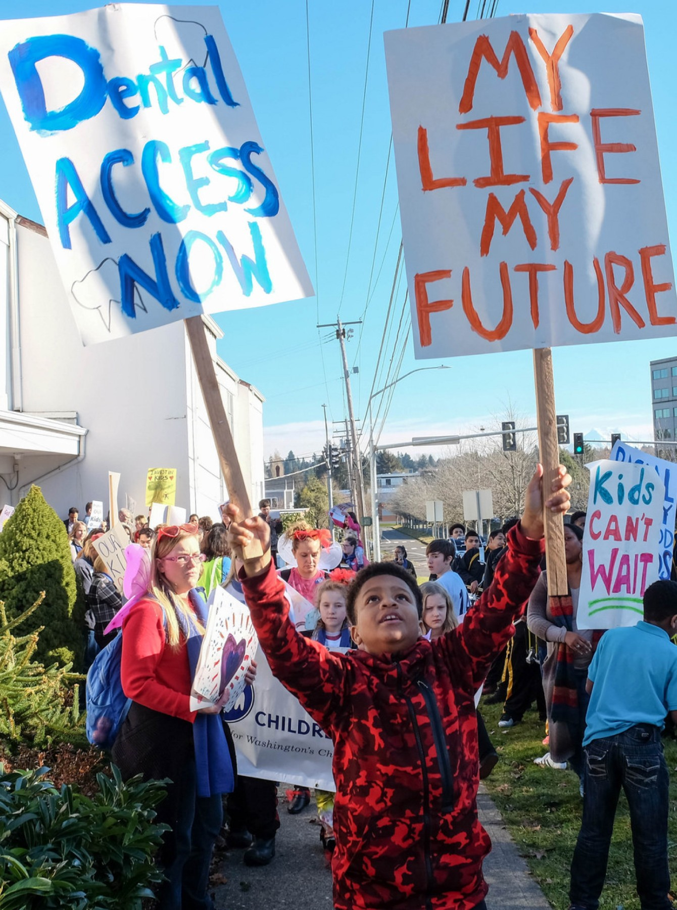
Community Catalyst Marketplace Affordability Project
Currently working with partners in 5 states – 2-3 partners per state
Current states: Washington, California, Colorado, Pennsylvania, Massachusetts
Adding two states this fall
Adding diverse political context, teachers and learners
Project Goals:
Reducing out-of-pocket costs – expanding financial assistance, and increasing comprehensiveness of coverage (e.g. EHBs)
Expanding access – including to immigrants, through SEPs, simplified enrollment
Cross state relationships and movement building
North star = policies that address structural racism in our health care system
Notes:
With Washington divided and power increasingly shifting to the states, governors and mayors are making crucial decisions that are shaping our future.
Coordination across states, and with state/federal medical debt advocacy efforts
2 orgs: , one with experience in community organizing and one with experience in policy advocacy
Pace cars: All SBMs, which give greatest flexibility, some political openness or developing windows around Marketplace Affordability (legislative or administrative), organizations with interest in taking on the issue. – working on promising practices that can be replicated elsewhere

Slide 22
Community Catalyst Marketplace Affordability Project
Federal Policy
State Policy
Marketplace enrollees and communities
+ Power building
+ Narrative change
+ Policy support
+Actuarial resources
+ Research capacity
= increased ability to be active in the movement for health justice and push towards policy change
Notes:
State policymaking as a critical piece of this puzzle.
Importance of issue – Marketplace Affordability is a key state and federal policy priority among our surveyed partners, with more than a third listing it among their top state policy priorities
Sometimes necessary to skip over state level regulation, especially in states with unfriendly political environments, i.e. much of the civil rights movement.
The Community Catalyst project is looping specifically to those state levers, and how they can improve affordability for individuals, where they might point to promising practices that can be brought to the federal level, and where federal policy prohibits or limits state innovation – all of the policies impact one another
Allows for iteration, checking of outcomes in implementation
ACA from MA innovation
State public option work
State affordability work which put pressure to establish enhanced tax credits
Because of the overlapping nature of these pathways, many of the things coming up in our project will be familiar
The CBPP report itself notes that many of the ideas in it have come from state legislation

Slide 23
Themes from Phase I
Advocacy, engagement, power-building
Advocating for state-based Marketplaces and state agencies to better integrate directly-impacted communities into their decision-making processes
Serving as a bridge to directly-impacted community members
Hosting listening sessions, focus groups and creating surveys
Managing broad and diverse coalitions
Engaging the media and policymakers
Providing FAQs and health literacy tools to newly covered individuals

Slide 24
Themes from Phase I
Policy Change
Increasing/implementing state-level financial assistance (through CSRs and/or additional premium assistance)
Focus on deductibles – reducing/eliminating, also reducing copays
Improving plan design
Adding or changing benefits including increased access to Rx drugs, exploring option to add adult dental
Expanding access to affordable coverage for immigrants, including for people with DACA and undocumented immigrants
©COMMUNITY CATALYST 2022 • 24
Notes:
CA: eliminating deductibles for ALL Silver plans in Covered California (across all income levels), and otherwise reduce copayments for doctor visits and prescription drugs
MA: ConnectorCare expansion pilot program was officially signed into law by the governor in August. 46,000 people enrolled in the expansion coverage during just the initial open enrollment period – on track to meet the estimates of at least 50,000 enrollees in the first year of the program. – eliminates deductibles up to 500% FPL
PA: Passed a state subsidy wrap this year
CO: Tracking implementation of OmniSalud through engaging enrollees, standard plan with no co-insurance
WA: Allowing undocumented Washingtonians to purchase on the Marketplace, with some financial assistance
CA: Allowing people with DACA to purchase on the Marketplace

Slide 25
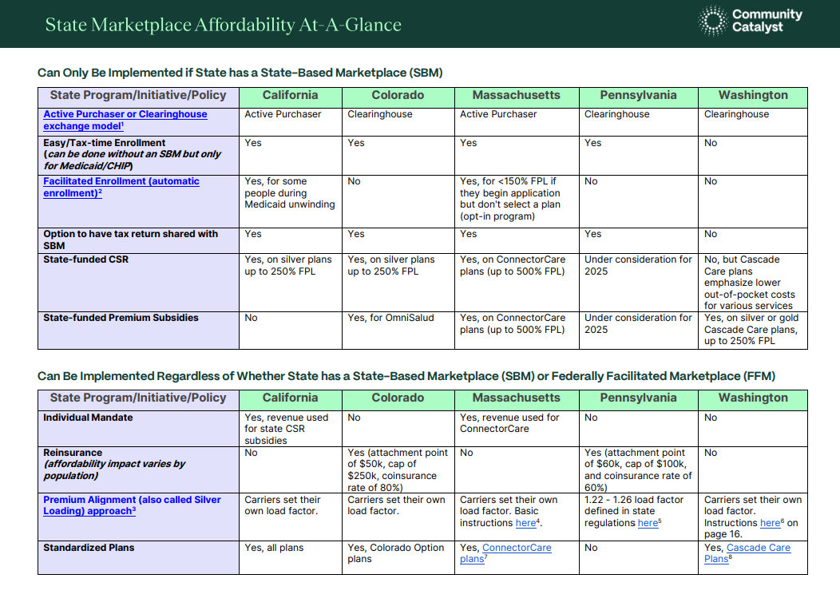
See: https://communitycatalyst.org/resource/reducing-out-of-pocket-costs-for-marketplace-enrollees/
Notes:
Importance of issue – Marketplace Affordability is a key state and federal policy priority among our surveyed partners, with more than a third listing it among their top state policy priorities
Sometimes necessary to skip over state level regulation, especially in states with unfriendly political environments, i.e. much of the civil rights movement.
The Community Catalyst project is looping specifically to those state levers, and how they can improve affordability for individuals, where they might point to promising practices that can be brought to the federal level, and where federal policy prohibits or limits state innovation – all of the policies impact one another
Because of the overlapping nature of these pathways, many of the things coming up in our project will be familiar
The report itself notes that many of the ideas in it have come from state legislation

Slide 26
Remaining Policy Barriers
Progress relies on enhanced Premium Tax Credits:
States cannot make them up that revenue
Inequity across states:
Need to fill the coverage gap/create federal backstop
Inconsistent benefit standards (Essential Health Benefits
Actuarial value limitations & benefit design:
Deductibles and MOOPs remain too high
2025 NBPP Federal Standard Silver:
$5,000 deductible and $8,000 MOOP
Constrained plan designs inside the AV calculator
Notes:
CBPP report recommended federal action on EHBs to improve and standardize
CBPP report also recommended increasing AV values, and or using the gold as the benchmark plan

Slide 27
Remaining Policy Barriers (Continued)
Federal laws and regulations that maintain unnecessary and oppressive exclusion of immigrants:
LPRs in 5-year bar have 94% AV plans facing high maximum out-of-pocket costs
Court cases regarding DACA
Lack of full federal financial participation for undocumented immigrants
Insurer requests for social security numbers
Hospital pricing and financial assistance policies for people with Marketplace coverage
Notes:
Explain people in 94% AV plans – 5 year bar -- Federal law requires people with some lawfully residing immigration statuses to wait five years before they can qualify for Medicaid or CHIP. Thankfully, people in these situations can get marketplace coverage, but the plans aren’t designed for people at these lower income levels. Even though they qualify for the highest level of CSRs, health care – especially routine or emergency care – can still be unaffordable for people with marketplace coverage who have incomes below the poverty level.
Hospital financial assistance for immigrants – in 5-year bar and undocumented
Pause for questions

Slide 28
What’s Next
Implementation at the state level
Affordability context shifts, legislation allows for flexibility, and requires constant attention -- coalition building, serving on Governing bodies
Medicaid budget impacts
Strong implementation of ACA DACA as allowed by courts
Evaluating impact on medical debt
Support ongoing policy efforts to reduce out-of-pocket costs at the state and federal level
Raise state revenue and look to new models
Defend and expand federal policies, close coverage gap
Expanding coverage of services at state and federal level
EHB opportunities, equity-centered benefit designs
New state models (Covered CT)
Ongoing expansions to undocumented immigrants
Iterate where there is state action to capitalize on federally
SEPS (pregnancy, tax time)
Auto enrollment
Notes:
Per Commonwealth report cited in our report, 33% of people with Marketplace plans have medical or dental debt
Prevent reinsurance from swallowing funds, ensuring equity-centered prioritization of resources
EHBs in the report

Slide 29
Thank you
Contact: emiller@communitycatalyst.org

Slide 30
Discussion
Any questions for us?
What do you wish your state would do to increase Marketplace affordability?
Have your states pursued any policies to improve affordability for people with Marketplace coverage that we did not cover?
Are there any barriers to policy change at the state level that you’ve experienced that we did not discuss?
How do out-of-pocket costs factor into your work on medical debt?
Notes:
Now, we’d like to open the floor to questions from our audience. Please feel free to submit your questions through the Q&A box, and we will do our best to address as many as possible in the time remaining.

Slide 31
Special thanks to Claire Heyison and Erin Miller for presenting, the Robert Wood Johnson Foundation, and Webinar attendees. Contact Information:
Claire Heyison, Center on Budget and Policy Priorities Cheyison@cbpp.org
Erin Miller, Community Catalyst emiller@communitycatalyst.org
Dr. Beth Beaudin-Seiler, Altarum Health Care Value Hub Beth.Beaudin-Seiler@altarum.org
Britt Sanderson, Altarum Health Care Value Hub Britt.Sanderson@altarum.org
Healthcare Value Hub
Notes:
Thank you again to our panelists and to all of you for participating in today’s discussion. We hope you found the insights and strategies shared today valuable as we all work toward making Marketplace coverage more affordable for everyone. ​
​
If you have any follow-up questions or would like additional resources, don’t hesitate to reach out. The slides and a recording of today’s webinar will be available on our website in the next week. Have a wonderful rest of your day and thank you again for joining us!​

