Slide 1
Hospital Consolidation: Affordability and Access to Care for Patients
Altarum Healthcare Value Hub
November 18, 2024
Notes:
Thank you everyone for joining us this afternoon to our webinar on Hospital Consolidation, Affordability and Access to Care for Patients.
My name is Alexandra Allen, I’m a health policy analyst with the Altarum Health Care Value Hub, I’ll be moderating and monitoring the webinar, so if you have any questions please put them in the chat. We also have the Q&A function open and please add questions there as well.
Before we begin, I have a few housekeeping items. I’ll ask everyone to remain muted during the presentation to minimize background noise. If you have any technical issues or questions, please use the chat box and we will assist you through that.
[Next Slide]

Slide 2
Speakers
Corey Rhyan
Health Management and Policy PhD Student, University of Michigan
Michelle Sternthal
Director of Government Affairs, Community Catalyst
Liz Coyle
Executive Director, Georgia Watch
Q&A
Notes:
For today’s agenda, we have some great presenters lined up to talk about the impacts of hospital consolidation on prices and access to care for patients, followed by a brief Q&A. The entire session will run 1 hour.
We will hear from Corey Rhyan, a current PhD policy student at University of Michigan; Michelle Sternthal, Director of Government Affairs at Community Catalyst; and finally, Liz Coyle, Executive Director at Georgia Watch.
With all that in mind, let’s get started!
[Next Slide]

Slide 3
Corey Rhyan
University of Michigan,
Health Management and Policy PhD Student

Slide 4
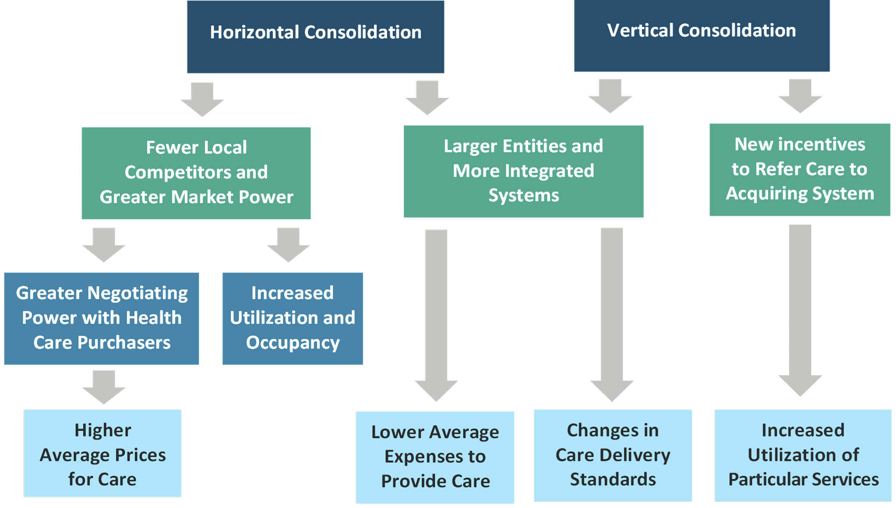
Background on Consolidation
Horizontal Consolidation:
Mergers or acquisitions of organizations in the same industry
Vertical Consolidation:
Purchase or affiliation of an organization that provides an input or part of the supply chain

Slide 5
National Trends in Healthcare Consolidation
Hospital Consolidation:
Between 1998 and 2023, there were over 2,000 hospital mergers in the US.¹
Studies have found somewhere between 77% and 90% of hospital markets are highly concentrated.^{2,3}
As of 2022, the ten largest hospital systems account for 22% of nonfederal, acute hospital beds.¹
Physician Practice Consolidation:
77.6% of physicians were hospital- or corporate-employed in January 2024.⁴
58.5% of physician practices were owned by hospital or corporate entities.⁴
Notes:
Ten Things to Know About Consolidation in Health Care Provider Markets | KFF
Health Care Market Concentration Trends In The United States: Evidence And Policy Responses | Health Affairs
HMI Interactive Report - Health Care Cost Institute
Physicians Advocacy Institute > PAI Research > PAI-Avalere Study on Physician Employment-Practice Ownership Trends 2019-2023

Slide 6
Research on the Impacts of Consolidation
Studies of Effects on Prices
Cooper & Gaynor (2022): “A number of studies have examined individual hospital mergers and found price increases greater than 20%”.
Liu et al. (2022): “Estimated price increases that are due to a hospital merger vary significantly, ranging from 3% to 65%”.
Arnold et al. (2024): “We find cross-market hospital acquisitions are associated with price increases of 12.9%”.
Koch & Ulrick (2020): Evidence that physician practice mergers also increase prices, in the range of 10-20%.
Studies of Effects on Worker Compensation
Arnold and Whaley (2020): We find that hospital mergers lead to a $521 increase in hospital prices and a $638 reduction in wages. Consumers bear the price effects of hospital mergers in the form of reduced wages.

Slide 7
Research on the Impacts of Consolidation
Studies of Effects on Cost Savings
Craig et al. (2018): Cost efficiencies of hospital mergers are less than 5%.
Studies of Effects on Hospital Worker Wages
Prager & Schmidt (2019): “Among the top 25 percent of concentration-increasing mergers, resulting wage growth was 1.1 percentage points lower for skilled nonmedical workers and 1.7 percentage points lower for nursing and pharmacy workers”
Studies of Effects on Quality
Liu et al. (2022): “We identified 12 studies that examined the effect of hospital consolidation on selected measures of quality of care, and the majority found no change or worse quality of care after consolidation.”

Slide 8
Research on the Impacts of Consolidation
Studies of Effects on Utilization
Whaley & Zhao (2024): “Vertical integration creates an “arbitrage” opportunity to move patients to higher-priced providers.”
Baker et al. (2016): “patients are more likely to choose a high-cost, low-quality hospital when their physician is owned by that hospital.”
Studies of Effects on Access & Equity
O’Hanlon et al. (2019): “Following health system affiliation, rural hospitals experienced a significant reduction in on-site diagnostic imaging technologies, the availability of obstetric and primary care services, and outpatient nonemergency visits.”
Desai (2023): “Hospital Concentration Decreases Care for Medicaid Beneficiaries”

Slide 9
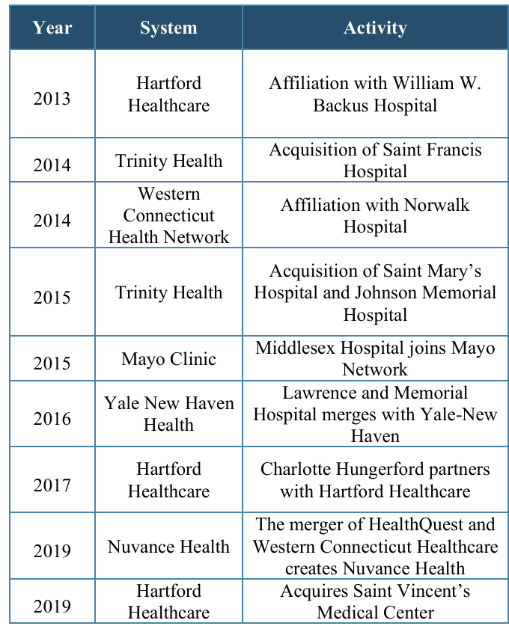
Study of Connecticut Healthcare Mergers (2013-2019)
Overview
Between 2013 and 2019, the four large hospital systems either affiliated with or purchased 14 different hospitals
By 2021, 8 of the 9 regions in the state were at least “highly concentrated” for acute care hospital services
Data were also collected on approximately 100 physicians that were part of physician groups acquired by hospital systems between 2016 and 2021

Slide 10
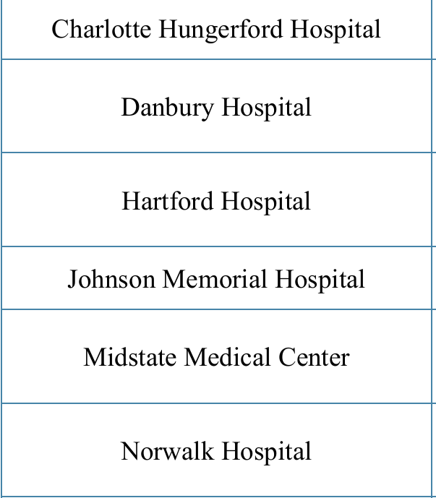
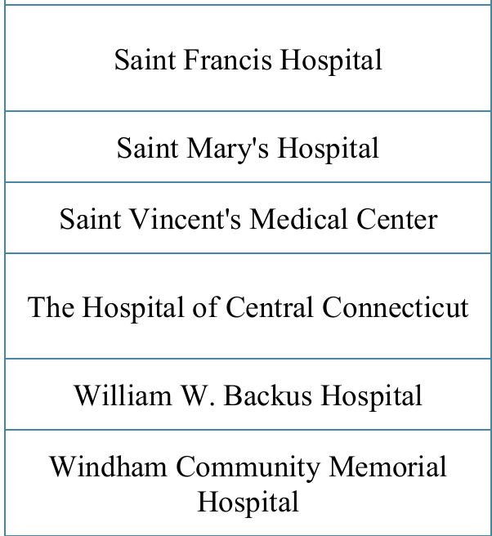
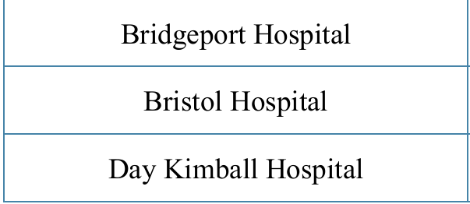
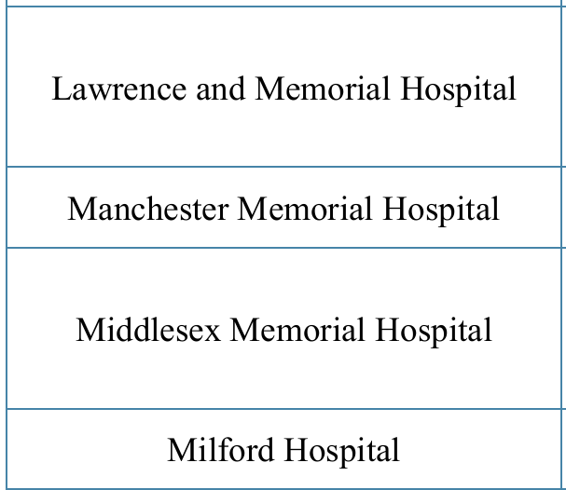
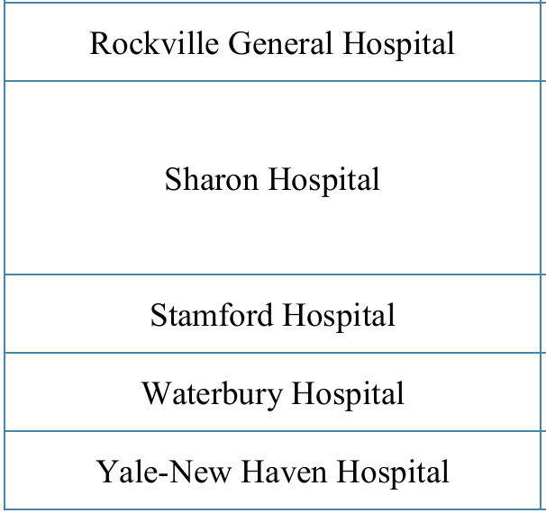
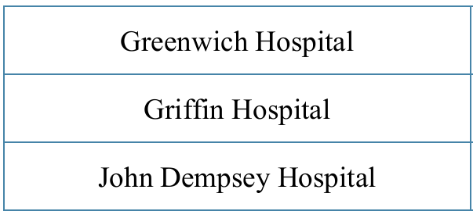
Study of Connecticut Healthcare Mergers (2013-2019)
Methods
Trends in outcomes were compared between a “Consolidation Group” and “Comparison Group”
Consolidation Group includes both “acquiring systems” and “acquired hospitals”
Trends were measured as annualized growth rates in an outcome over the period of study
Data from Connecticut All-Payer Claims Database (APCD) and Hospital Discharge Database (HDD)
Consolidation Group
Control Group

Slide 11
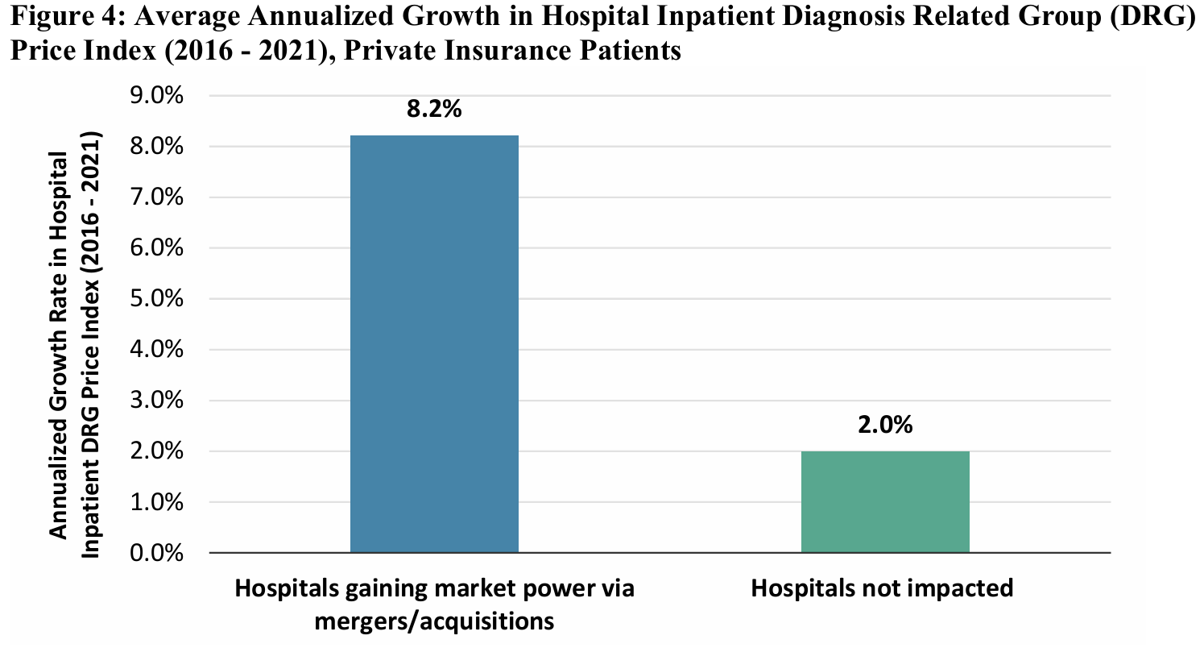
Study of Connecticut Healthcare Mergers (2013-2019)
Results (Private Insurance Inpatient Prices)

Slide 12
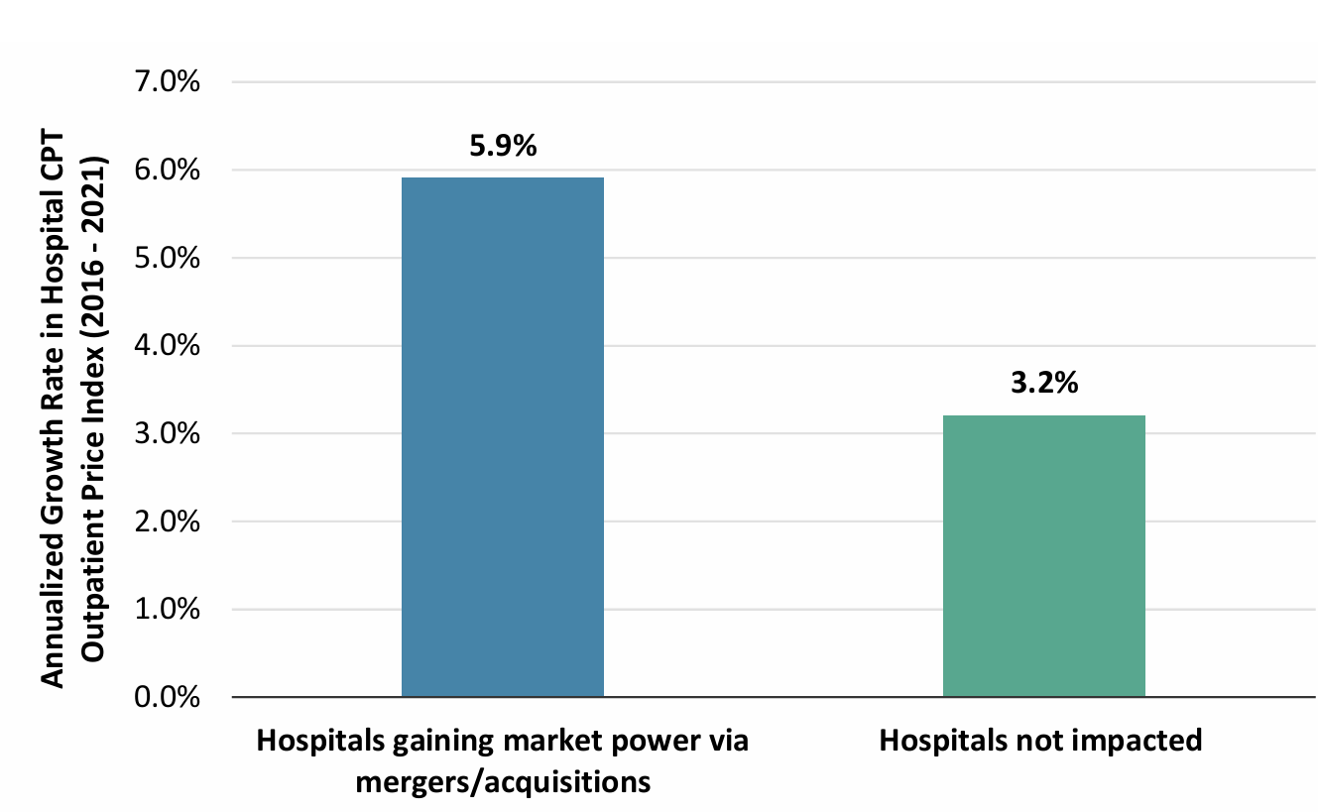
Study of Connecticut Healthcare Mergers (2013-2019)
Results (Private Insurance Outpatient Prices)

Slide 13
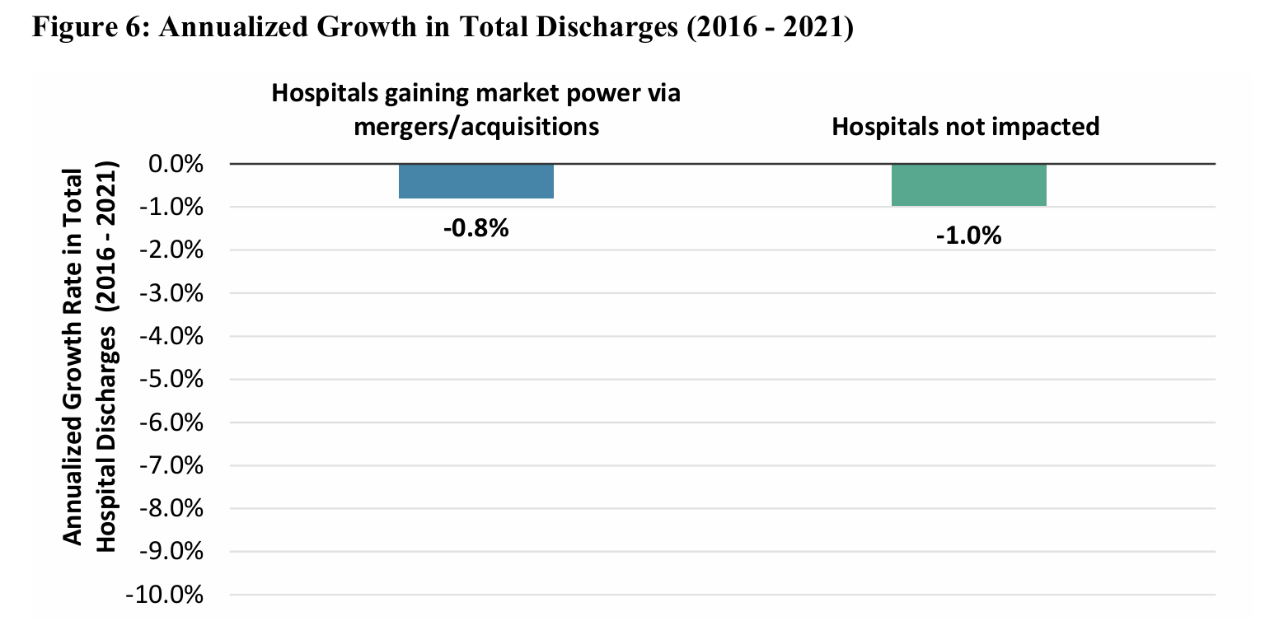
Study of Connecticut Healthcare Mergers (2013-2019)
Results (Total Discharges)

Slide 14
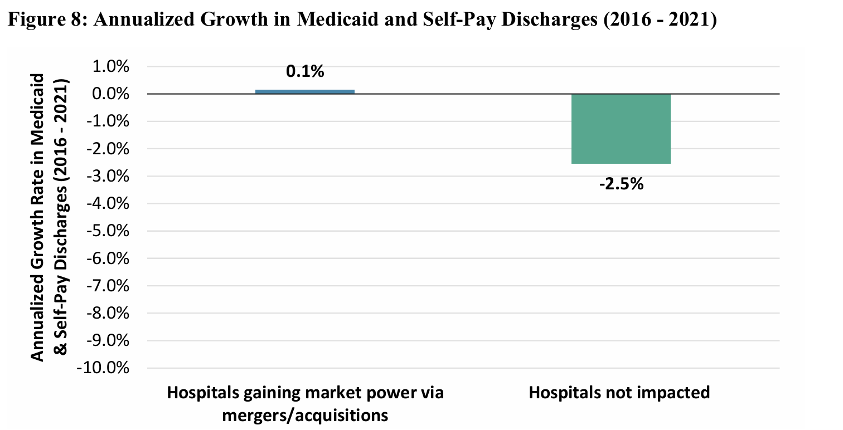
Study of Connecticut Healthcare Mergers (2013-2019)
Results (Medicaid Discharges)

Slide 15
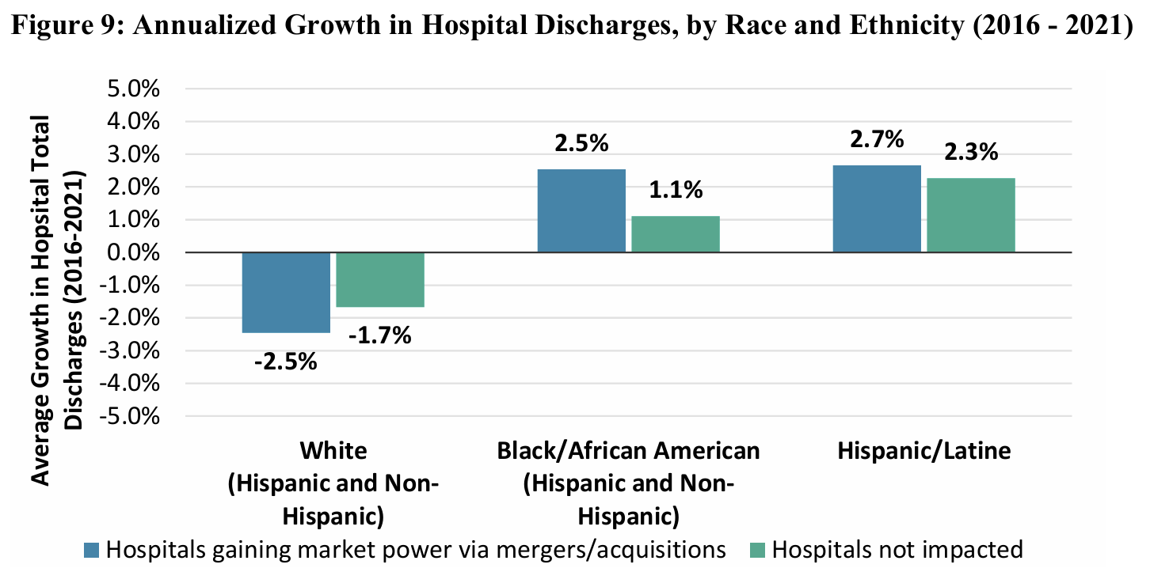
Study of Connecticut Healthcare Mergers (2013-2019)
Results (Discharges by Race/Ethnicity)

Slide 16
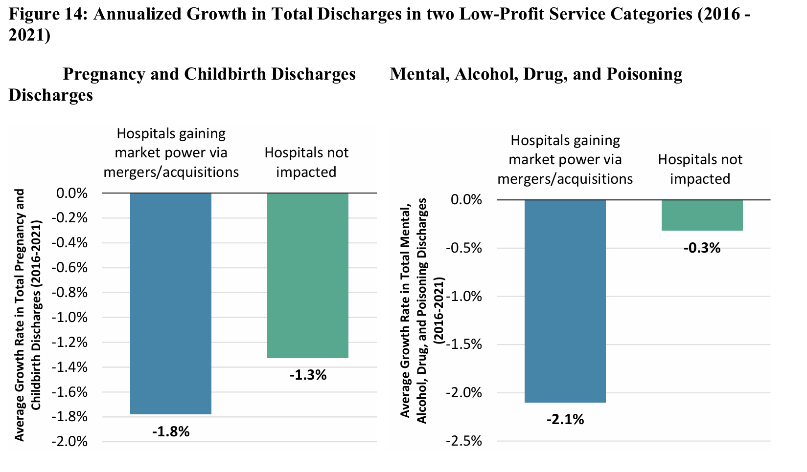
Study of Connecticut Healthcare Mergers (2013-2019)
Results (Discharges by Service Line)

Slide 17
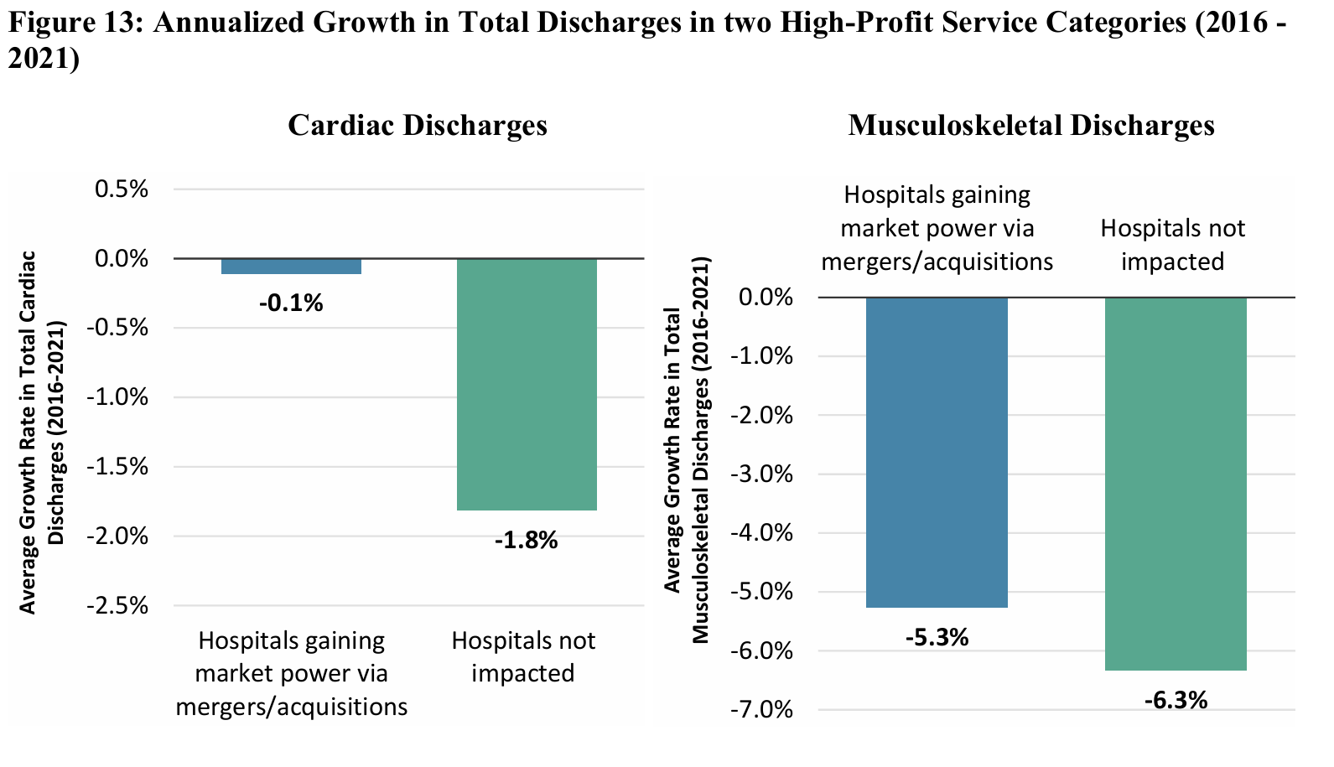
Study of Connecticut Healthcare Mergers (2013-2019)
Results (Discharges by Service Line)

Slide 18
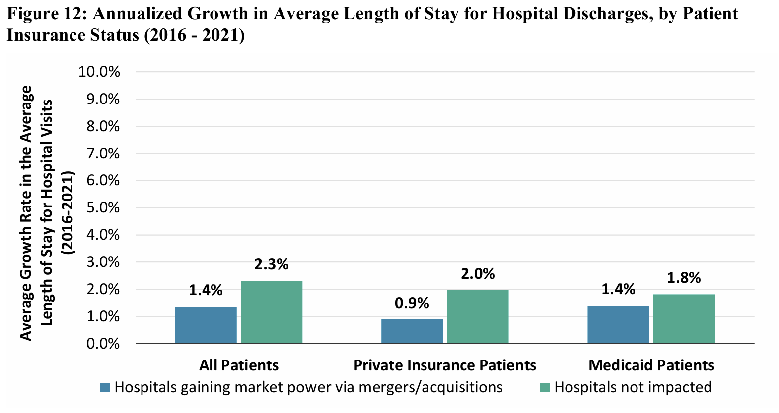
Study of Connecticut Healthcare Mergers (2013-2019)
Results (Length of Stay by Insurance)

Slide 19
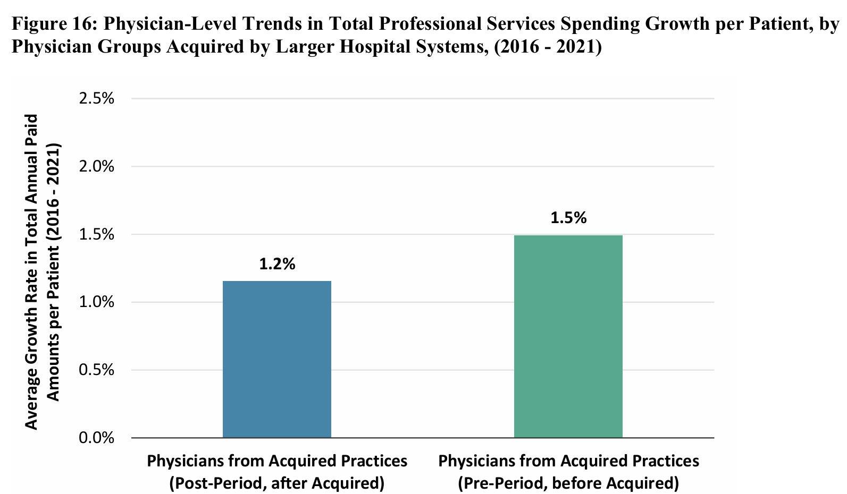
Study of Connecticut Healthcare Mergers (2013-2019)
Results (Physician-Trends in Spending per Patient)

Slide 20
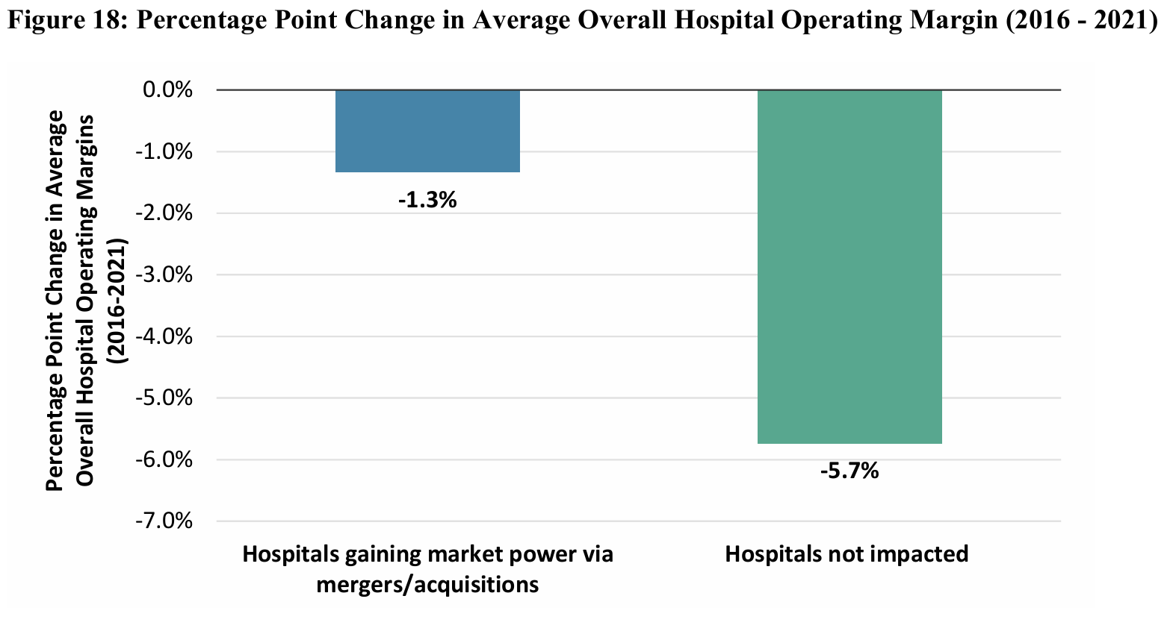
Study of Connecticut Healthcare Mergers (2013-2019)
Results (Hospital Operating Margin)

Slide 21
Study of Connecticut Healthcare Mergers (2013-2019)
Conclusion
Over this period in Connecticut, we find evidence for consolidation leading to:
Faster growth in hospital prices (especially private insurance prices)
Slower growth in use of low-margin service lines
Faster relative growth in use of high-margin service lines
Higher overall hospital operating margins
We do not find evidence for:
Differences in length of stay (intensity of care)
Impacts on access to care for Medicaid patients or different race/ethnicity groups
Impacts on physician or professional prices/utilization
Impacts on bed occupancy rates

Slide 22
Future Research
Moving beyond impacts of consolidation to consider impacts of changes in ownership
Specifically impacts of Private Equity (PE) Ownership (Brown et al. 2024):
“Over the past decade PE has invested $750 billion in acquiring US healthcare providers.”
“PE acquisitions have led to higher prices, higher Medicare spending, and changes in referral patterns.”
“PE acquisitions increased the clinician replacement ratio, or the ratio of physician entry and exit, indicating higher physician churn at PE-acquired practices.”
“PE has been associated with declines in quality of care for patients in some settings.”

Slide 23
Michelle Sternthal
Community Catalyst, Director of Government Affairs

Slide 24
Hospital Consolidation and Reproductive Health: Challenges & Opportunities Ahead
Michelle Sternthal, PhD
Director of Government Affairs
Presentation for Altarum’s Health Care Value Hub | November 18, 2024

Slide 25
Why Focus on Reproductive Health

Slide 26
Perilous Environment for Reproductive Health
.
Maternal Mortality:
The U.S. maternal death rate remains among the highest for wealthy nations, with disparities impacting Black, Indigenous, and Hispanic women disproportionately.
Preterm Birth Rate:
Nearly 10% of births in the U.S. are preterm, with elevated rates among Black women.
Access to Care:
Over 5 million women live in “maternity care deserts,” impacting maternal and child health outcomes.
Abortion Restrictions:
14 states have banned abortion, affecting women’s access to comprehensive reproductive care.

Slide 27
Hospital Consolidation and Maternity Ward Closures

Slide 28
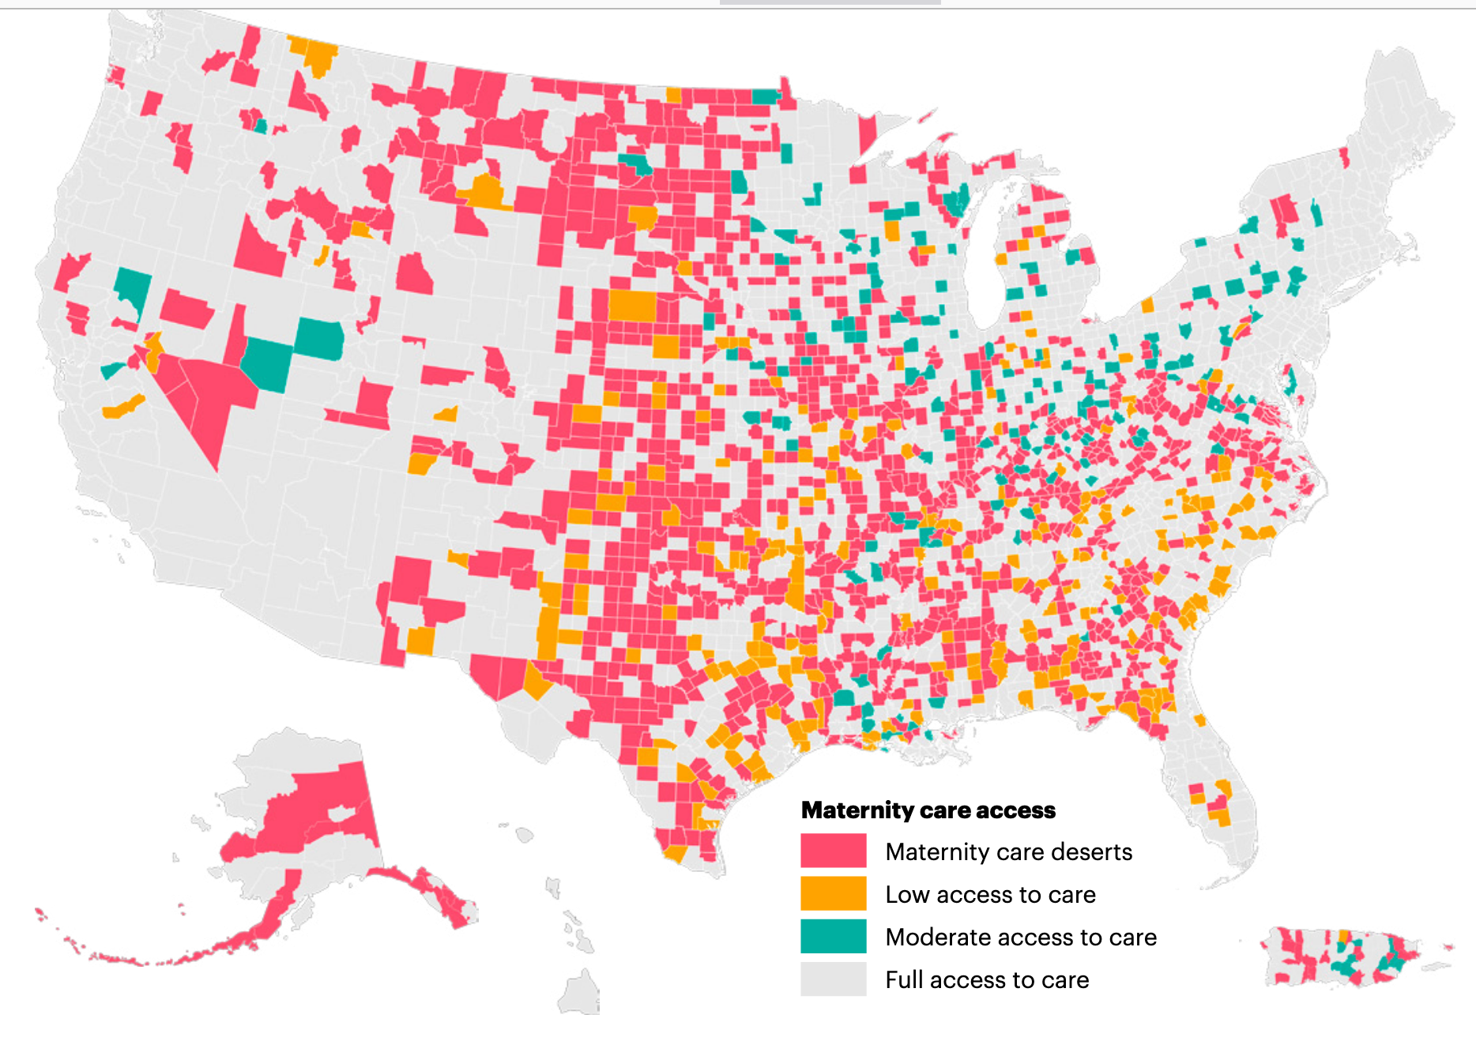
Prevalence of Maternity Care Deserts
Over 35% of US counties are maternity care deserts.
Nearly two thirds of these deserts are in rural areas.
Disproportionately clustered among low-income counties and counties with higher proportions of Black birthing people
31 maternity service closures in 2024.

Slide 29
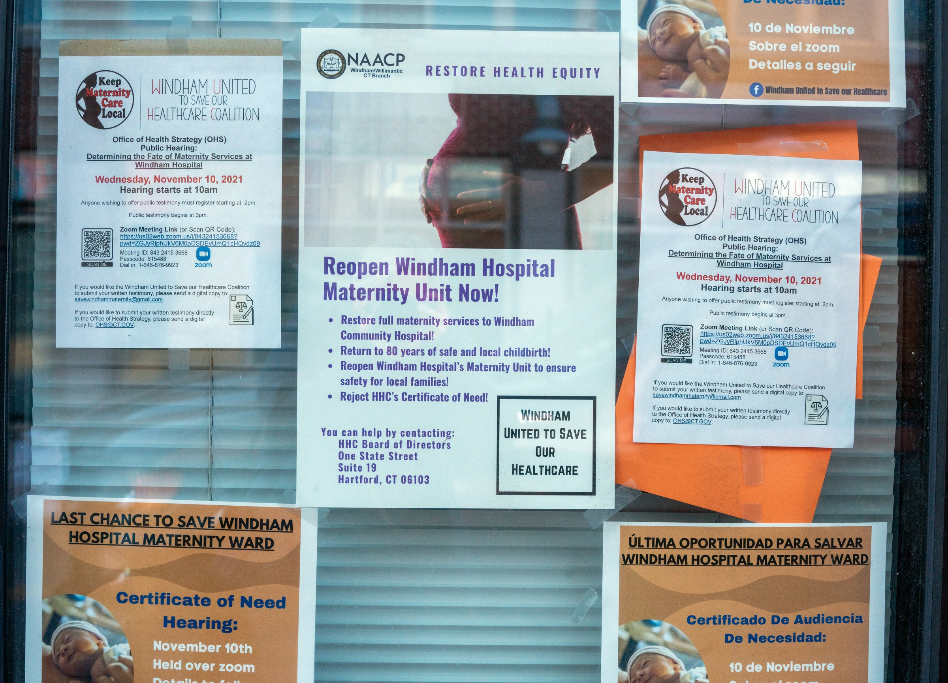
Hospital Mergers Can Result in Closure of Maternity Wards
Notes:
Hospital consolidation leads to closures of maternity wards, because they aren’t affordable. Studies show a 13.4% reduction in rural maternity services post-consolidation

Slide 30
Ascension Catholic Hospital
Third largest health system in country, with $28 billion operating revenue in 2023
Closed more than a quarter of its labor and delivery units that existed in 2012

Slide 31
Ascension Catholic Hospital
2019
Closed birthing services at the Ascension Sacred Heart Bay Hospital in Bay County Florida, where 67% of the residents are Black
2021
Maternal death rates in Bay County spiked to 95.2 per 100,000 live births – more than twice the rate in 2018, the year prior to the closure.

Slide 32
Health Impacts
Elevated Pregnancy Complications,
Preterm Births
Infant Mortality
Maternal Death
Decreased availability
Longer travel times for expectant mother services
Overcrowded hospitals
Decline in quality of care
Declines in prenatal care
Exacerbating existing health inequities

Slide 33
Hospital Consolidation and Private Equity

Slide 34
Private Equity
Private equity firms take large funds and buy companies
They own these companies for a few years (usually 4-7) before selling them (ideally at a profit)
Goal of private equity: make outsized returns over short time horizons

Slide 35
Private Equity Owned Hospitals

Slide 36
Private Equity and Hospitals
PE firms own at least 386 hospitals in US
10% of all non-government hospital
30% of all for-profit hospitals are now owned by private equity firms,
Chains include LifePoint Health, ScionHealth, Ardent Health, Ernest Health, Quorum Health

Slide 37
Maternity Closures By PE-Owned Hospitals
Seton Medical Center Harker Heights in Harker Heights, Texas – Bell County (acquired in 2017 by Equity Group Investments) closed maternity care unit in September 2023
Conemaugh Nason Medical Center in Roaring Springs, Pennsylvania – Blair County (acquired in 2018 by Apollo Global Management) closed its labor and delivery unit in 2022
Memorial Hospital of Gardena in California (acquired in 2019 by Stanton Road Capital, David Kempner, Deerfield Management) closed its labor and delivery unit in 2020
PE-owned Hahnemann Hospital in Philadelphia closed its labor and delivery unit in 2019
In Upland, PA, PE-owned Delaware County Memorial Hospital closed its maternity and neonatal intensive care units in 2022
In Youngstown, OH, PE-owned Northside Regional Medical Center closed in 2018. Northside had operated the only labor and delivery unit within Youngstown city limits.
In Miami, FL, PE-owned North Shore Medical Center closed its neonatal and obstetrics department in 2024.
McKenzie-Willamette Medical Center in Oregon (acquired in 2020 by GoldenTree Asset Management, Davidson Kempner) disbanded its in-house midwifery unit in 2023, less than four years after launch
Notes:
owned hospitals are more likely to close maternity wards
Private equity’s focus on short-term profits likely contributes to closures of Labor and Delivery units and of safety net hospitals. In suburban Philadelphia, for instance, closures of PE-owned hospitals have led to “a maternal care desert.”
In Youngstown, OH, PE-owned Northside Regional Medical Center closed in 2018. Northside had operated the only labor and delivery unit within the Youngstown city limits.
In Upland, PA, PE-owned Delaware County Memorial Hospital closed its maternity and neonatal intensive care units in 2022.
In Miami, FL, PE-owned North Shore Medical Center closed its obstetrics and neonatal intensive care units in 2024.

Slide 38
Impact
Reduced staffing, or filling beds without adequate staffing ratios
Underpaying employees, resulting in high-turnover and understaffing
Overreliance on unlicensed staff to reduce labor costs
Failure to provide adequate training
Cutting services/programs
Failing to invest in maintaining facilities
Surprise medical bills and increased costs
Closures, bankruptcies
Notes:
This under-resourcing is endemic to the business model of PE hospitals, who siphon off extraordinary amounts of money from community hospitals to pay investors. The results are longer wait times, substantial supply and labor shortages, closures of unprofitable wards, and a worsening of patient outcomes. Ultimately, many hospitals are driven into bankruptcy and out of business. While the research connecting women’s health and PE is still emerging, the evidence to date, are cause for concern.

Slide 39
STEWARD HEALTH CARE’S BANKRUPTCY: A Cautionary Tale of Corporate Greed in our Health Care System
Notes:
One of the most poignant examples of these harms is the harrowing case of Sangita Rashid, a new mother who bled to death during childbirth. The hospital she delivered at, gutted and in bankruptcy after being acquired by a PE firm, lacked the life-saving device needed to stop the bleeding. The manufacture had repossessed it only weeks before due to lack of payment.
Pregnancy Complications
In August 2018, Steward Health Care announced the closure of Northside Regional Medical Center in Youngstown, Ohio. The hospital, which had 398 beds and employed 388 people, operated the only labor and delivery unit within Youngstown city limits. The hospital’s closure had a serious impact on access to maternal health care in this city, where over 43 percent of the population is Black. Representative Tim Ryan (D-OH) famously – and correctly – stated in 2019: “An African American baby born in Youngstown, Ohio, has a higher infant mortality rate than a baby born in Iran.” Tragically, infant mortality in Mahoning County (which includes Youngstown) worsened in subsequent years. Since 2019, the proportion of births in which the mother had a prenatal care visit has decreased in Mahoning County, and the infant mortality rate has increased – most dramatically for Black babies.

Slide 40
PE-Owned Obstetrics Emergency Departments
Routine births are turning into moneymaking ‘emergency’ events at hospitals that work with private equity-backed staffing companies.
Notes:
Routine births are turning into moneymaking ‘emergency’ events at hospitals that work with private equity-backed staffing companies. Individuals are hit with surprise emergency charges for being triaged in an OBED while in labor.
In one case, a patient never knew she entered an obstetrics emergency department when, in an area separated from the rest of the labor and department by a curtain, a doctor checked her cervix, timed her contractions, and told her to go home and come back later. However, the hospital received $1,300 for that so-called “emergency” visit - $530 of which was directly from the patient.
Individuals are hit with surprise emergency charges for being triaged in an OBED while in labor.
Potential delay in postpartum care

Slide 41
PE-owned “Advanced Birthing Centers” Fill Vacuum of Care
FL became first state to allow physicians to perform C-sections outside of hospital
Planned elective cesarean section deliveries are more profitable
Health and safety concerns for birthing person and baby
Notes:
Advanced Birthing Centers illustrate a potentially risky development driven by PE companies that prioritize opportunities for profit rather than patient safety.
Florida recently became the first state to allow physicians to perform these C-sections outside of hospitals, after lobbying by Women’s Care Enterprises, a private equity-owned physicians group with locations mostly in Florida along with California and Kentucky. The new law allows “advanced birthing centers,” where physicians can deliver babies vaginally or by C-section to women deemed at low risk of complications.
This has raised significant health and safety concerns. Having a C-section outside of a hospital puts the woman and child at even greater risk of birth injuries. C-sections already have associated dangersheavy bleeding, infections, endometritis, tearing of the uterine walls, or injury to another organ.

Slide 42
Hospital Consolidation and Catholic Health Systems

Slide 43
Rapid Growth of Catholic Hospitals Through Mergers and Acquisitions
800,000
16%
4 of the 10
people have only Catholic hospitals nearby
.
of all births occur in Catholic hospitals
largest health systems in the country are Catholic, with facilities in 41 states
©COMMUNITY CATALYST 2022 • 43

Slide 44
Catholic Health Care Religious Directives:
→ Bans Abortion
→ Bans Sterilization and Contraception
→ Qualified Treatment of Miscarriages &
Ectopic Pregnancies
→ Limits Most Fertility Treatments
→ Bans Gender Affirming Care
→ Referrals Prohibited

Slide 45
Travel for Abortion Care, 2023
Notes:
Washington state (where 41% of total acute care hospital beds are in Catholic facilities), Colorado (38%), Oregon (30%) and Illinois (28%), according to a 2020 Community Catalyst report.

Slide 46
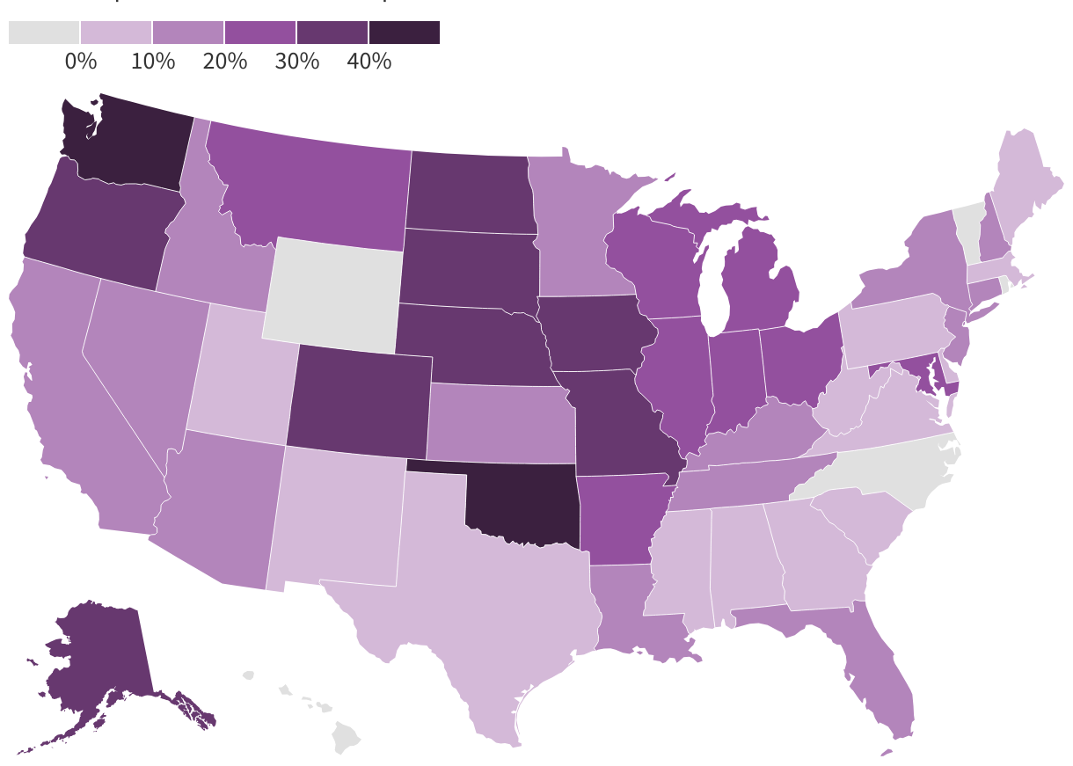
Percent of Births in Catholic Hospitals
550,000 births occur in Catholic Hospitals
Credit: Hannah Recht/KFF Health News

Slide 47
Impact on Reproductive Health
Risk of infection, hemorrhaging, and other complications
Increased risk of maternal mortality
Severely limits access to overarching reproductive healthcare
Exacerbates racial and ethnic disparities

Slide 48
State-Level Policy Solutions

Slide 49
State Regulatory Landscape Over Health Care Consolidation
Key Players with Oversight Authority
Primary Actions
Attorneys General (AG) – antitrust, non-profit / charities
State Public Health Departments – Certificate of Need, licensing
Other State Agencies/Oversight Entities – policy oversight
Broad Antitrust Enforcement Statutes and Merger Review Processes
Authority to Seek Injunction to Block Merger
Impose Conditions on Merger Approvals
Oversight and Regulation Health Care Facility Licensing
State

Slide 50
Strategies to Address Hospital Consolidation
Strengthen Merger Oversight
Impose Merger Conditions
Reviewing Agencies Need:
Authority to gather information for review (from merging entitites)
Staff and resources to investigate
Political autonomy to act and decline merger
Address Root Causes of Consolidation (Medicaid Reimbursement, for instance)
Notes:
Reviewing agencies should be provided:
The authority to gather necessary information for review (from merging entities and others)
The staff and resources to do the necessary analysis
Political autonomy and/or will to act when a merger raises concern
mpower state agency with direct authority to decline to allow a merger (i.e., through DPH via CON programs/licensing, or other agency)

Slide 51
Key Examples
New York’s Health Equity Assessment Act
Requires an independent assessment of how proposed health facility changes, such as reductions or elimination of services, affects access to care for medically-underserved individuals and communities.
Must include meaningful engagement with community.
Assessment is filed with Certificate of Need application.
Oregon’s New Health Market Oversight Program
Gives the Oregon Health Authority (OHA) jurisdiction over large mergers, acquisitions and affiliations.
Could deny approval if the applicants cannot show the transaction increases access to services in medically-underserved areas, improves health outcomes or reduces patient costs.
Transactions that could cause a loss of services essential to health equity would receive special scrutiny.

Slide 52
Regulating Private Equity
Strategies
More disclosures and data collection
Regulate the type of entity permitted to own health care facilities
Prohibit harmful private-equity tactics (e.g., sale-leaseback of hospitals, leverage buyouts, surprise billing).
Prohibit hospitals from renting property from Real Estate Trusts [MA H.4620, Sec. 117]
Steward owes its landlord (Medical Properties Trust) more than $110M in annual rental payments, contributing to financial distress.
Require 60-days’ notice to DPH before a lender repossesses any “medical device” that is collateral on loan [MA H.4620, Sec. 103]
10/23 incident at Steward where postpartum patient died when she needed an embolization following delivery and necessary equipment had been repossessed due to non-payment.

Slide 53
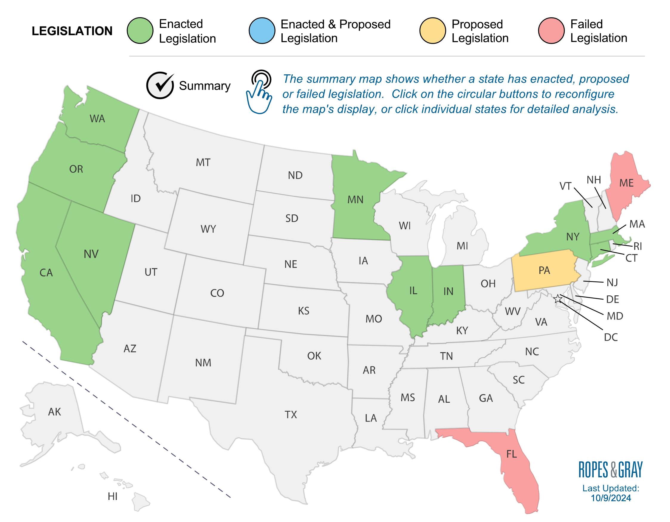
State Laws Governing Health Care Transactions
Notes:
Indiana: As of July 1, 2024, requires health care entities, including medical and dental providers, insurers, administrators, and private equity partnerships entering into transactions with health care companies, to notify the AG before undergoing a merger or acquisition with another health care entity with a value of at least $10 million.
Massachusetts: Health care service providers and provider organizations with more than $25 million in AG, the Center for Health Information and Analysis, and the Health Policy Commission (“HPC”). HPC has 30 days to either approve the transaction or initiate a more in-depth cost and market impact review (“CMIR”), which may delay closing up to 215 days from the initial notice date.

Slide 54
Resources
State Healthcare Consolidation Tracker: https://www.ropesgray.com/en/sites/healthcare-transactions-laws
Community Catalyst’s Action Toolkit for Communities Facing Hospital Consolidation: https://communitycatalyst.org/resource/an-action-toolkit-for-communities-facing-hospital-consolidation
The Source: https://sourceonhealthcareˌorg/

Slide 55
Thank You
Michelle Sternthal
msternthal@communitycatalyst.org

Slide 56
Liz Coyle
Georgia Watch, Executive Director

Slide 57
Liz Coyle, lcoyle@georgiawatch.org Executive Director, Georgia Watch
Our vision: Equity and Justice for All Georgia Consumers
Our mission: To protect and inform consumers so all Georgians prosper and their communities thrive
Nonprofit Hospital Accountability
Healthcare Cost & Quality
Industry Transparency
Patient Safety
Medical Bills & Debt
Affordable Care Act: CHNAs
Medicaid Expansion
Price Transparency

Slide 58
Hospital Consolidations and Closures Across Georgia
The Landscape:
Financial incentives and market pressure drive consolidation across GA.
More profitable hospital systems buy smaller hospitals often located in communities of color or rural areas.
Sometimes larger systems close the less profitable facilities they acquire.
Case in Point:
In 2016 Wellstar Health System acquired Atlanta Medical Center, which served predominantly Black, lower income communities with many patients uninsured or on Medicare or Medicaid.
Citing financial losses, Wellstar shuttered AMC in 2022, having devastating consequences on former patients, the community, and the surrounding health system. These consequences reverberate to this day.
“Now if I get sick, I don’t know where I’ll go or how I’ll get there. It’s just so scary.”

Slide 59
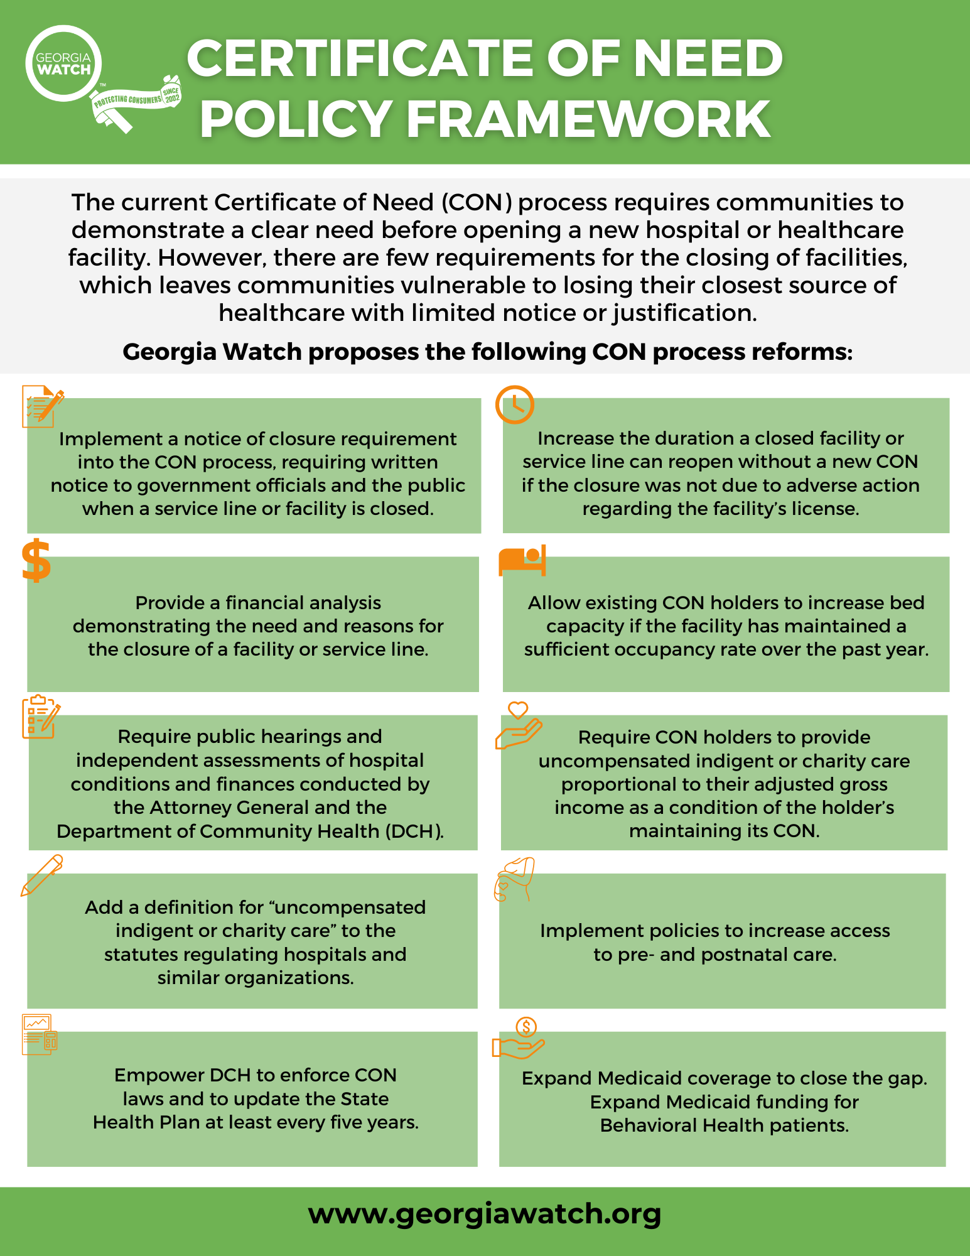
Hospital Consolidations and Closures Across Georgia
Georgia Watch’s Hospital Accountability Framework seeks to protect consumers as they engage with Georgia’s hospital systems. Recent legislation modernizing the Certificate of Need (CON) process and increasing hospital accountability are one step towards increasing healthcare consumer protections.
Policy Recommendations:
Codify Community Benefit spending
Improve Hospital Authority governance
Implement Certificate of Don’t Need

Slide 60
Solutions to Counter High Cost of Care Amid Hospital Consolidation
Codify Community Benefit Spending
Require uncompensated indigent or charitable care spending that meets or exceeds five percent of adjusted gross revenue to maintain nonprofit status and tax exemption.
Create a methodology to assign minimum community benefit spending floors to hospitals every two years to clearly align hospital tax breaks with free and reduced care.
Increase hospital notification of the availability of financial assistance to low-income patients and increase screening for eligibility.
Improve Hospital Authority Governance
Require that the hospital CEO and/or CFO report to the Hospital Authority board at least quarterly regarding the financial health of the hospital in open meetings.
State that no current employee of a hospital operated by a hospital authority or of a nonprofit organization that leases assets from a hospital authority may serve as a member of the hospital authority board.
Require that each hospital authority board contain at least one community resident with a household income at or below 200% of the federal poverty level and who will be provided with a $100 monthly stipend for participation.

Slide 61
Solutions to Prevent Future Destabilizing Closures
Implement Certificate of Don’t Need
Increase notice of closure, elimination of a service line, or conversion to a free- standing ED from 30 days to 180 days.
Ensure hospitals provide financial analysis to the Dept. of Community Health and the Attorney General before closure is an option.
This financial analysis will:
Include an overview of the hospital's patient population
Be made publicly available on the DCH Website

Slide 62
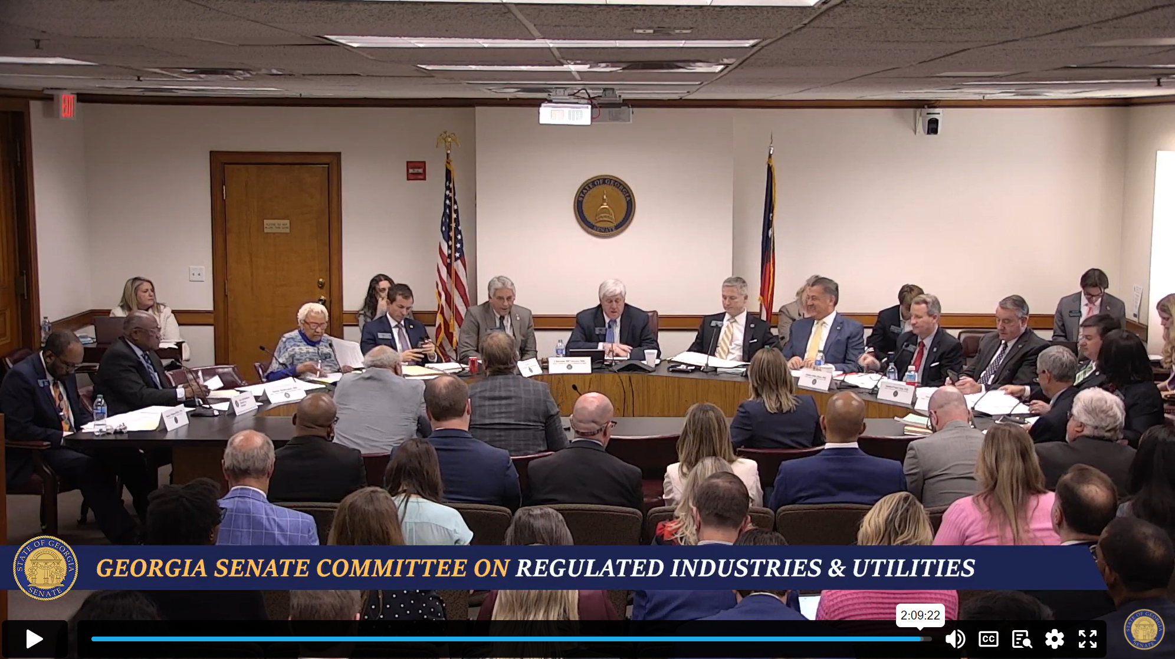
Looking Ahead to Next Session
State’s alternative to Medicaid expansion continues
New state-based marketplace rolls out
Republican appetite for hospital accountability remains strong
Comprehensive Health Coverage Commission will advise on access and quality of healthcare for Georgia’s low-income and uninsured populations

Slide 63
Q&A
Notes:
Now we will proceed to our Q&A session. If you have any questions for our presenters, please put them in the chat and we can discuss them.

Slide 64
Thank You Please send all questions and comments to: Alexandra.Allen@altarum.org Beth.Beaudin-Seiler@altarum.org
Special thanks to our panelists, our funders, the Robert Wood Johnson Foundation, and Webinar attendees.
HubInfo@altarum.org
linkedin.com/company/healthcarevaluehub
With support from Arnold Ventures and the Robert Wood Johnson Foundation, the Healthcare Value Hub provides free, timely information about the policies and practices that address high health care costs and poor quality, bringing better value to consumers. The Hub is part of Altarum, a nonprofit organization with the mission of creating a better, more sustainable future for all by applying research-based and field-tested solutions that transform our systems of health and health care.
Notes:
Thank you all so much for attending this webinar, we are excited to contribute to everyone’s understanding of hospital consolidation and the different ways that advocates and policymakers can respond to these issues.
The slide deck and recording for this webinar will be published to our website in the coming days, and if you have any questions, please feel free to email us at the addresses listed above.
Thank you and have a great day!

