Slide 1
Facing the Future: Understanding Federal Policy Changes and their Effect on Coverage and Affordability
April 8, 2026
Notes:
Good afternoon, everyone, and thank you for joining us for today’s webinar “Facing the Future: Understanding Federal Policy Changes and their Effect on Coverage and Affordability.”
My name is Britt Sanderson, and I am a policy analyst with Altarum’s Healthcare Value Hub. I’ll be facilitating and running some of the technology today.

Slide 2




Housekeeping
Please keep your audio muted during the presentations. We will take audience questions during the panel discussion, time permitting.
Please refrain from using the chat feature for questions. Presenters and audience members may use the chat to share resources, related publications, or contact information.
Please submit all panelist questions via the Q&A feature. Answers may be given live or shared privately or publicly for all attendees.
The webinar is being recorded, and all slides and resources will be uploaded to the Healthcare Value Hub website.
Notes:
Before we begin, I’d like to go over a few items so you know how to participate in today’s event.
First, please keep your microphone muted during the presentations. If you are unmuted during a presentation, we may mute your microphone manually.
We’d also like to ask you to refrain from using the chat unless you are connecting with other attendees or need technical assistance.
If you have questions for the panelists, please submit them using the Q&A feature at the bottom of the screen. You may send in your questions at any time, and we will collect these and address them during the Q&A session at the end of today’s presentation.
Finally, the webinar is being recorded, and the recording and slides will be uploaded to the Healthcare Value Hub website following the Webinar.

Slide 3
Agenda
3:00 pm | Welcome and Introduction | Britt Sanderson, MS, MPH Altarum Institute
3:05 pm | Introduction to H.R. 1 | Mary Rozga, PhD, RDN Altarum Institute
3:15 pm | H.R. 1 Impacts on Medicaid | Laura Harker, MPH Center on Budget and Policy Priorities
3:25 pm | Existing Affordability Burdens among Medicaid Enrollees | Alexandra Allen, MSPPM Altarum Institute
3:30 pm | Existing Affordability Burdens among Marketplace Enrollees | Megan Szalwinski, MSW Altarum Institute
3:35 pm | H.R. 1 Impacts on Marketplace Coverage | Dan Meuse, MBA State Health and Value Strategies
3:45 pm | Panel Discussion | Britt Sanderson, MS, MPH Altarum Institute
3:55 pm | Adjourn | Britt Sanderson, MS, MPH Altarum Institute
Notes:
Over the next hour we will be hearing from policy experts across Altarum, the Center on Budget and Policy Priorities, and State Health and Value Strategies.
We will start with an overview of the 2025 Budget Reconciliation Act, which may also be referred to as “H.R.1” or the “One Big Beautiful Bill Act.”
From there, we will discuss the anticipated impacts of the federal policy changes included in H.R.1 on Medicaid and Marketplace enrollees, and how these may contribute to existing affordability burdens identified in Consumer Healthcare Experience State Surveys, or “CHES” surveys.

Slide 4
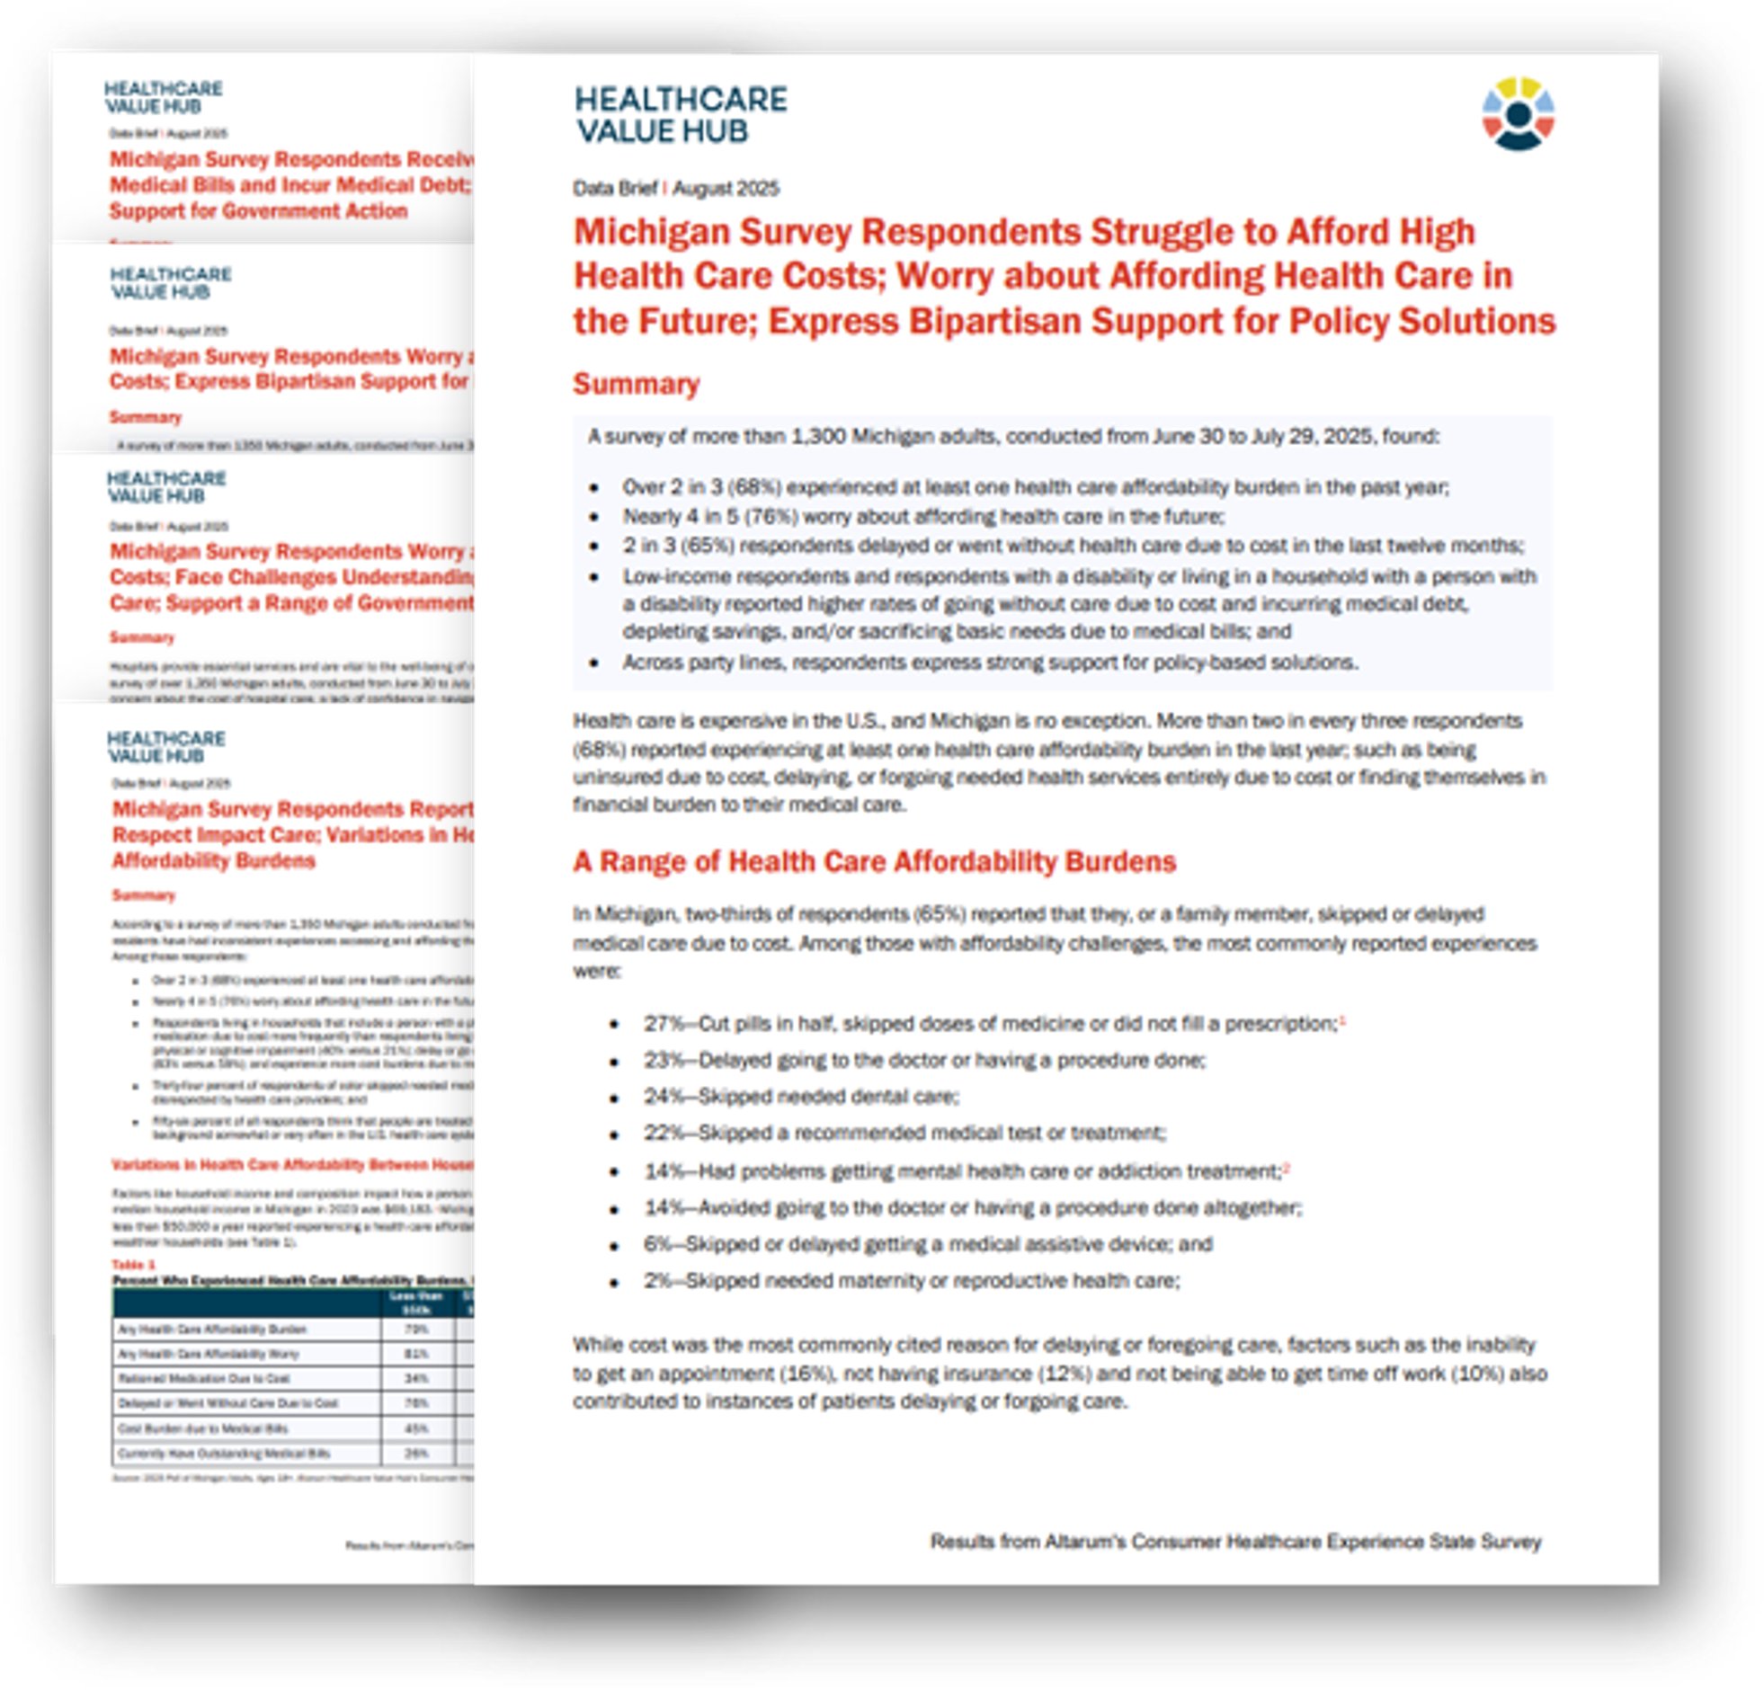
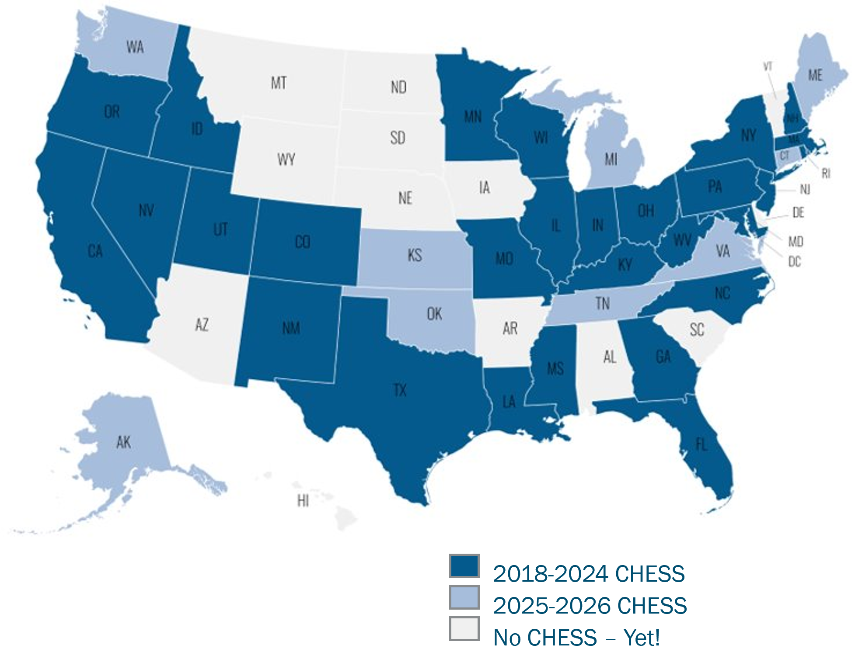
About Altarum’s Healthcare Value Hub
Consumer Healthcare Experience State Survey (CHESS)
Notes:
In case you are not familiar with the CHES survey, it examines respondents' perceptions of the health care system, including their experiences with financial burdens that bar access to care or negatively impact a patients’ financial wellbeing.
Conducted in both English and Spanish using a web panel of approximately 1,500 state respondents, the CHESS is designed to elicit perceptions of a wide range of health care issues and quantify state-level challenges related to healthcare affordability, ​medical debt, ​health literacy, ​coverage, trust in the health care system, and ​drug costs. Since 2018, the CHESS has been fielded in thirty-eight states and the District of Columbia.
Later on, Alexandra Allen and Megan Szalwinski will provide an overview of pertinent CHESS results and describe how this data informs our understanding of existing burdens and what we expect to see moving forward.
I would now like to introduce Dr. Mary Rozga, Evaluation Project Manger with Altarum, who will be providing our overview of H.R.1 – hi Mary!

Slide 5
Overview: The Scale of Impact
What is H.R. 1?
The “One Big Beautiful Bill Act” (H.R. 1) is a budget reconciliation bill that restricts Medicaid and Marketplace health coverage. The bill was signed into law July 4, 2025.
10 million Americans lose health coverage by 2034.
$1.2 trillion cut from federal health programs over two years.
Coverage Loss Breakdown
7.5 million from Medicaid/CHIP provisions
2.4 million from private health insurance (Marketplace) provisions
Most Affected
Working families, small business owners, rural communities, lawfully present immigrants
References: Congressional Budget Office 2025 (A); Congressional Research Service 2025 (A); Georgetown University Center for Children and Families (Park et al) 2025
Notes:
I want to start by grounding us in what H.R. 1 actually is and why it matters.
H.R. 1, the One Big Beautiful Bill Act, is a budget reconciliation law that was signed in July 2025. It made very large, permanent changes to both Medicaid and the Marketplace.
When we talk about impact, the headline number comes from the Congressional Budget Office: about 10 million people are projected to lose health coverage by 2034. That’s not a short‑term blip — it’s a sustained increase in the uninsured.
Those losses are driven by roughly $1.2 trillion in federal health cuts over ten years. Most of that comes from Medicaid and CHIP, with additional losses in Marketplace coverage.
What’s important to flag now — and I’ll come back to this — is that these losses come from a variety of provisions that make it harder to navigate, stay on and pay for coverage.

Slide 6


Impact on Medicaid Enrollees: New Barriers
    Work/Community Engagement Requirements
    Requirement: adults 19-64 must complete 80 hours per month of work, job training, education, or volunteer activities.
    Implementation: January 1, 2027
    Exemptions: pregnancy and postpartum, medially frail individuals, full-time students, parents/caretakers of individuals with disabilities, foster youth, and others.
    5.3 million people projected to lose coverage
    Increased Renewal Frequency
    Current: Prove eligibility once every 12 months
    New: Prove eligibility every 6 months (starting January 2027)
References: Center for Health Care Strategies 2025; Congressional Research Service 2025 (A)
Notes:
Let’s talk about Medicaid first, because that’s where most of the coverage loss occurs.
The biggest driver is the new work or community engagement requirement. Starting in 2027, many adults will have to document 80 hours per month of work, training, education, or volunteering.
About 5.3 million people are projected to lose Medicaid coverage because of this requirement. And based on past evidence, most of these individuals are already working or qualify for an exemption. The coverage loss happens because people miss notices, can’t navigate reporting systems, or don’t understand what’s required of them.
At the same time, H.R. 1 increases how often people have to prove they’re eligible for Medicaid. Instead of renewing once a year, many enrollees will now have to complete the process every six months, starting in 2027.
That may not sound dramatic, but research shows that a large share of Medicaid coverage loss happens at renewal — not because people are ineligible, but because paperwork isn’t completed correctly or on time. Doubling the number of renewal deadlines doubles the opportunities for people to fall off coverage.
So even before we get to the additional changes in the next slide, these two administrative shifts alone — work reporting and more frequent renewals — create a lot more churn in Medicaid.
Medicaid Work Requirements — Results from the First Year in Arkansas | New England Journal of Medicine

Slide 7



Impact on Medicaid Enrollees: Additional Barriers
    Reduced Retroactive Coverage
    Current: 3 months
    New: 2 months (most), 1 month (expansion adults)
    People liable for medical bills before application approval.
    New Cost-Sharing Requirements
    Starting 2028: Expansion adults above 100% FPL will have more out-of-pocket costs
    Primary care, mental health exempt.
    New costs for previously free services.
    Unintended Impact on Children
    Up to 1.5 million children may lose coverage
    Affected by administrative errors and confusion over parental coverage. Families with uninsured parents face medical debt threats.
References: Congressional Research Service 2025 (A); Georgetown University Center for Children and Families (Brooks et al) 2025
Notes:
And those aren’t the only barriers H.R. 1 introduces.
Another is reduced retroactive coverage. Today, Medicaid can cover care from up to three months before someone’s application is approved. Under H.R. 1, that window shrinks — in some cases to just one month. For those who aren’t familiar, this refers to adults 19-64 with incomes up to 138% of FPL who became eligible for Medicaid under ACA. That means people can be left holding medical bills even though they ultimately qualify.
Another change is new cost‑sharing for some expansion adults starting in 2028. Services that used to be free may now come with out‑of‑pocket costs, which can be a real deterrent for low‑income households.
And importantly, children are affected too. Even though many children remain technically eligible, up to 1.5 million may lose coverage because of administrative spillover when parents lose or cycle off Medicaid

Slide 8
H.R.1 Impact on Marketplace Coverage
2.4 million people will lose Marketplace coverage due to H.R. 1 provisions
Immigrant Eligibility Restrictions (up to 1.2 million)
Coverage limited to: Lawful Permanent Residents, Cuban/Haitian entrants, COFA migrants
Subsidies eliminated with incomes below 100% FPL.
Refugees, asylees and trafficking victims lose affordable coverage.
Enrollment Period Restrictions (up to 1.1 million)
No year-round enrollment for people below 150% FPL
Auto-reenrollment ends; enrollment paused until paperwork complete
Tax Credit Verification and Repayment (100,000)
Caps removed: Families repay all excess subsidies if actual income exceeds projections
New verification and tax filing requirements
References: Congressional Budget Office 2025 (B); Congressional Research Service 2025 (A)
Notes:
Now shifting to the Marketplace, where 2.4 million people are projected to lose coverage due directly to H.R. 1.
A major driver here is new eligibility restrictions for immigrants. About 1.2 million lawfully present immigrants lose access to subsidized Marketplace coverage, even though they are working, paying taxes, and living legally in the U.S.
On top of that, enrollment becomes more rigid. Auto‑reenrollment ends, special enrollment opportunities shrink, and people can lose coverage simply because paperwork isn’t completed on time.
Finally, repayment protections disappear. If someone underestimates their income and receives excess tax credits, there’s no longer a cap on how much they owe back.
credit no longer available to noncitizens (900,000), removes eligibility for the credit from anyone whose income is below 100 percent of the FPL (300,000)
people to actively affirm their eligibility to enroll in marketplace coverage (700,000), changes to the special enrollment period (400,000)

Slide 9
Additional Marketplace Losses
Enhanced Premium Tax Credits Expired End of 2025
3.8 million more people lose coverage without the extension of subsidies
What Expired?
Enhanced credits from 2021 American Rescue Plan, extended by Inflation Reduction Act through 2025 expired December 31, 2025.
The Impact
Premiums increase 114% on average (~$1,016 more per year)
Example: Family of four at $110K sees premiums jump from $7,755 to $10,956 annually.
10.9 million with lower incomes (100 – 150% FPL) face premiums rising from $0 in 2025 to 4% of income.
This coverage loss is separate from H.R. 1 Marketplace cuts (2.4 million from last slide)
References: Bipartisan Policy Center (Patzman et al ) 2025; Congressional Budget Office 2025 (B) ; Congressional Research Service 2025 (B); Kaiser Family Foundation (Lo et al) 2025
Notes:
This slide is important because it shows something that’s separate from H.R. 1 but compounds its effects.
The enhanced premium tax credits that were created during the pandemic expired at the end of 2025. H.R. 1 did not extend them.
As a result, the CBO estimates an additional 3.8 million people will lose Marketplace coverage over the next several years. And many who remain insured face dramatic premium increases.
On average, premiums more than double. People who paid nothing in premiums now have to pay hundreds of dollars a year.
These are two separate coverage hits: about 2.1–2.4 million from H.R. 1 Marketplace provisions and roughly 3.8 million from the expiration of enhanced tax credits.

Slide 10




Who Loses Coverage?
Communities Facing the Largest Impact
Rural Americans
$137B cut to rural Medicaid funding (10 years).
$50B Rural Health Fund offsets only 37% of cuts. Many rural hospitals already in the red.
Communities of Color
Medicaid is a major source of coverage.
Medicaid cuts and ACA changes will widen coverage disparities.
Workers and Entrepreneurs
48% of Marketplace enrollees are small business owners/employees or self-employed.
Includes gig workers, freelancers, contractors, early retirees.
Lawfully Present Immigrants
1.2M lose Marketplace coverage.
Includes DACA recipients, work visa holders and their families, and individuals in immigration proceedings.
References: Center on Budget and Policy Priorities (Lukens) 2025; Congressional Budget Office 2025 (B); Congressional Research Service 2025 (A); Kaiser Family Foundation (Levinson et al, McGough et al, Ndugga et al) 2025
Notes:
These coverage losses don’t fall evenly across the population.
Rural communities face a particularly serious challenge. H.R. 1 cuts $137 billion in Medicaid funding to rural areas, and the rural health fund only partially offsets that loss.
Workers and entrepreneurs are heavily affected because nearly half of Marketplace enrollees are self‑employed or work for small businesses.
Communities of color are disproportionately impacted because Medicaid is a major source of coverage and these cuts widen existing disparities.
And lawfully present immigrants — including people with work visas and DACA recipients — lose access to affordable coverage entirely.

Slide 11


The Ripple Effects
Beyond Coverage Loss
Healthcare System Impact
Uncompensated care to increase 35% in rural hospitals.
100+ rural hospitals at risk of closure by 2034.
Federally qualified health centers to lose 5-7 million patients as revenues fall.
Economic Impact
1.2M job lost across healthcare and related sectors.
State economies could contract by $154B annually by 2029.
$12B annual loss in state and local tax revenue.
Public Health Impact
Up to 16,642 additional deaths annually by 2034.
145,000+ preventable hospitalizations each year.
8.7 million estimated to delay or forgo needed care due to cost.
References: Basu et al 2025; Gafney et al 2025; Nichols et al 2025; Commonwealth Fund 2026
Notes:
When people lose coverage, the consequences don’t stop with insurance status.
Health systems see more uncompensated care, especially rural hospitals and community health centers. Over 100 rural hospitals are projected to be at risk of closure.
Economically, these changes ripple outward — job losses in health care, reduced state and local tax revenue, and weaker local economies.
From a public health perspective, studies project more preventable hospitalizations, delayed care, and thousands of additional deaths each year.
These are system‑wide effects, not isolated outcomes

Slide 12
What Happens Next?
Implementation Timeline
Key Implementation Dates
June 1, 2026: CMS must issue interim final rule on work requirements
June 30 - Aug 31, 2026: States must conduct member outreach on work requirements
October 1, 2026: Immigrant eligibility restrictions for Medicaid and CHIP take effect
December 31, 2026: States must implement work requirements
Jan 1, 2027: Work requirements take effect; six-month redeterminations begin; Marketplace restrictions for immigrants
October 1, 2027: Provider tax reductions begin; state-directed payment caps phase in
October 1, 2028: Cost-sharing requirements for expansion adults begin
References: Kaiser Family Foundation 2025; State Health and Value Strategies 2025
Notes:
One thing that stands out is how fast all of this is happening.
CMS guidance, state outreach, and system changes all occur in 2026. By January 1, 2027, work requirements, more frequent renewals, and Marketplace restrictions are all live at once.
States are being asked to build and implement new administrative systems on a very compressed timeline.
As each of these dates hits, coverage disruptions are likely to accelerate

Slide 13




The Path Forward
Key Takeaways
H.R. 1 will increase the uninsured by 10 million by 2034 through Medicaid cuts, work requirements, and administrative barriers.
Enhanced ACA tax credits expired December 31, 2025 – adding 3.8 million more to the uninsured.
Rural communities, communities of color, workers, and immigrants will be disproportionally affected.
What We Can Do…
Monitor Implementation
Track state responses, CMS guidance, and coverage data to understand real-world impacts.
Amplify Voices
Share stories of those affected to illustrate the human impact of these policy changes.
Advocate for Policy Solutions
Urge Congress to extend enhanced tax credits and protect Medicaid funding at federal and state levels.
Support Affected Communities
Connect affected populations with enrollment assistance, appeal rights, and alternative coverage options.
Notes:
So to wrap up, the big picture is this: H.R. 1 increases the uninsured through a combination of funding cuts and administrative barriers, and the expiration of enhanced tax credits adds to that problem.
Certain communities — rural residents, workers without employer coverage, immigrants, and communities of color — face disproportionate harm.
What we can do now is monitor implementation closely, support people navigating these changes, and use both data and lived experience to show what’s happening on the ground.
This isn’t just about policy — it will have real measurable impacts on the population nationwide.

Slide 14
H.R. 1:
Impact on Medicaid Affordability
Laura Harker, MPH
Center on Budget and Policy Priorities

Slide 15
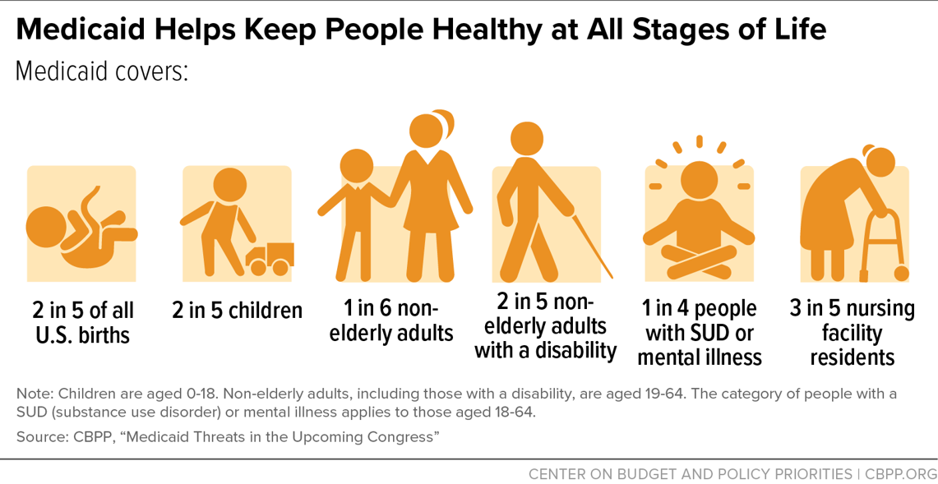
Medicaid Enrollment & Coverage Overview
About 76 million people are enrolled in Medicaid/CHIP
  19% decline from March 2023, when the COVID-19 continuous enrollment provisions ended. But 6% higher than pre-pandemic enrollment nationally.
States must cover “mandatory” populations and benefits to get federal funding. Many states also cover “optional” populations and benefits (e.g., extending income limits for children; covering home and community-based services).
Ten states have not adopted the ACA’s Medicaid expansion, leaving nearly 3 million uninsured adults without a path to Medicaid coverage
CMS, December 2025 Medicaid and CHIP Enrollment; KFF, Medicaid Enrollment and Unwinding Tracker; CBPP, Policy Basics: Introduction to Medicaid; CBPP, Nearly 3 Million Uninsured Adults Would Gain a Path to Medicaid Coverage if Their States Adopted ACA Medicaid Expansion; CBPP, Medicaid Plays an Important Role in Providing Health Coverage to Key Populations

Slide 16
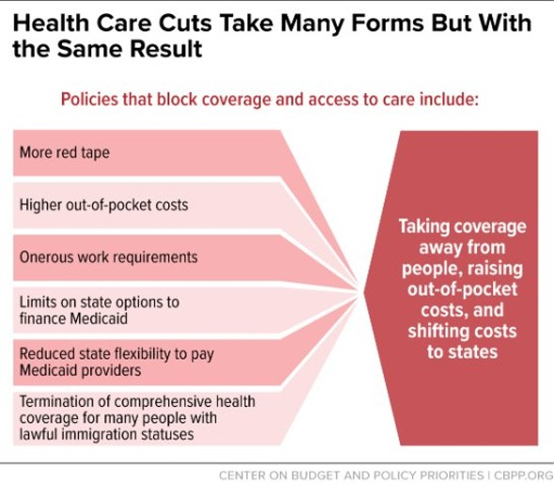
Medicaid Coverage Losses Due to H.R. 1
Cuts Medicaid by more than $900B, largest cut in program history.
Work requirements put coverage at risk for between 9.9 and 14.9 million people.
Experience shows that some people who are working or should be exempt would lose coverage due to red tape, but states can make choices to mitigate coverage loses.
CBPP, By the Numbers
Notes:
Voice over the points from the graphic to explain the factors driving coverage losses.
*In more red tape- briefly mention 6-month redeterminations (they were introduced in the beginning slides).
*Higher out of pocket costs – mention mandatory cost sharing for expansion enrollees above poverty line
*Expected coverage losses from provider tax limitations is 1.2 million and from termination of Medicaid funding for lawfully residing immigrants is 100K.
Second box: CBO estimates 4.8 million coverage loss from work reqs, but this could be higher.

Slide 17
Impacts on Affordability & Access for Medicaid Enrollees
Delayed Care and Increased Medical Debt
Many people losing coverage will become uninsured because they won’t have other affordable health coverage options
  Two-thirds of people had a period of uninsurance in the year following disenrollment from Medicaid or CHIP
Coverage losses and policies such as restrictions on retroactive coverage, will leave people with higher medical bills and less financial security
  New medical debt dropped 34 percentage points more over the same period in states that expanded Medicaid in 2014 than in states that did not
  Rising health care costs will increase hardship for families already struggling to meet basic needs, such as food, rent and other household necessities
Children will be less likely to get the care they need, if their parents lose health coverage due to policies like work requirements and more frequent redeterminations
KFF, What Happens After People Lose Medicaid Coverage?; CBPP, Medicaid Expansion: Frequently Asked Questions; CBPP, Taking Away Medicaid for Not Meeting Work Requirements Harms Children

Slide 18
Impacts on Affordability & Access for Medicaid Enrollees
Increased Out-of-Pocket Costs
New required cost-sharing for working people with incomes just above the poverty line ($16,000 year for an individual) who are enrolled in the Medicaid expansion
  Starting October 1, 2028, states could charge cost-sharing up to $35 per non-exempt service for this group. States can permit providers to deny services to any non-exempt expansion adults who can’t make the payment.
Research shows that even relatively small levels of cost-sharing for people with lower incomes is associated with reduced use of care, worse health outcomes, and increased financial burden
H.R. 1 blocks Biden administration rules to streamline Medicaid eligibility and enrollment processes, making it harder for seniors and disabilities to get and stay enrolled in Medicaid
  Dual-eligible seniors use Medicaid coverage to help keep their Medicaid coverage affordable
Georgetown CCF, Medicaid, CHIP, and Affordable Care Act Marketplace Cuts and Other Health Provisions in the Budget Reconciliation Law, Explained, KFF, Understanding the Impact of Medicaid Premiums & Cost-Sharing: Updated Evidence from the Literature and Section 1115 Waivers
Notes:
On cost sharing, if asked about exemptions: primary care services; mental health care services; substance use disorder services; and services furnished by a Federally Qualified Health Center, certified community behavioral health clinic and rural health clinic are made newly exempt.

Slide 19
Impacts on Affordability & Access for Medicaid Enrollees
Fewer Available Health Care Providers
Many states use state directed payments (SDPs) to increase provider reimbursement rates and ensure an adequate network. These are often funded by provider taxes. H.R. 1 put limits on both SDP rates and on new or increased provider taxes.
  Providers will likely see lower payment rates on top of increased uncompensated care due to coverage losses.
Hospitals may close or eliminate important services such as obstetrics care
  Rural hospitals are especially at risk and H.R. 1’s Rural Health Transformation Fund is insufficient to make up for the loss in payments to providers
Increased strain on providers who serve more people who are uninsured, such as community health centers and public hospitals who may struggle to stay open
Loss of health care providers will impact people with all types of health coverage, not just Medicaid enrollees
CBPP, Medicaid Cuts Would Reduce Access to Health Care for Entire Communities
Notes:
Ban on Planned Parenthood and other abortion providers for one year, will limit access to reproductive health and other services. There is ongoing litigation on this provision.

Slide 20
State Responses to H.R.1 Medicaid Changes
States will have to make tough choices to make up for lost funding due to federal Medicaid cuts and limits on their ability to raise revenue through provider taxes. And many state budgets are already constrained due to state policymakers passing tax cuts in recent years
States must either find new funding sources and/or make cuts to Medicaid, such as:
  Reducing provider reimbursement rates – destabilizes providers, limits access for patients,
  Eliminate or reduce optional benefits – home and community-based services for people with disabilities are especially at risk
  Restrict eligibility – states could consider rolling back coverage for “optional” groups or adding more barriers to coverage beyond required by H.R. 1
States can make implementation decisions to minimize coverage losses or adopt policy options to cover more groups such as immigrant children and pregnant people
CBPP, States’ Recent Tax-Cut Spree Creates Big Risks for Families and Communities; CBPP, Medicaid Cuts Would Reduce Access to Health Care for Entire Communities
Notes:
*On HBCS at risk: Federal attacks around waste, fraud and abuse have singled out HCBS, which seems to be driving the risks at the state level. Can mention Idaho as an example of recent cut to HCBS rates
*On states adding more barriers: Examples include states seeking more frequent redeterminations beyond groups required and prohibiting self attestations. These would require federal approval. These are as much about ideology as they are about saving more money b/c adding red tape is not efficient for states.

Slide 21
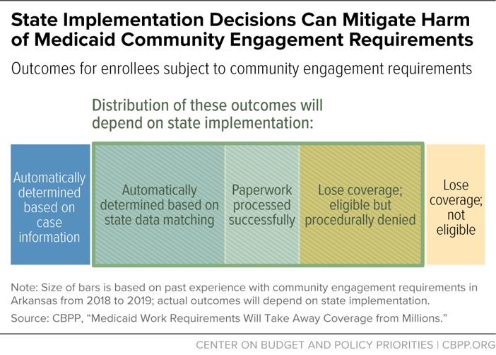
State Responses to H.R. 1 Medicaid Changes Cont.
CBPP, A Guide to Reducing Coverage Losses Through Effective Implementation of Medicaid’s New Work Requirement

Slide 22
Health Care Affordability Burdens:
Medicaid Enrollees
Alexandra Allen
Notes:
Hello everyone, my name is Alexandra Allen and I’m here today to discuss CHESS survey results capturing healthcare affordability burdens among Medicaid enrollees.
[Next Slide]

Slide 23
Median Percentage of Respondents who Experienced
Any Health Care Affordability Burdens, by Insurance Type (2021-2025)
Notes:
Looking at all surveys taken from 2021 through 2025, we see that 8 in 10 Medicaid enrollees reported healthcare affordability burdens, the highest rate compared to other insurance types.
Healthcare affordability burdens include a variety of issues, including going without care due to cost, rationing medication, and experiencing financial burdens due to medical bills.
[Next Slide]

Slide 24
Median Percentage of Respondents who Experienced
Any Health Care Affordability Burdens, by Insurance Type and Year (2021-2025)
Notes:
This pattern has been consistent across years – in each year we see Medicaid enrollees reporting the highest rates of affordability challenges.
[Next Slide]

Slide 25
Median Percentage of Respondents who
Went Without Care Due to Cost by Insurance Type
Notes:
In addition, Medicaid enrollees reported the highest median rates of going without care due to cost at a median of 3 in 4 respondents.
Now, one might ask “Medicaid is supposed to cover everything at no cost, why are Medicaid enrollees going without care at such high rates?”
Here the surveys’ open text responses help us understand what’s happening.
[Next Slide]

Slide 26
Text Responses Show…
Limited Coverage for Certain Services for Medicaid Enrollees
Dental Care
“Dental is not covered by my insurance. Living with pain because of lack of coverage and had tooth pulled instead of a cavity filled because of the expense.”
-- Utah, 2023
Vision Care
“I need glasses, my insurance doesn’t cover vision therefore I have trouble reading and seeing when I drive.”
- Pennsylvania, 2023
Prescription Drugs
“Prescriptions sometimes aren’t covered by Medicaid.”; “Ended up quitting my anxiety, PTSD and depression meds because unable to afford them.”
-- Utah, 2023
Specialty Care
“I need a back surgery for disc replacement and my insurance didn’t cover the procedure and the cost was too much for my family to afford out of pocket.”
-- Washington, 2025
Notes:
We see Medicaid enrollees report a lack of coverage for services like dental care, behavioral health, prescription drugs, and specialty care. When services are not covered, they must pay out-of-pocket, which many low-income household cannot afford, so they go without care.
And even if a service is covered by Medicaid, some low-income households don’t want to risk getting a large bill.
[Next Slide]

Slide 27
Text Responses Show…
Limited Network Adequacy for Medicaid Enrollees
Dental Care
“I have insurance that only has like two dentists in my entire state that I’m covered by. I cannot find a good dentist.”
-- Washington, 2025
Behavioral Health Care
“I had to completely stop all therapy appointments because she did not take my insurance and I had to pay $100 out of pocket for every session”
-- Oregon, 2024
Specialty Care
“I don’t have a car…the nearest specialist that takes my insurance is at least 30-40 minutes away. I can sometimes get my friends/family to give me rides to/from appointments, but they need gas money and that is high.”
-- Ohio, 2024
Assistive Devices
“I needed a hearing aid but there is no doctor near me that [accepts] my insurance for the hearing aid.”
-- New York, 2020
Notes:
In addition, respondents report providers in their area don’t accept Medicaid, including dentists, specialists, and therapists, forcing them to either go without care or see an out-of-network provider and pay out-of-pocket. Again, they may go without care because the cost is too high.
[Next Slide]

Slide 28

Financial Burdens due to Medical Bills
50%
of Medicaid respondents experienced financial burdens due to medical bills.
Used up all or most of their savings
Sacrificed basic necessities, such as food, heat, or housing;
Borrowed money
Got a loan or take out another mortgage
Used a crowdfunding platform to solicit donations
Interacted with a collections agency
Went into credit card debt
Placed on a long-term payment plan
Declared bankruptcy
*Only includes surveys conducted from 2022-2025, excluding states where one or more insurance types did not have sufficient sample size to report separate estimates or were combined.
Notes:
While some go without care, others DO get care, but experience financial burdens as a result.
From 2022 through 2025, a median half of Medicaid respondents experienced some financial burden due to medical bills, including:
Using up all or most of their savings
Sacrificing basic needs like food, heat, or housing;
Borrowing money or going into credit card debt
Bills going to collections or declaring bankruptcy
[Next Slide]

Slide 29
Median Percentage of Respondents who Experienced
Overdue Medical Bills by Insurance Type
Notes:
Medical debt is also an issue -- roughly 1 in 3 Medicaid respondents had an overdue medical bill, the highest of any insurance type. Overdue bills that go to collections can reduce patients’ credit scores, which affects renting, car loans, and other essential needs, as well as potential wage garnishment or liens placed on homes.
Medical debt also negatively impacts overall mental health, contributing to a “downward spiral of ill-health and financial precarity” according to Undue Medical Debt.
Sources:
https://www.medicarerights.org/medicare-watch/2025/07/31/federal-court-reverses-federal-medical-debt-protections
https://unduemedicaldebt.org/medical-debt-money-and-mental-health/

Slide 30
Median Percent Worried About
Losing Health Insurance (2021-2025)
Notes:
In addition to issues in the present, respondents also worry about losing coverage in the future—Medicaid enrollees reported the highest rates worry about losing their health insurance of all insurance types at 50%.
This makes sense for a few reasons—if a Medicaid enrollee’s income goes up too much, they lose their insurance. For those who earn close to the threshold or have variable income, any change could cause them to lose coverage. In addition, state and federal governments can cut their coverage at any time based on budgets or political will. In the wake of Medicaid cuts and changes under HR1, enrollees may be aware of this public discourse and its potential impact on their coverage.
[Next Slide]

Slide 31
Key Takeaways
CHES Survey data consistently shows that:
Medicaid enrollees experience healthcare affordability burdens at higher rates than those with other insurance types, including:
  Going without care due to cost
  Overdue medical bills
Medicaid enrollees face affordability challenges due to:
  Limited coverage for certain services, including dental care, behavioral health services, certain prescription drugs
  Lack of providers who will accept their coverage (network adequacy) forcing them to pay out-of-pocket costs or go without care due to cost
Medicaid enrollees report higher rates of worry about losing their health insurance than those with other insurance type
Potential H.R. 1 Implications:
Challenges affording services no longer covered due to funding cuts.
Challenges affording new Medicaid cost-sharing.
Worry about losing Medicaid coverage due to work requirements, increased eligibility checks, reduced populations covered due to funding cuts.
Notes:
In summary, the CHESS survey data consistently shows that:
Medicaid enrollees experience healthcare affordability burdens at higher rates than those with other insurance types
They face affordability challenges due to Limited coverage for certain services and lack of providers who will accept their insurance; and
Medicaid enrollees report higher rates of worry about losing their health insurance than other insurance type
Referring back to Laura’s explanation of HR1’s impact on state Medicaid programs, we can see how these issues could be exacerbated by these policy changes, including:
Going without care due to cost for services that are cut, capped, or limited due to reduced state Medicaid budgets;
Challenges affording new cost-sharing required for those earning over 100% FPL; and
Worry about losing coverage due to work requirements, increased eligibility checks, or state-imposed limitations on who is eligible
While Medicaid is a prime focus of HR1, ACA marketplace enrollees are also deeply affected by reduced premium tax credits and eligibility changes in the legislation. So next, I’ll hand it over to my colleague Megan to examine affordability challenges among marketplace enrollees captured in the CHESS surveys.

Slide 32
Health Care Affordability Burdens:
Marketplace Enrollees
Megan Szalwinski
Notes:
Hello everyone,
My name is Megan and I am going to talk to you all briefly today about affordability burdens experienced by marketplace enrollees.
To make sure we are on the same page before we jump in, I want to clarify that Marketplace Enrollees are individuals that have health insurance they have purchased on their own through the Health Insurance Marketplace which was established by the Affordable Care Act in 2010.
Our next speaker will cover more of this information and we heard a little about this at the beginning of this webinar, but it is important to note that Marketplace Enrollees will be facing many changes because the new Administration and H.R.1, including the increase of the health insurance premiums by substantial amounts, reduced enrollment periods, immigrant eligibility restrictions, and changes in tax requirements .
As a result, we are anticipating that many people will go without insurance that were once enrolled in the Marketplace, and that those who can maintain Marketplace insurance will experience an increasing number of affordability burdens.
Let’s look at some numbers for this group through 2025!

Slide 33
Median Percentage of Respondents who Experienced Any Health Care Affordability Burdens (2021-2025), by Insurance Type
Notes:
The first set of data we will look at is median percentages of respondents who experienced any health care affordability burdens during CHESS years.
Marketplace Enrollees are represented in the red and as you can see from the chart, have consistently been the group with the second most reported frequency of experiencing any health care affordability burdens each year the CHESS was administered. Burdens captured in this chart include but are not limited to skipping dental care, avoiding the doctor, rationing medication, or delaying getting a procedure done due to cost.

Slide 34
Median Percentage of Respondents who Experienced Any Health Care Affordability Burdens (2021-2025), Marketplace Enrollees
Notes:
This chart shows us the same numbers as the last slide, except we are only looking at the numbers for Marketplace Enrollees.
When looking at this data, we can see the trend in rising affordability burdens from 2021 – 2024 for this group. While there was a slight decrease in 2025, it was only by 3 percentage points.
When considering changes coming from the new Administration, one item we will be watching for in future CHESS surveys is this trend increasing for Marketplace enrollees.
As of December 2025, all premium tax credits for Marketplace Enrollees expired. This means that enrollees no longer receive assistance in the form of tax credits to pay for their insurance premiums, making the cost of these plans more expensive for members. Some estimates show that premiums will more than double for individuals and families.
Because of this, it is likely that we will see enrollees opting for coverage that is not as comprehensive as their prior plans to save on cost. Therefore, they may experience higher frequencies of needing health care and no longer having adequate coverage for it despite still having insurance. As a result, this group may have a higher frequency of burdens such as skipping care or rationing medication.
Now we will look at financial burdens due to medical bills, by insurance type.
ACA enrollees go uninsured after enhanced subsidies expire: KFF poll

Slide 35
Median Percentage of Respondents who Experienced
Any Financial Burden Due to Medical Bills, by Insurance Type
*Only includes surveys conducted from 2022 – 2025, excluding states where one or more insurance types did not have sufficient sample slide to report separate estimates, or were combined.
Notes:
The chart you see on the screen shows us the median percentage of respondents who reported experiencing a financial burden, such as going into credit card debt or needing to borrow money because of medical bills, by insurance type. Again, marketplace enrollees are in the red and have the highest frequency of this.
So, why might this be?
When we look at some of the CHESS surveys that have been administered across states, this group of individuals often faces the problem of having insurance coverage that only covers part of the medical services they need.
One Marketplace Enrollee respondent in Tennessee on the 2025 CHESS remarked “I am in great need of dental care but even with insurance, I cannot afford the treatment I need. The same thing applies to my chemo meds. The out-of-pocket cost is so high I have to borrow money from others to help pay for it, or skip doses to make it last longer.”
This group also frequently has high rates of high deductibles and copays, making their medical bills more expensive, and therefore more difficult to afford.
Considering these existing barriers and new changes coming from HR1, we are also expecting to see this increase for Marketplace Enrollees.

Slide 36
Median Percentage of Respondents who Expressed
Worry About Losing Health Insurance, by Insurance Type
(2021-2025)
Notes:
This chart shows us the median percentage of respondents who expressed worry about losing health insurance by insurance type for each CHESS year. We are focusing in on the red bars, or the second bar in each grouping.
As we can see, Marketplace enrollees were again the group reporting worry at the second highest frequency, with Medicaid being the top.
Let’s focus in on the Marketplace Enrollee numbers.

Slide 37
Median Percentage of Respondents who Expressed
Worry About Losing Health Insurance
(2021-2025), Marketplace Enrollees
Notes:
As we can see, there has been a small but steady increase in worry for this group from 2022 – 2025. This again is a statistic we will be watching over the coming years and expect to see increase due to the reasons we have been discussing.
Increases in cost for Marketplace Insurance coupled with changes in Medicaid due to H.R.1 have the potential to result in over 15 million people losing insurance.
Already during the most recent open enrollment period, more than a million less people enrolled in marketplace insurance than in 2025.
Additionally, changes such as ending auto-reenrollment and restrictions on immigrant eligibility will make enrollment more challenging or impossible for millions. As these changes continue to trickle down to consumers, we could see a rise in worry about individuals being able to keep their Marketplace insurance.
I am now going to turn it over to Dan who will elaborate more about these changes!
About 17 Million More People Could be Uninsured due to the Big Beautiful Bill and other Policy Changes| KFF Quick Takes
People Who Rely on the ACA Marketplaces Face Mounting Affordability Challenges | Center on Budget and Policy Priorities

Slide 38

H.R.1 Changes to Marketplace Coverage and Enrollment
Healthcare Value Hub H.R.1 Webinar
April 8, 2026
A grantee of the Robert Wood Johnson Foundation

Slide 39
About State Health and Value Strategies
State Health and Value Strategies (SHVS) assists states in their efforts to transform health and healthcare by providing targeted technical assistance to state officials and agencies. The program is a grantee of the Robert Wood Johnson Foundation, led by staff at Princeton University’s School of Public and International Affairs. The program connects states with experts and peers to undertake healthcare transformation initiatives. By engaging state officials, the program provides lessons learned, highlights successful strategies, and brings together states with experts in the field. Learn more at www.shvs.org.
Questions? Email Heather Howard at heatherh@Princeton.edu.
Support for this presentation was provided by the Robert Wood Johnson Foundation.
The views expressed here do not necessarily reflect the views of the Foundation.

Slide 40

H.R.1: Removing Repayment Limits, Beginning in 2026
Eliminate the Cap on APTC Recapture (Section 71305)
The law removes the limitation on APTC repayment, meaning that enrollees will be responsible for repaying all APTC in excess of the PTC calculated on the tax return.
Previous statutory limits: For the 2025 tax year, the repayment limit for a single filer is $375 for a person with income less than 200% of the FPL, up to $1,575 for a person with income between 300% and 400% of the FPL. (Amounts are doubled for filing statuses other than single; there is no repayment cap for people with income over 400% of the FPL.)
Current regulatory exception: Current regulations create a special exception for the lowest-income tax filers. A person who is determined by the Marketplace to have projected income over 100% of the FPL, but at tax filing has income that falls under 100% of the FPL, is not required to repay the entire APTC received.

Slide 41



H.R.1: Other Marketplace Changes, Beginning in PY 2026
End Tax Credits for Income-based Special Enrollment Periods (SEP) (Section 71304)
The law prohibits enrollees from receiving PTC if they enroll through an income-based SEP, unless the SEP is also tied to a life change. Considered with the final rule, this effectively ends the SEP for people with income up to 150% of the FPL.
Require Enrollees Receiving APTC to File Taxes and Reconcile the Credit (Section 71303)
The law requires enrollees who receive APTC to file their tax return and reconcile the APTC received against the PTC they are entitled to receive based on actual income and household composition. Enrollees who did not file and reconcile in the applicable tax year will lose APTC.
Term All Bronze and Catastrophic Plans as High-Deductible Health Plans (Section 71307)
This provision considers all bronze and catastrophic Marketplace plans to be high-deductible health plans (HDHPs), making them eligible to be paired with a health savings account (HSA).
Some Marketplace plans already qualify as HDHPs, but other plans with high deductibles do not, often because they cover additional services prior to meeting the deductible.

Slide 42

H.R.1: Noncitizen Eligibility Limitations, Beginning PYs 2026 and 2027
Limit Immigrant Eligibility for Financial Assistance (Sections 71301 & 71302)
The law limits eligibility for financial assistance for immigrants, though it does not explicitly say that lawfully present immigrants cannot enroll in qualified health plans (QHPs).
Effective in PY 2026: The law ends PTC eligibility for people who are ineligible for Medicaid due to immigration status and have income less than 100% of the FPL.
  The five-year bar population includes lawful permanent residents (LPRs) and individuals with other lawful statuses that are not otherwise statutorily exempted from the bar.
  However, lawfully present immigrants—including those subject to the five-year bar—with income between 100% and 400% of the FPL may receive PTC in PY 2026.
Effective in PY 2027: The law layers on new limitations on the immigrant groups who qualify for PTC to:
  LPRs;
  Certain Cuban and Haitian entrants; and
  Compact of Free Association (COFA) migrants.
  Statuses newly denied assistance include: Refugees, asylees, and victims of human trafficking.

Slide 43


H.R.1: Enrollment and Reenrollment Changes, Beginning PY 2028
Eliminate Automatic Reenrollment (Section 71303)
The law ends passive reenrollment. All enrollees must return to the Marketplace to verify information on their application (e.g., household income, family size, immigration status, enrollment in or eligibility for other health coverage) and enroll in a health plan, even if nothing has changed.
Marketplace and reliable third-party resources may be utilized.
Allows for an extended verification period that could begin no later than August 1.
In PY 2025, 10.8 million of the 24.3 million Marketplace enrollees chose to automatically reenroll in their plan, constituting 45% of all Marketplace enrollment. The automatic reenrollment rate was 38% in the Federally Facilitated Marketplace (FFM) and, on average, 60% in State-Based Marketplaces (SBMs). Automatic reenrollment in SBMs is as high as 75%.
End Eligibility for APTC Pending Verification (Section 71303)
The law prevents enrollees from using their APTC until all verification is complete.
Individuals may be unable to pay their binder payment or have difficulty paying the gross premium while verification progresses, which may lead to attrition. Enrollees may be eligible for APTC for a previous coverage month, if eligibility is successfully verified.
This requirement may be waived for individuals enrolling through a SEP for a change in family size.

Slide 44



H.R.1: Marketplace and Medicaid Interactions
New Medicaid requirements will also impact Marketplace enrollment and operations.
Medicaid Work Requirement Mandate (Section 71119)
Starting Jan. 1, 2027, states must impose work requirements for expansion and expansion-like adults ages 19 to 64.
States must verify that individuals complete 80 hours of qualifying activities for at least one month prior to application and again at least one month within every six-month period.
States may implement earlier via a section 1115 or SPA or may request an exemption to delay by up to two years—through December 31, 2028.
HHS is required to release an interim final rule with implementation details by June 1, 2026
Individuals denied Medicaid due to work requirements are not permitted to receive Marketplace tax credits.
Medicaid Redetermination Every Six Months (Section 71107)
Effective in 2027, states must redetermine eligibility for expansion and expansion-like adults once every six months.

Slide 45
Thank You
Daniel Meuse Deputy Director State Health and Value Strategies dmeuse@princeton.edu
Heather Howard
Director
State Health and Value Strategies
heatherh@princeton.edu
609-258-9709
www.shvs.org
Dan Meuse
Deputy Director
State Health and Value Strategies
dmeuse@princeton.edu
609-258-7389
www.shvs.org

Slide 46
Panel Discussion
Please submit all panelist questions via the Q&A feature. Answers may be given live or shared privately or publicly for all attendees.
Notes:
Thank you so much, Dan. We’re now going to begin answering the questions submitted during today’s presentation. As a reminder, you can still submit questions using the Q&A feature on your attendee control panel.
Let’s start with,
Dan, “What are states doing to mitigate coverage losses from HR1?”
Laura, “Which populations do we expect to be most impacted by coverage losses?”
Megan, “What role do data and surveys like CHESS play in helping us understand what’s happening on the ground?”
Mary, “You highlighted several groups that are disproportionately affected. Why do these impacts tend to concentrate among small business employees, rural communities, and immigrants?”
Alexandra, “Beyond coverage loss, what ripple effects should people be paying attention to that might not show up immediately in enrollment numbers?”
Laura, “How do we expect coverage losses from HR1 to affect hospitals and other healthcare providers?”
Dan, “From your perspective, what makes H.R. 1 different from previous Medicaid or Marketplace changes we’ve seen?”

Slide 47
Thank you!
Please reach out to us with any questions or comments
Dr. Beth Beaudin-Seiler
Director, Healthcare Value Hub
Beth.Beaudin-Seiler@altarum.org
Britt Sanderson, MS, MPH
Policy Analyst, Healthcare Value Hub
Britt.Sanderson@altarum.org
Notes:
That concludes our webinar for today. I’d like to thank Mary, Alexandra, Laura, Megan and Dan for their presentations, our funders the Robert Wood Johnson Foundation, and all of you for attending today’s webinar.
If you have any other questions, please contact me or our Director, Dr. Beth Beaudin-Seiler at the email addresses listed on the slide. Thank you again for joining us today, and have a great rest of your day!

Slide 48
References 1
Basu, S., Patel, S. Y., & Berkowitz, S. A. (2025). Projected health system and economic impacts of 2025 Medicaid policy proposals. JAMA Health Forum, 6(7), e253187. https://doi.org/10.1001/jamahealthforum.2025.3187
Brooks, T., Alker, J., Green, H., Yafimenka, Y., & Lin, A. (2025, September 4). Are states ready to implement H.R. 1 and Medicaid work reporting requirements? Georgetown University Center for Children and Families. https://ccf.georgetown.edu/2025/09/04/are-states-ready-to-implement-hr-1-and-medicaid-work-reporting-requirements/
Center for Health Care Strategies. (2025, July). A summary of national Medicaid work requirements. https://www.chcs.org/resource/a-summary-of-national-medicaid-work-requirements/
Congressional Budget Office (A). (2025, August 11). Distributional effects of Public Law 119‑21. https://www.cbo.gov/publication/61367
Congressional Budget Office (B). (2025, August 25). Clarifications of marketplace coverage and eligibility under Public Law 119‑21 (H.R. 1) and the 2025 Marketplace Integrity and Affordability Rule. https://www.cbo.gov/system/files/2025-08/61506-marketplace.pdf
Congressional Research Service (A). (2025, June 13). Health coverage provisions in the One Big Beautiful Bill Act (H.R. 1) (CRS Report No. R48569). Library of Congress. https://www.congress.gov/crs-product/R48569
Notes:
Let’s walk through what's happening and when. H.R. 1 was signed in July 2025, but the impacts roll out over several years.
We're currently in the middle of the implementation timeline. June 1, 2026—just a few months from now—CMS must issue an interim final rule on work requirements. Between June 30 and August 31, states have to conduct member outreach to notify people about these new requirements.
October 1, 2026 is when immigrant eligibility restrictions for Medicaid and CHIP take effect. Then December 31, 2026 is the deadline for states to implement work requirements systems.
January 1, 2027 is a major inflection point. That's when work requirements actually take effect, six-month eligibility redeterminations begin, and Marketplace restrictions for immigrants kick in. This is less than 10 months away, and states are scrambling to build new verification and reporting systems.
Throughout 2027 and 2028, additional provisions phase in: provider tax reductions in October 2027, and cost-sharing requirements for expansion adults in October 2028.
The timeline is extremely compressed. States have to build entirely new administrative systems in less than a year. And the coverage losses we discussed earlier will accelerate as each of these dates arrives.

Slide 49
References 2
Congressional Research Service (B). (2025, December 10). Enhanced premium tax credit and 2026 exchange premiums: Frequently asked questions (CRS Report No. R48290). Library of Congress. https://www.congress.gov/crs-product/R48290
Gaffney, A., Himmelstein, D. U., & Woolhandler, S. (2025). Projected effects of proposed cuts in federal Medicaid expenditures on Medicaid enrollment, uninsurance, health care, and health. Annals of Internal Medicine. https://doi.org/10.7326/ANNALS-25-00716
Kaiser Family Foundation. (2025). Implementation dates for 2025 budget reconciliation law. https://www.kff.org/medicaid/implementation-dates-for-2025-budget-reconciliation-law/
Levinson, Z., & Neuman, T. (2025, August 4). A closer look at the $50 billion rural health fund in the new reconciliation law. Kaiser Family Foundation. https://www.kff.org/medicaid/a-closer-look-at-the-50-billion-rural-health-fund-in-the-new-reconciliation-law/
Lo, J., Levitt, L., Ortaliza, J., & Cox, C. (2025, September 30). ACA Marketplace premium payments would more than double on average next year if enhanced premium tax credits expire. Kaiser Family Foundation. https://www.kff.org/affordable-care-act/aca-marketplace-premium-payments-would-more-than-double-on-average-next-year-if-enhanced-premium-tax-credits-expire/
Lukens, G. (2025, June 12). 5 million small business owners and self‑employed workers likely enrolled in ACA Marketplace in 2025. Center on Budget and Policy Priorities. https://www.cbpp.org/research/health/5-million-small-business-owners-and-self-employed-workers-likely-enrolled-in-aca
Notes:
Let’s walk through what's happening and when. H.R. 1 was signed in July 2025, but the impacts roll out over several years.
We're currently in the middle of the implementation timeline. June 1, 2026—just a few months from now—CMS must issue an interim final rule on work requirements. Between June 30 and August 31, states have to conduct member outreach to notify people about these new requirements.
October 1, 2026 is when immigrant eligibility restrictions for Medicaid and CHIP take effect. Then December 31, 2026 is the deadline for states to implement work requirements systems.
January 1, 2027 is a major inflection point. That's when work requirements actually take effect, six-month eligibility redeterminations begin, and Marketplace restrictions for immigrants kick in. This is less than 10 months away, and states are scrambling to build new verification and reporting systems.
Throughout 2027 and 2028, additional provisions phase in: provider tax reductions in October 2027, and cost-sharing requirements for expansion adults in October 2028.
The timeline is extremely compressed. States have to build entirely new administrative systems in less than a year. And the coverage losses we discussed earlier will accelerate as each of these dates arrives.

Slide 50
References 3
McGough, M., Claxton, G., Rae, M., & Cox, C. (2025, September 10). About half of adults with ACA Marketplace coverage are small business owners, employees, or self‑employed. Kaiser Family Foundation. https://www.kff.org/affordable-care-act/about-half-of-adults-with-aca-marketplace-coverage-are-small-business-owners-employees-or-self-employed/
Ndugga, N., Hill, L., Pillai, D., & Artiga, S. (2025, October 8). Race, inequality, and health. Kaiser Family Foundation. https://www.kff.org/racial-equity-and-health-policy/health-policy-101-race-inequality-and-health/
Nichols, B. E., Dodge, J. L., Lee, B. P., Bhadelia, N., & Bor, J. (2025). Medicaid cuts, mortality, and health‑care expenditure in the USA. The Lancet, 405(10491), 1736. https://doi.org/10.1016/S0140-6736(25)00761-5
Park, E., & Corlette, S. (2025, July 22). Medicaid, CHIP, and Affordable Care Act Marketplace cuts and other health provisions in the budget reconciliation law, explained. Georgetown University Center for Children and Families. https://ccf.georgetown.edu/2025/07/22/medicaid-chip-and-affordable-care-act-marketplace-cuts-and-other-health-provisions-in-the-budget-reconciliation-law-explained/
Patzman, A., Strong, K., & Harootunian, L. (2025, October 15). Enhanced premium tax credits: Who benefits, how much, and what happens next? Bipartisan Policy Center. https://bipartisanpolicy.org/issue-brief/enhanced-premium-tax-credits-who-benefits-how-much-and-what-happens-next/
State Health and Value Strategies. (2025, July 24). Budget reconciliation implementation roadmap. https://shvs.org/resource/budget-reconciliation-implementation-roadmap/
Notes:
Let’s walk through what's happening and when. H.R. 1 was signed in July 2025, but the impacts roll out over several years.
We're currently in the middle of the implementation timeline. June 1, 2026—just a few months from now—CMS must issue an interim final rule on work requirements. Between June 30 and August 31, states have to conduct member outreach to notify people about these new requirements.
October 1, 2026 is when immigrant eligibility restrictions for Medicaid and CHIP take effect. Then December 31, 2026 is the deadline for states to implement work requirements systems.
January 1, 2027 is a major inflection point. That's when work requirements actually take effect, six-month eligibility redeterminations begin, and Marketplace restrictions for immigrants kick in. This is less than 10 months away, and states are scrambling to build new verification and reporting systems.
Throughout 2027 and 2028, additional provisions phase in: provider tax reductions in October 2027, and cost-sharing requirements for expansion adults in October 2028.
The timeline is extremely compressed. States have to build entirely new administrative systems in less than a year. And the coverage losses we discussed earlier will accelerate as each of these dates arrives.

Slide 51
References 4
Nichols, B. E., Dodge, J. L., Lee, B. P., Bhadelia, N., & Bor, J. (2025). Medicaid cuts, mortality, and health‑care expenditure in the USA. The Lancet, 405(10491), 1736. https://doi.org/10.1016/S0140-6736(25)00761-5
Park, E., & Corlette, S. (2025, July 22). Medicaid, CHIP, and Affordable Care Act Marketplace cuts and other health provisions in the budget reconciliation law, explained. Georgetown University Center for Children and Families. https://ccf.georgetown.edu/2025/07/22/medicaid-chip-and-affordable-care-act-marketplace-cuts-and-other-health-provisions-in-the-budget-reconciliation-law-explained/
Patzman, A., Strong, K., & Harootunian, L. (2025, October 15). Enhanced premium tax credits: Who benefits, how much, and what happens next? Bipartisan Policy Center. https://bipartisanpolicy.org/issue-brief/enhanced-premium-tax-credits-who-benefits-how-much-and-what-happens-next/
State Health and Value Strategies. (2025, July 24). Budget reconciliation implementation roadmap. https://shvs.org/resource/budget-reconciliation-implementation-roadmap/

