Slide 1



Data in
Action:
Using Consumer Healthcare Experience State Survey (CHESS) results in practice

Slide 2

3:00 PM
Welcome
Dr. Beth Beaudin-Seiler, Altarum Healthcare Value Hub
3:05 PM
An Introduction to the Consumer Healthcare Experience State Survey
Dr. Beth Beaudin-Seiler, Altarum Healthcare Value Hub
AGENDA
3:15 PM
Using CHESS for Academic Research: Connecting Rurality to Healthcare Access Disparities using CHESS
Patrick Kuehl, Cornell
3:25 PM
Using CHESS data in policy and healthcare benchmarking
Dr. Alexander Reger, Connecticut Office of Health Strategy
3:35 PM
Using CHESS data in advocacy and engagement
Emily Brice, NoHLA
3:45 PM
Panel Q&A
Dr. Beth Beaudin-Seiler, Altarum Healthcare Value Hub
4:00 PM
Adjourn

Slide 3
Introducing the Consumer Healthcare Experience State Survey (CHESS)
Dr. Beth Beaudin-Seiler

Slide 4
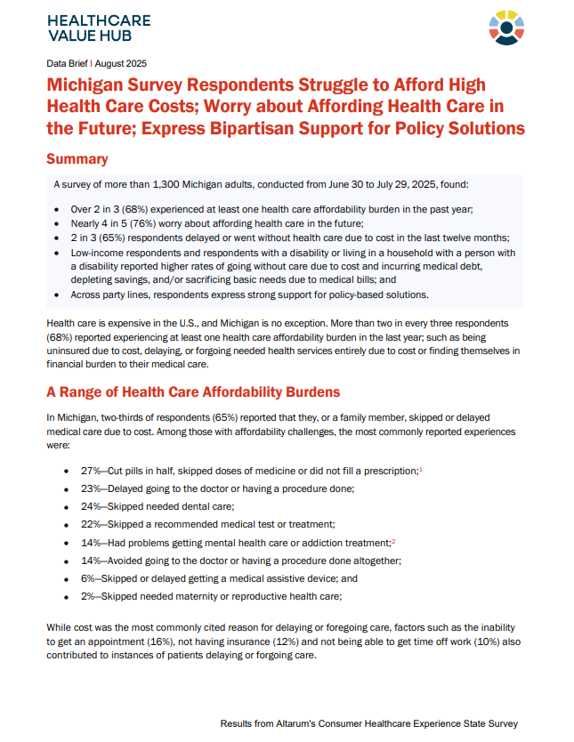
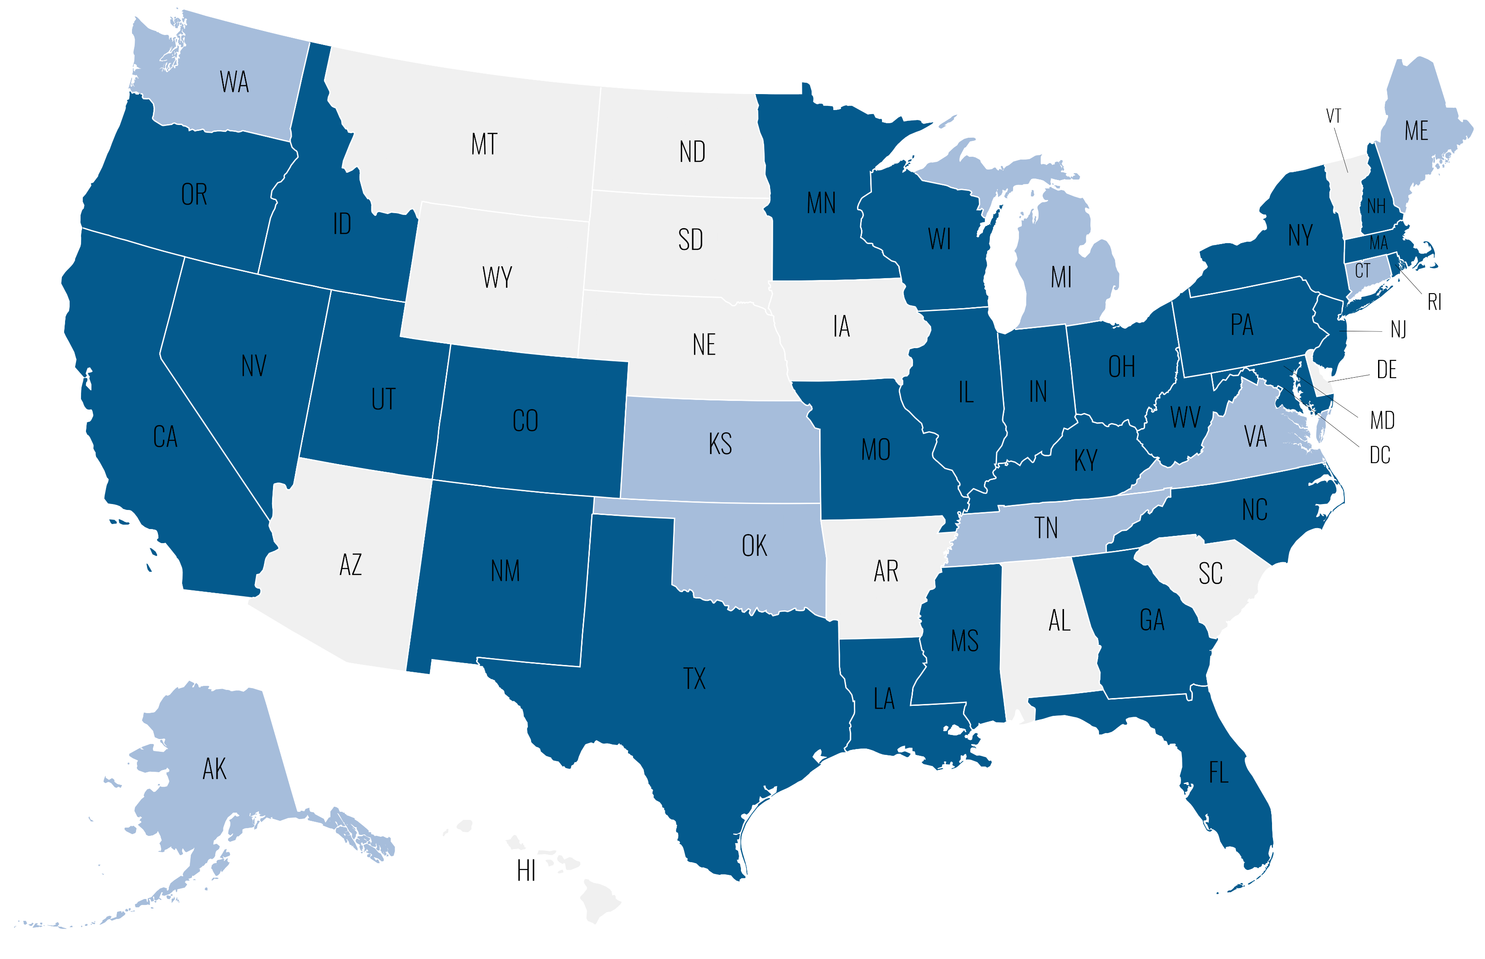
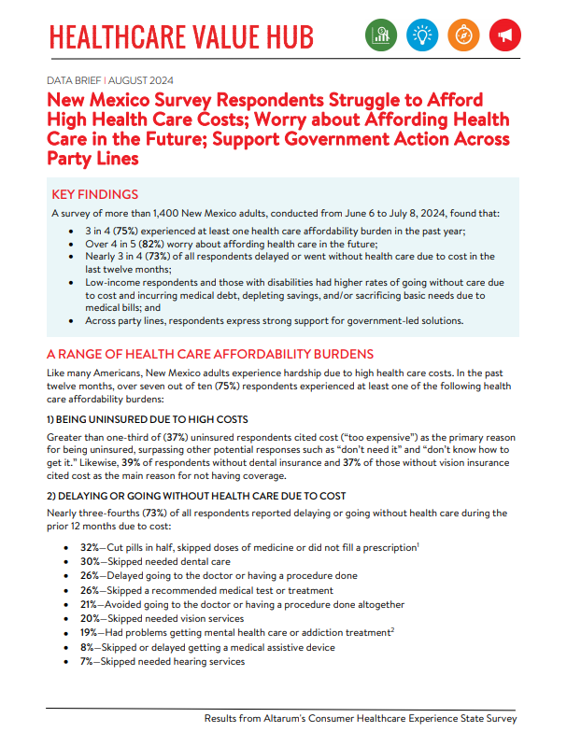
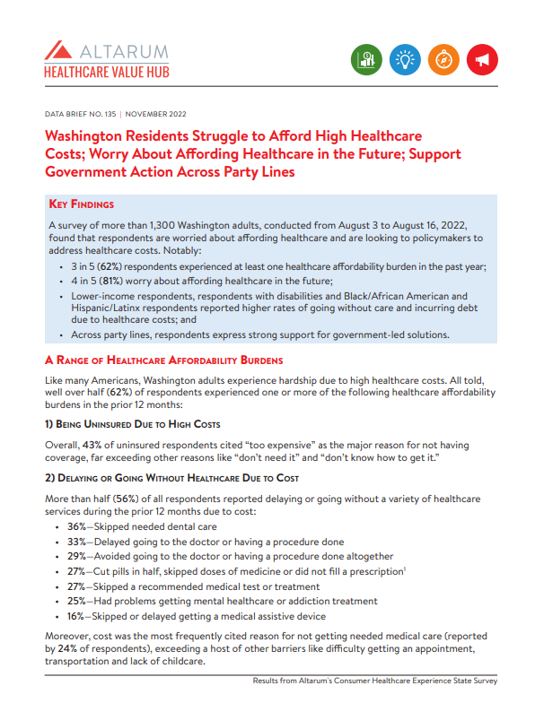
Data in Action Webinar: Introducing the CHESS | January 7, 2025
2018-2024 CHESS
2025-2026 CHESS
No CHESS – Yet!
Notes:
Since 2018, the CHESS has been conducted in thirty-eight states and the District of Columbia. Several of these states have multiple CHESS surveys from two or more years, while others are still being developed. The CHESS is not available in thirteen states (yet!).

Slide 5
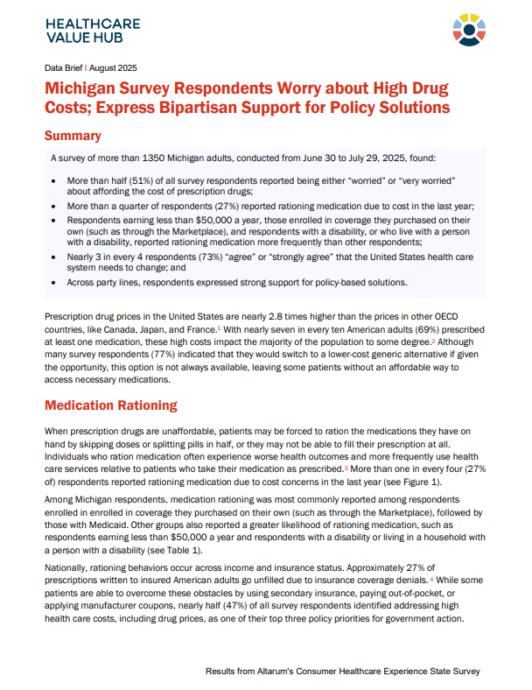
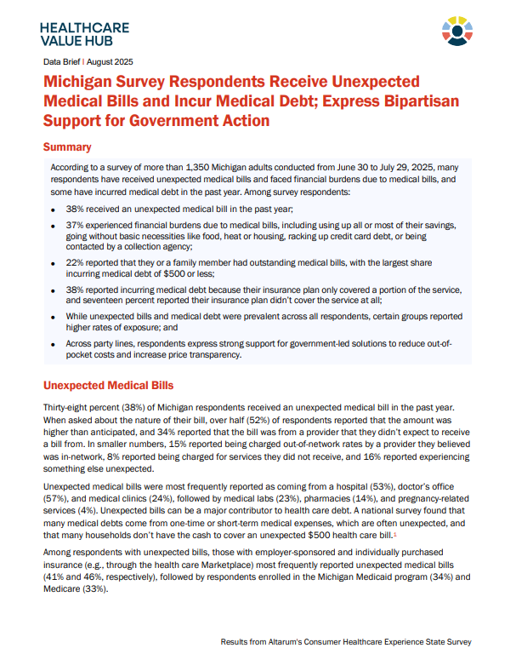
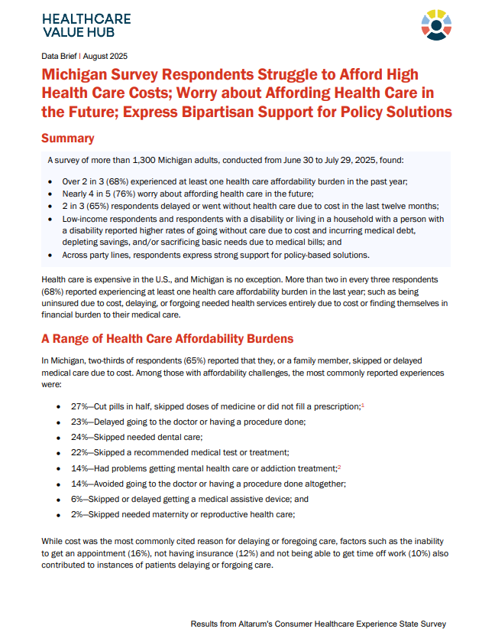
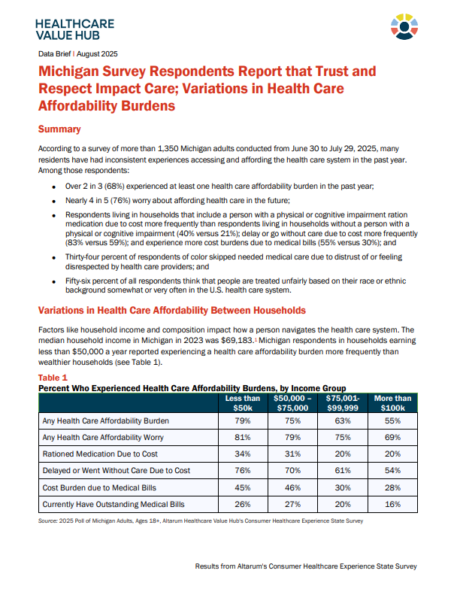
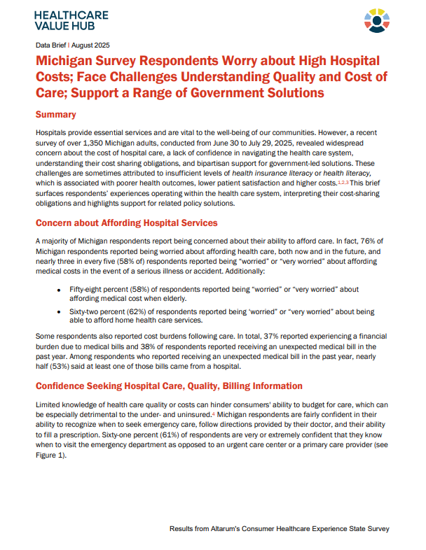
Data in Action Webinar: Introducing the CHESS | January 7, 2025
Notes:
The result of the survey are reported across five briefs; the main affordability brief, a brief on high drug costs, a brief on unexpected medical bills and medical debt, a brief on trust in the health care system, and a brief on high hospital costs. Many current health care survey efforts suffer from two shortcomings: (1) they are often not designed to produce reliable state-level estimates and (2) they often do not examine the full spectrum of health care affordability burdens that concern consumers and the systemic factors which produce these burdens.
Conducted in both English and Spanish using a web panel of approximately 1,500 state respondents, the Consumer Healthcare Experience State Survey (CHESS) is designed to elicit perceptions of a wide range of healthcare issues and quantify state-level challenges related to:
healthcare affordability,
medical debt,
health literacy,
coverage,
trust in the health care system, and
drug costs.

Slide 6
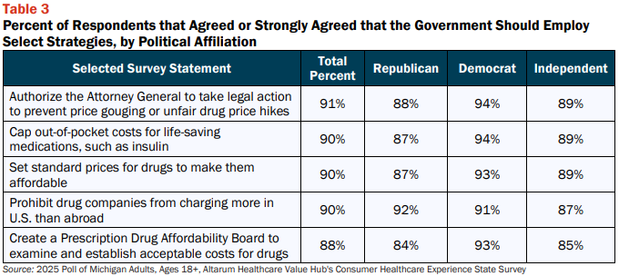
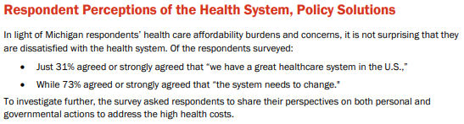
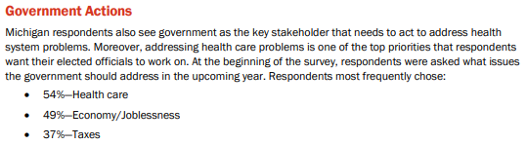
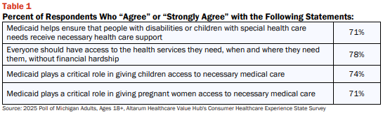
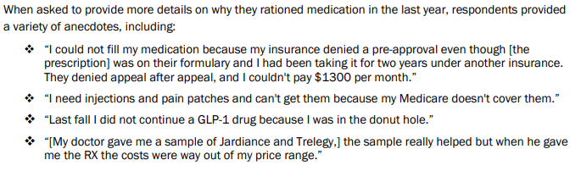
Data in Action Webinar: Introducing the CHESS | January 7, 2025
Notes:
In addition to data on perceived affordability barriers, anxieties surrounding the costs of care, and the prevalence of medical debt; the CHESS also elicits respondents support of a variety of potential policy solutions and their thoughts on the health and social support system, capturing this information in both quantitative and qualitative outputs.

Slide 7






Data in Action Webinar: Introducing the CHESS | January 7, 2025
31%
(2024)
35%
11%
34%
35%
18%
18%
(2022)
(2023)
(2023)
(2023)
50%
(2022)
(2022)
(2023)
% of respondents reporting any health care affordability burden
% of respondents with outstanding medical debt
% of respondents who have had to use up all or most of their savings to cover medical debt
Notes:
A range of burdens has been unearthed across the thirty-eight states surveyed. For example, the percent of respondents that have had to use up all or most of their savings; forgo necessities like food, heat, or housing; borrow money, take out a loan, or remortgage their home; crowdsource funds through a platform like GoFundMe; incur credit card debt; declare bankruptcy; or enroll in a payment plan due to medical debt range from 31% in New York (2024) to 50% in North Carolina (2023). Similarly, the percent of respondents with any outstanding medical debt has ranged from 18% in California (2022) to 35% in Mississippi (2023); and the percent of respondents who reported having to use up all or most of their savings to cover medical debts has ranged from 11% in Pennsylvania to 34% in Missouri.

Slide 8

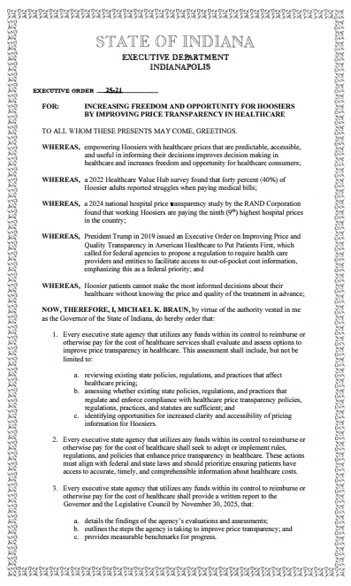
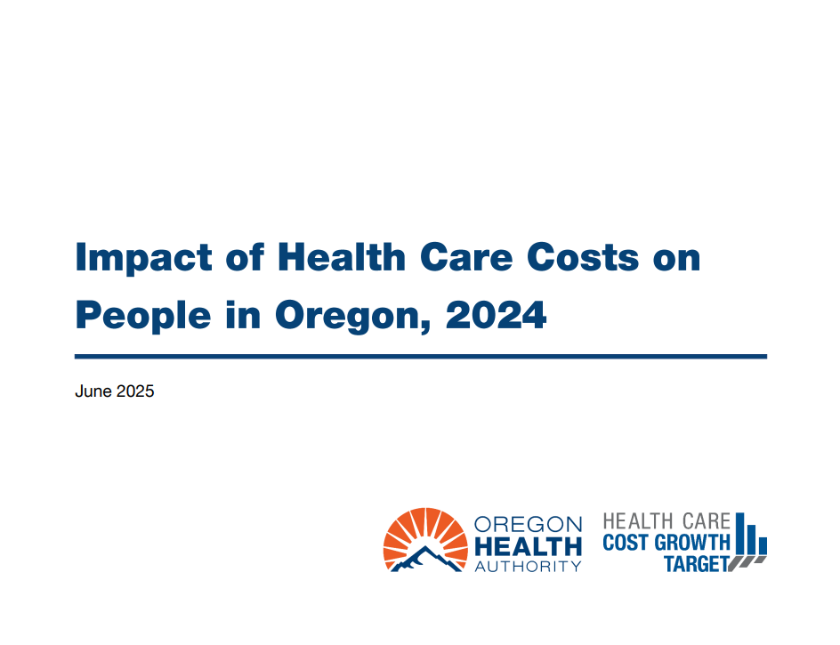
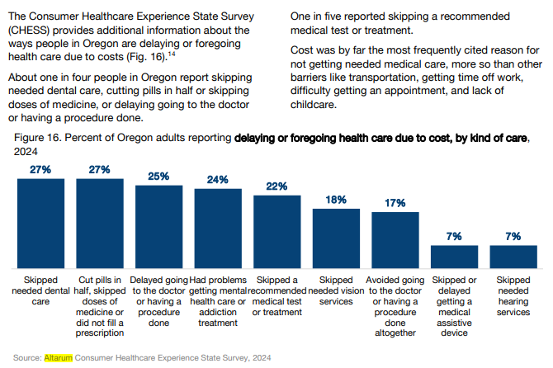
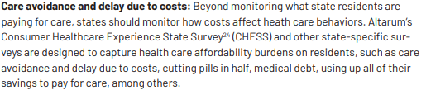
Data in Action Webinar: Introducing the CHESS | January 7, 2025
Source: Mar, J., Otter, C., Bailit, M. (2025). Best Practices in Health Care Claims Data Analysis to Inform State Action and Control Costs. Peterson-Milbank Program for Sustainable Health Care Costs. https://www.milbank.org/wp-content/uploads/2025/11/Data-Use-Strategy_11.10.pdf
Source: Indiana General Assembly. (2025, January 21). Executive Order 25-21: Increasing Freedom and Opportunity for Hoosiers by Improving Price Transparency in Healthcare. State of Indiana. https://www.in.gov/gov/files/EO-25-21.pdf
Source: Impact of Health Care Costs on People in Oregon [PowerPoint Presentation], 2024. (2025, June). Oregon Health Authority. 2024-Impact-of-Health-Care-Costs-on-Oregonians_FINAL.pdf
Notes:
CHESS data has been used in legislation, to examine the prevalence of care avoidance at the state level, and to aid legislators in identifying constituent priorities. In the following slides, we’ll examine these use cases in more detail across advocacy, academia, and policymaking.

Slide 9


Using CHESS data in academia and rural health research
Patrick Kuehl, Cornell University
Notes:
Patrick will advance his own slides using Arc StoryMaps: https://storymaps.arcgis.com/briefings/2040b61b379b4411ad991157accfbd41

Slide 10
Using CHESS data in policy and health care benchmarking
Dr. Alex Reger, Connecticut Office of Health Strategy

Slide 11

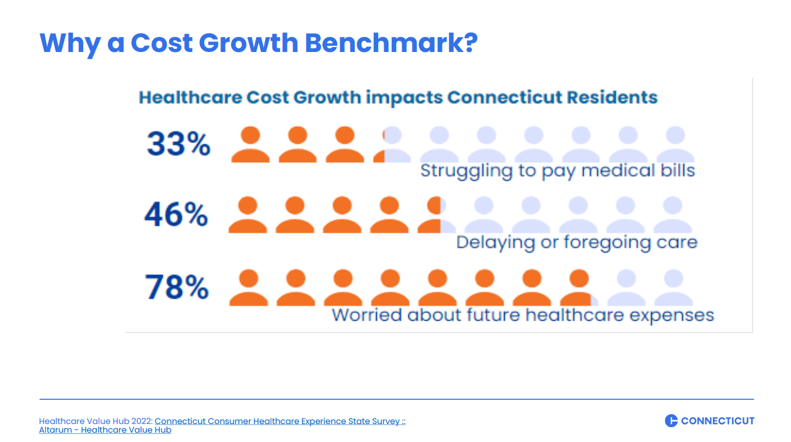
Data in Action Webinar: Using CHESS data in policy and health care benchmarking | January 7, 2025
Connecticut’s Healthcare Benchmark Initiative
Connecticut’s Healthcare Benchmarks were established in March 2020 in Executive Order No. 5, and later codified in Public Act 22-118.
The cost growth benchmark is the targeted annual per person growth rate for Connecticut’s total healthcare spending.
The benchmark goal is to slow the growth of healthcare spending and make healthcare more affordable for the residents of Connecticut. Data driven policy requires good data.
Benchmark data is important, but it only shows part of the picture. CHESS helps us move from “what” is happening to “why” stakeholders should act.
CHESS also helps us build connections between NGO stakeholders as well:
  Medical Debt
  Access and Fairness
Source: Cost Growth Benchmark Hearing. (2025, June 23). State of Connecticut Office of Health Strategy. https://portal.ct.gov/ohs/-/media/ohs/cost-growth-benchmark/hearing-2025/hcbi-2025-public-hearing-event-summary.pdf?rev=7435839ae1f74e0898171457cd012cf0
Source: Office of Health Strategy Healthcare Benchmarks CID Rate Hearing. (2024, August 20). Connecticut Office of Health Strategy. https://portal.ct.gov/-/media/cid/1_ratefilings/2025-ohs-healthcare-benchmarks.pdf
Notes:
Benchmark data is important, but it only shows part of the picture. What CHESS gives us is the impact, what the data means. It’s one thing to talk to other data analytics people about year over year trend, or pmpm, but our stakeholders (including legislators) need that distilled to the impact on every day people. In essence, what CHESS does is transform data into empathy; numbers into feeling; and because of that, helps drive policies that help Connecticut residents receive accessible, affordable healthcare.

Slide 12
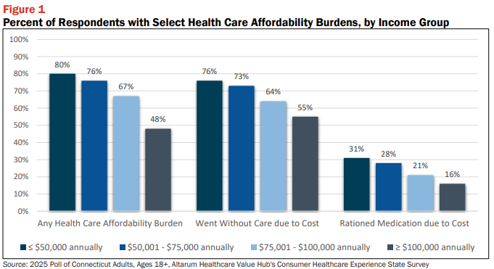
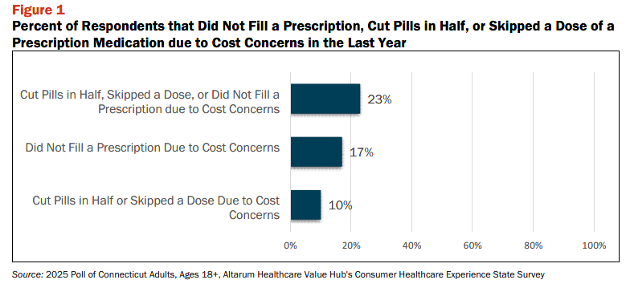
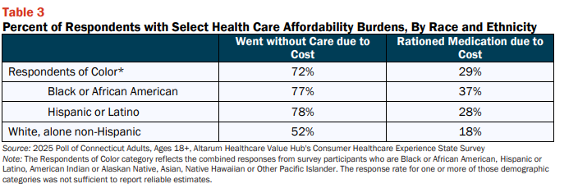
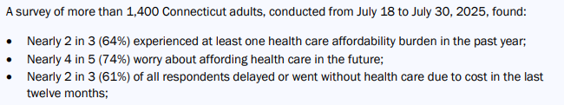
Notes:
Four CHESS surveys have been conducted in Connecticut to date, with the most recent released in September 2025. Getting the raw data, being able to show the impact on different income groups for example, has been particularly useful.

Slide 13
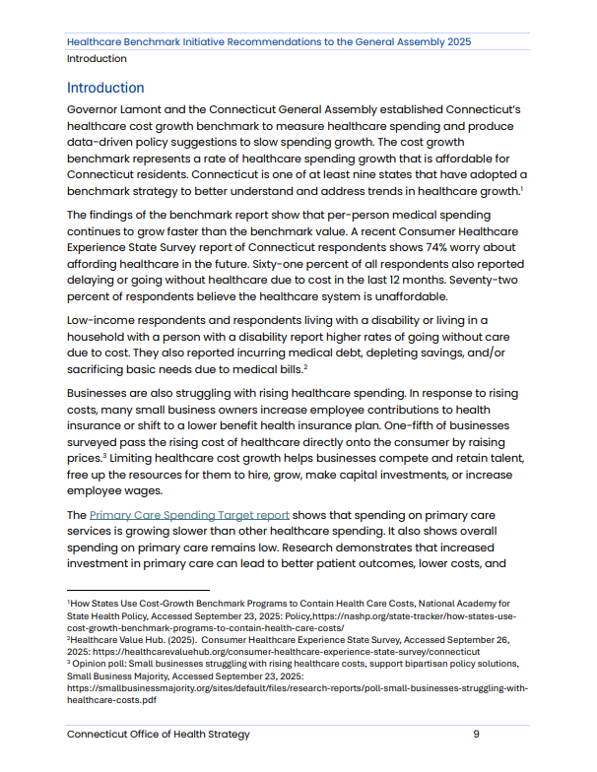
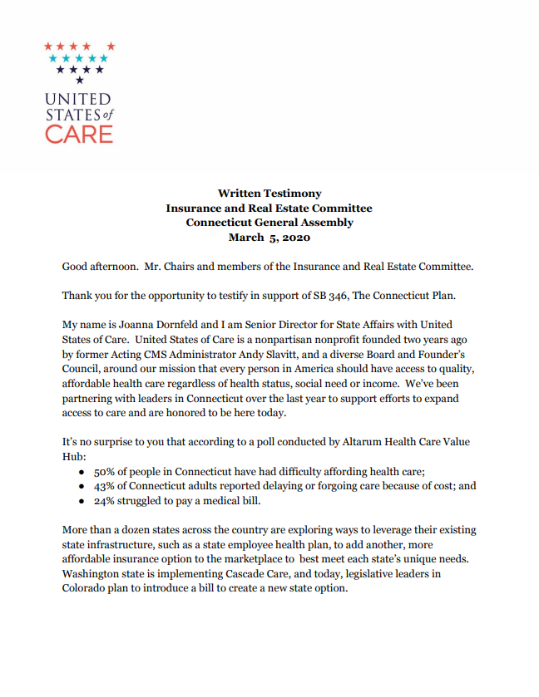

Data in Action Webinar: Using CHESS data in policy and health care benchmarking | January 7, 2025
Benchmarking Recommendations
Legislative Testimony
2024 Employer Symposium
Source: Porter, A. (2025, November 21). Healthcare Benchmark Initiative Recommendations to the General Assembly. State of Connecticut Office of Health Strategy. https://portal.ct.gov/ohs/-/media/ohs/cost-growth-benchmark/reports-and-updates/ohs-hcbi-recommendations-to-the-general-assembly-2025.pdf?rev=2319f3db5ff5450382d13aed1f12d84e
Source: Dornfeld, J. (2020, March 5). Written Testimony Insurance and Real Estate Committee to the Connecticut General Assembly in support of S.B. 346. United States of Care. https://www.cga.ct.gov/2020/insdata/tmy/2020SB-00346-R000305-Dornfeld,%20Joanna-Support-TMY.PDF
Source: https://portal.ct.gov/ohs/-/media/ohs/cost-growth-benchmark/healthcare-affordability-employer-symposium-2024/connecticut-healthcare-affordability-employer-event-summary-november-2024.pdf?rev=8b0bc61b56a54a63b513e9d681e397fb
Notes:
Connecticut stakeholders have been using CHESS data to support efforts to limit the rise of health care costs in the state since 2018. It has been used in legislative testimony, recommendations, and benchmarking efforts.

Slide 14
Using the CHESS in advocacy and engagement
Emily Brice, Northwest Health Law Advocates (NoHLA)

Slide 15
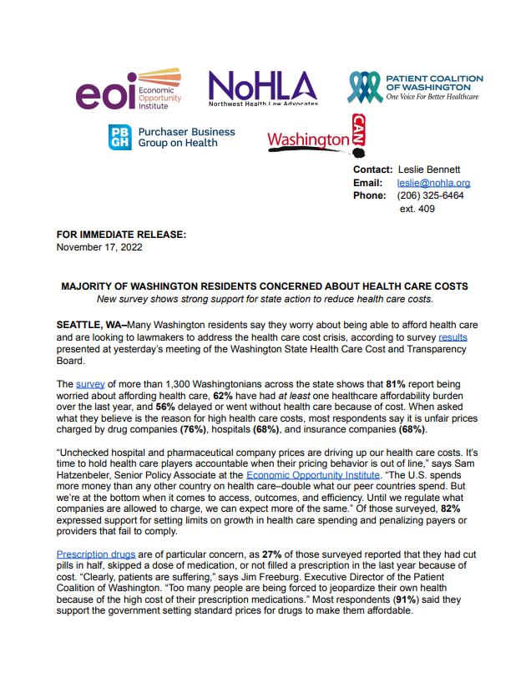

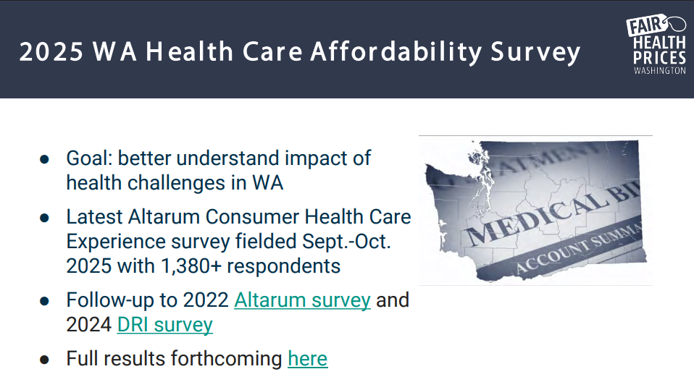
Data in Action Webinar: Using CHESS data in advocacy and engagement | January 7, 2025
NoHLA Advocacy Efforts
NoHLA has used CHESS data in legislative testimony and advocacy in support of proposed bills addressing medical debt, health care consolidation, and reference-based pricing, including “HB 1508: Improving Consumer Affordability through the Health Care Cost Transparency Board” and bills addressing facility fees.
In 2022, NoHLA and twenty other advocacy organizations cite the CHESS survey in a letter to the governor calling for improvements to the state Prescription Drug Affordability Board
CHESS data has been presented to the state's Health Care Cost Transparency Board twice, in 2022 and 2025
Source: Majority of Washington Residents Concerned about Healthcare Costs. (2022, November 17). Northwest Health Law Advocates. https://nohla.org/wordpress/wp-content/uploads/2022/11/WA-Health-Care-Affordability-Survey-Press-Release.pdf
Source: Health Care Cost Transparency Board’s Public Hearing. (2025, November 20). Washington State Health Care Authority. https://www.hca.wa.gov/assets/program/cost-board-meeting-materials-20251120.pdf
Notes:
I suggest mentioning that CHESS data has been presented to the state's Health Care Cost Transparency Board twice, once in 2022 and once last month. The 2022 materials are no longer available online, but I attached it. The 2025 materials are in Tab 8 here.
I suggest removing the second image, because that press release related to a different survey we did with DRI/US of Care in 2024 (not CHESS). Maybe you could sub in one of the Cost Board slides instead?
For the legislative advocacy piece, you could also add "bills addressing medical debt, health care consolidation, and reference-based pricing." (And maybe say "testimony and advocacy" rather than just referencing testimony, since I can't remember the specific bills where we used CHESS in testimony."

Slide 16
Data in Action Webinar: Using CHESS data in policy and health care benchmarking | January 7, 2025
Notes:
Two CHESS surveys have been conducted in Washington to date, with the most recent released in December 2025.

Slide 17
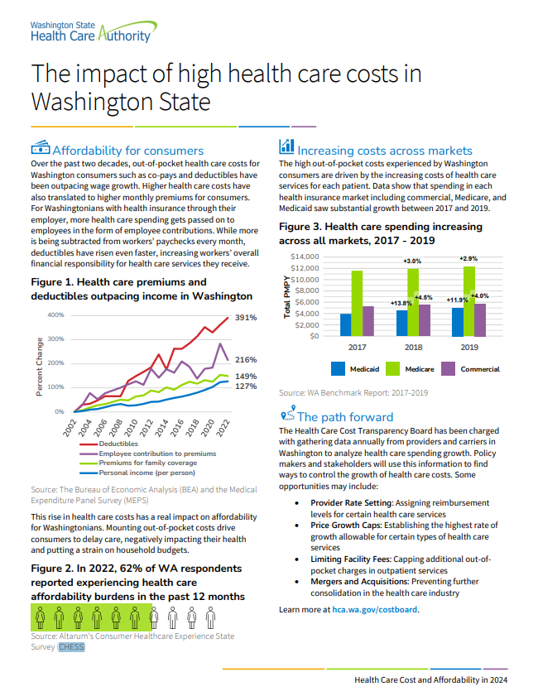

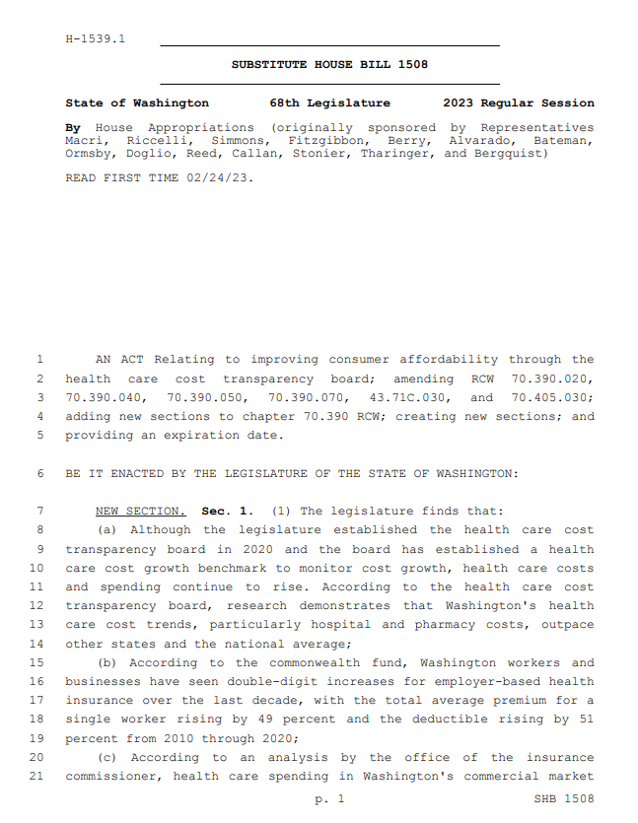
Data in Action Webinar: Using CHESS data in advocacy and engagement | January 7, 2025
Data Briefs
Recommendations
Legislation
Source: The Impact of High Health Care Costs in Washington State. (2024). Washington State Health Care Authority. https://www.hca.wa.gov/assets/program/spending-growth-benchmark-2017-2019-one-pager.pdf
Source: 2024 State Health Report. (2024). Washington State Board of Health. https://sboh.wa.gov/sites/default/files/2024-06/2024%20State%20Health%20Report%20V3.pdf
Source: Washington General Assembly. (2023). Substitute House Bill 1508. State of Washington. https://lawfilesext.leg.wa.gov/biennium/2023-24/Pdf/Bills/House%20Bills/1508-S.pdf?q=20240522212402
Notes:
Washington stakeholders have used the CHESS data in proposed legislation, data reports on the impact of high health care costs in the state, and in recommendations to the state to Improve Healthcare Access and Increase the Availability of Culturally Appropriate Care.
Slide 18 - Looks good! Another important state report that has used the data is here, on p. 3. (“Despite having one of the lowest uninsured rates in the country and seeing Washington state’s uninsured rate stay under 6%, rising health care costs have created a growing and persistent health care affordability challenge for individuals, families, employers, and taxpayers in Washington state.1 Health care expenditures now account for over 20% of Washington’s general fund budget.2 Challenges with health care affordability are not limited to individuals with lower incomes or those without health insurance. A survey of 1,300 Washingtonians in November 2022 found that 62% of respondents had experienced at least one health care affordability burden in the past year – including rationing medication, delaying or going without care, and depleting savings – and that 81% worried about affording health care in the future.3“)

Slide 18
Panel Q&A

Slide 19

Thank you!
If you have any additional questions or comments, please reach out to Dr. Beth Beaudin-Seiler at
Beth.Beaudin-Seiler@altarum.org
Support for this was provided by the Robert Wood Johnson Foundation. The views expressed here do not necessarily reflect the views of the Foundation.

